Slide 1
presentation title
Nanoscaled characterization of surfaces of solid biomaterials
Compiled by Hermanis Sorokins Riga Technical University, Faculty of Civil and Mechanical Engineering, Institute for Biomedical Engineering and Nanotechnology 2024
Author(s)
Collaborative e-platform for innovation and educational enhancement in medical engineering - CALLME

Slide 2
Prologue
Main goals of this presentation:
Provide a summary about the role of the surface of solid biomaterials in their interactions with the environment and other materials
Provide a brief description of the main properties of the surfaces of solid biomaterials, as well as the parameters used for their evaluation
Provide an overview of the general techniques and equipment used to study the properties of solid material surfaces
Thus, the presentation is split into three parts:
Part 1. Introduction
Part 2. Surface properties
Part 3. Techniques and equipment

Slide 3
Part 1. Introduction

Slide 4
Solid biomaterials
Solid biomaterials are inert or biocompatible substances used in medical applications to interact with biological systems
Primarily, these are materials for:
Implants
Prosthetics
Medical devices that interface with biological tissues (i.e., catheters)
Designed to interact with biological systems and tissues, often with the goal of replacing or repairing damaged or diseased body parts
Must ensure compatibility with the human body and to promote integration without causing harm or adverse reactions

Slide 5
Solid biomaterials
Common types of solid biomaterials include
Metals (stainless steel, titanium alloys, cobalt-chromium alloys, etc.)
Hip/knee replacements (load bearing parts), tooth implants, cardiac and vascular stents, spinal fusion devices, deep brain stimulation (DBS) electrodes
Ceramics (alumina, zirconia, hydroxyapatite, etc.)
Hip/knee replacements (joints), dental crowns, porous bone scaffolds, artificial corneas, implant enclosures
Polymers (PE, PET, PMMA, silicone, etc.)
Heart valve prostheses, vascular grafts, cosmetic implants, intraocular lenses, implantable drug delivery devices, biodegradable scaffolds, implant enclosures
Composite materials
All of the above, and more

Slide 6
Solid biomaterials
Key characteristics of biomaterials:
Biocompatibility
In all cases, should not elicit a toxic or immune response when in contact with biological tissues
Bioactivity
In some cases, designed to interact with biological systems, promoting tissue regeneration or facilitating specific biological functions
Mechanical properties
Should have strength, durability, and flexibility similar to the tissues it is replacing or supporting. Especially important for load-bearing applications

Slide 7
Solid biomaterials
Key characteristics of biomaterials:
Degradability
In some cases, biomaterials are designed to degrade over time, allowing the body's natural processes to replace the material with native tissue. Particularly important for temporary implants or scaffolds used in tissue engineering
Corrosion resistance
Should resist corrosion and degradation when exposed to bodily fluids
Surface characteristics
The surface of biomaterials is often modified to encourage specific cellular responses, such as adhesion or integration with surrounding tissues

Slide 8
Surface Characteristics
All the listed key characteristics are directly related to the surface characteristics of a solid biomaterial
Biocompatibility
The implant's surface serves as the interface with host tissue, and ensuring biocompatibility is essential to prevent inflammation, rejection, and other adverse body responses
Immunomodulation
Surface properties can modulate the host immune response to implants, with potential for surface modifications to reduce inflammation and improve acceptance by the immune system

Slide 9
Surface Characteristics
All the listed key characteristics are directly related to the surface characteristics of a solid biomaterial
Tissue Integration
An appropriate surface can foster cell adhesion, proliferation, and tissue ingrowth, facilitating the formation of a stable interface with the host tissue
Drug Delivery
Implants designed with drug-eluting capabilities utilize surface characteristics to influence the controlled release of medications, enabling targeted and localized treatment at the implant site
Reducing Infection Risk
The susceptibility of an implant to bacterial adhesion and biofilm formation is influenced by its surface properties; a smooth, non-porous surface with antibacterial properties can mitigate the risk of infections

Slide 10
Surface Characteristics
All the listed key characteristics are directly related to the surface characteristics of a solid biomaterial
Corrosion Resistance
The surface of metallic implants must be corrosion-resistant to endure the corrosive environment of bodily fluids, ensuring long-term longevity and structural integrity
Wear Resistance
Implants, especially those in joints, may undergo mechanical wear from repeated movement, and a wear-resistant surface can extend the implant's lifespan while minimizing the generation of wear debris
Mechanical Stability
Appropriate surface treatments and coatings can enhance structural integrity, mitigating issues like fracture or failure.

Slide 11
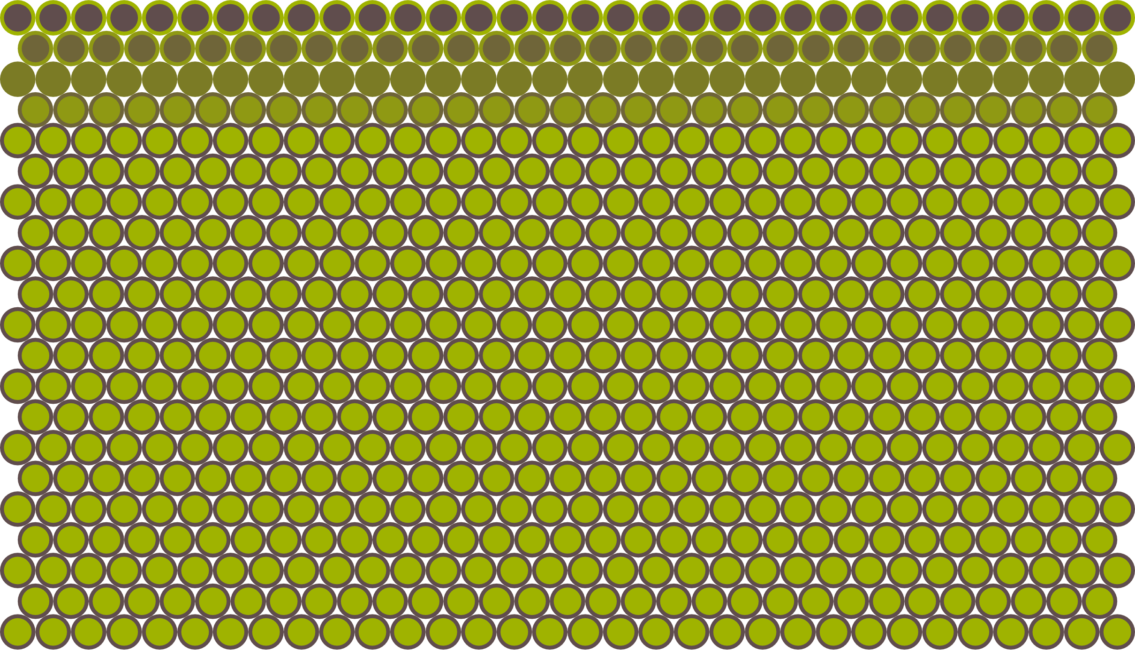
What is a surface, anyway?
“In-between”
In materials science, a surface is the outermost layer of a material that comes into direct contact with the surrounding environment
Beneath the surface is the interior, or the bulk of an object
Ideally, the first few atomic layers of the material are considered as the surface, and everything else beneath that – the bulk
However, the distinction between the surface layer and the bulk is not always clear cut and, in many ways, depends on the technique used to study the surface
Surface
Bulk

Slide 12
What is a surface, anyway?
Stimulus
Information volume
To interrogate a system for useful information about its state the following is needed:
a stimulus,
an interaction volume in the system that responds to the stimulus,
a means of gathering the information generated within that volume because of the stimulus
information is gathered from the information volume, which is smaller than the interaction volume
The information volume's shape and size define lateral and depth resolutions, involving some information averaging
Interaction volume

Slide 13
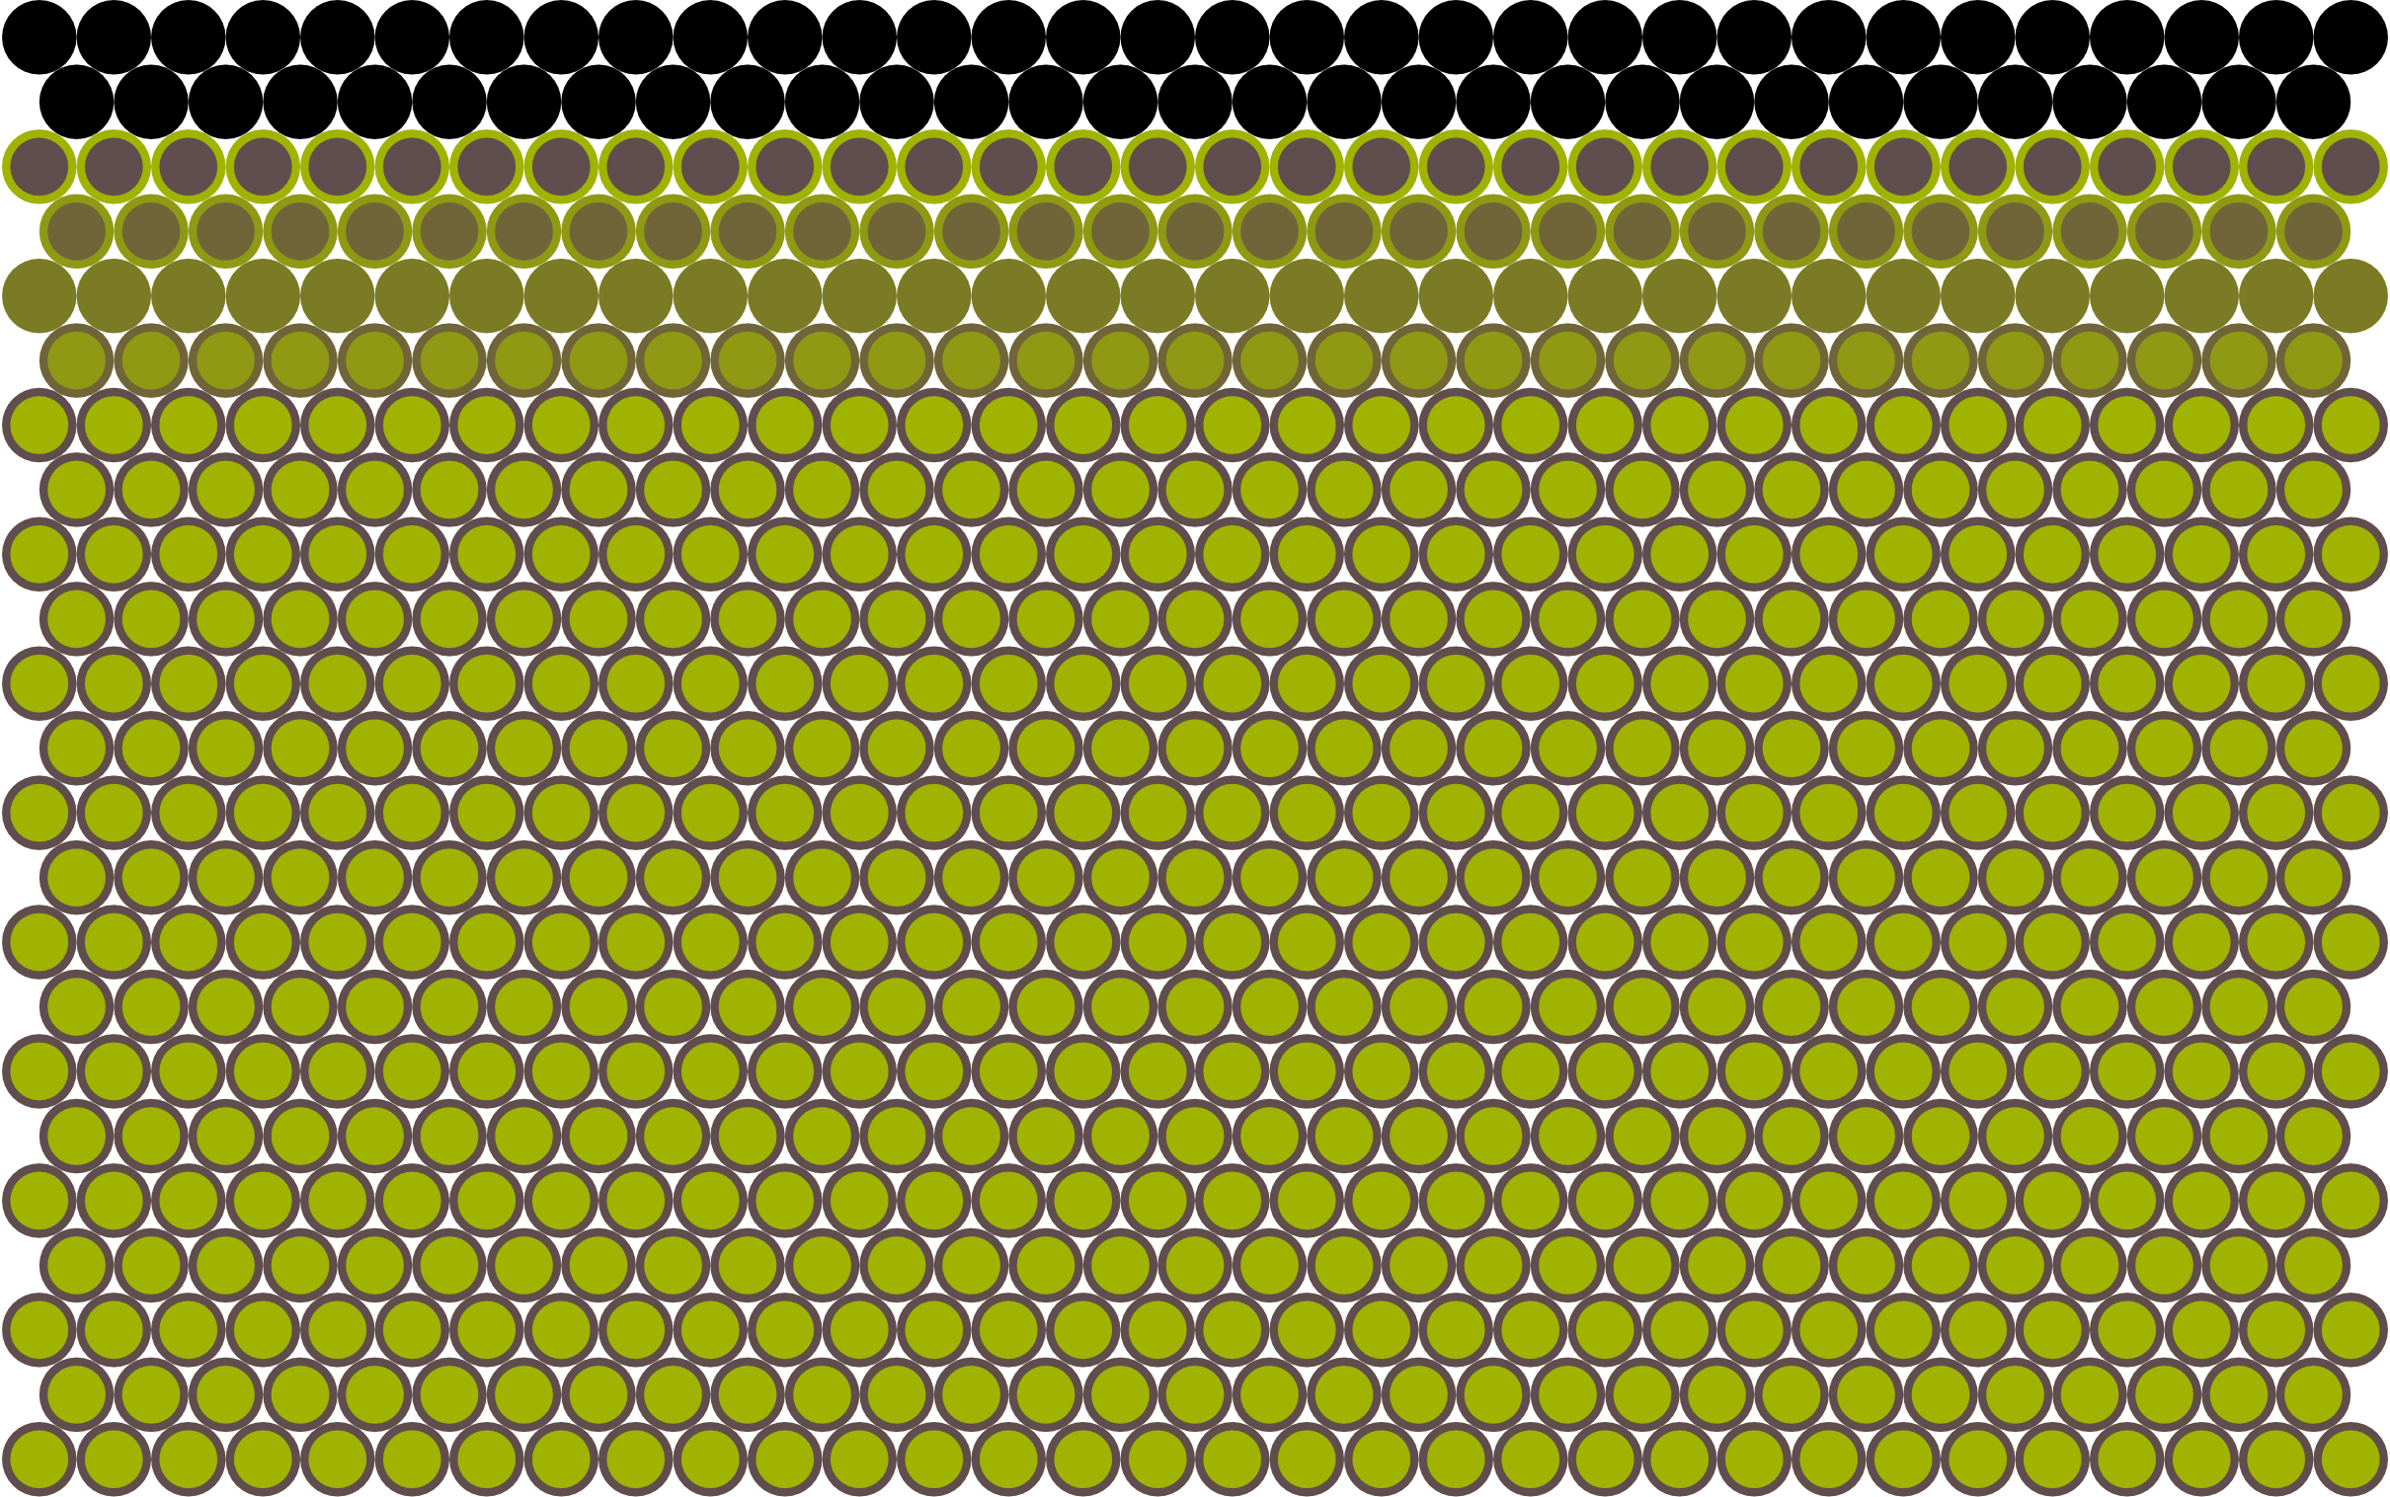
What is a surface, anyway?
Surface
Frequently, the true surface can be hidden under a layer of contaminant
This may have a profound effect on the results of the measurements since we will be getting information about the contaminant, as an admixture to the surface information or as it’s full substitute
Contamination can occur due to improper sample handling and storing conditions, and can be as little as one atomic layer thick
In most cases it should be removed at some point before or during the measurement
However, in some cases we may be interested in the contaminant itself
Surface
Notes:
For proper sample handling and storage, see ISO

Slide 14
What’s “nano” and why is it important?
In surface science, the term "nano" refers to structures or features existing at the nanoscale, typically ranging from 1 to 100 nanometers in size
At this scale, materials exhibit properties distinct from their micro/macro counterparts due to their high surface area-to-volume ratio and quantum effects, which can significantly influence their interactions with other materials
Due to their small size and properties, nanostructured biomaterial surfaces can play an important role in directing cellular behavior and tissue integration processes

Slide 15
What’s “nano” and why is it important?
By providing tailored cues for cell adhesion, proliferation, and differentiation, these surfaces can promote tissue regeneration and enhance the formation of functional biological interfaces
Moreover, nanostructured biomaterial surfaces offer unique advantages in drug delivery applications
Their high surface area allows for efficient loading and controlled release of therapeutic agents, improving drug delivery efficacy and minimizing adverse effects
This capability makes them valuable for delivering drugs to specific targets within the body, such as diseased tissues or wounds

Slide 16
What’s “nano” and why is it important?
The importance of nanostructured biomaterial surfaces extends to a wide range of medical applications, including implants, prosthetics, wound healing, and tissue engineering
By improving biocompatibility, promoting tissue regeneration, and enhancing therapeutic outcomes, these surfaces contribute to the development of advanced medical devices and therapies with increased efficacy and safety
Therefore, to improve the properties of biomaterials in a way that is beneficial to the cell, one needs to study and enhance the surface properties of biomaterials at the nanoscale

Slide 17
Part 2. Surface properties

Slide 18
What surface properties can be measured?
Surface chemistry
Surface topography
Surface energy
Biocompatibility
Adhesion and cohesion
Corrosion resistance
Mechanical properties
Optical properties
Electrical properties

Slide 19
Surface property: surface topography
Description. The physical features of a material's surface, including details about its roughness, texture, and any irregularities
Evaluation scale. Can be in the nanometer (0.1-100 nm), micrometer (0.1-100 µm), and millimeter (0.1 – 10 mm) ranges; each scale uses its own measurement techniques which may overlap
Frequently evaluated parameters.
Height Parameters
Arithmetical mean height (S_{a}), RMS height (S_{q}), skewness (S_{sk}), kurtosis (S_{ku})
Spatial parameters
Autocorrelation length (S_{al}), texture aspect ratio (S_{tr})
Hybrid parameters
RMS gradient (S_{dq}), developed interfacial area ratio (S_{dr})
Functions and related parameters
Feature parameters
Density of peaks (S_{pd}), arithmetic mean peak curvature (S_{pc}), texture direction (S_{td})
Notes:
Further reading:
Roughness parameters - https://www.olympus-ims.com/en/metrology/surface-roughness-measurement-portal/parameters/#!cms[focus]=cmsContent14709

Slide 20
Surface property: surface topography
Commonly applied measurement techniques.
Scanning electron microscopy (SEM)
Uses an electron beam to scan the surface of a sample, providing a three-dimensional view of the surface
Feature size measurement range – ~10⁻⁹ – 10⁻³ m
White light interferometry (WLI)
A non-contact optical technique which measures surface height variations by analyzing interference patterns of white light reflected from the surface
Feature size measurement range – ~10⁻¹⁰ – 10⁻³ m
Confocal microscopy
Uses a point-wise illumination and detection system to create images of the surface
Feature size measurement range – ~10⁻⁷ – 10⁻³ m
Notes:
Brief description.
Feature size measurement range
Further reading: https://www.ebatco.com/laboratory-services/3d-topography-surface-roughness/surface-roughness-analysis-using-white-light-interferometry/

Slide 21
Surface property: surface topography
Commonly applied measurement techniques.
Atomic force microscopy (AFM)
Information about surface topography is gathered by scanning the surface at the atomic or molecular level using the tip of a sharp probe
Feature size measurement range – ~10⁻¹⁰ – 10⁻⁶ m
Stylus profilometry
Uses a stylus or probe to trace the surface and measure its profile
Feature size measurement range – 10⁻⁹ – 10⁻⁴ m
Notes:
Brief description.
Feature size measurement range

Slide 22
Surface property: surface chemistry
Description. The chemical composition of a material's surface, including the presence of different elements, chemical groups, and functionalization
Evaluation scale. Defined by the technique and the size of the “probe” and the particles providing the stimulus; can be anywhere from nano to milli
Frequently evaluated parameters.
Elemental composition – the presence and relative abundance of elements on the surface
Chemical states – information about the chemical bonding states of elements on the surface
Functional groups – identification and quantification of specific chemical groups on the surface
Surface coverage – the proportion of the surface covered by specific elements or functional groups; frequently involves surface chemical mapping
Isotopic composition – measurement of isotopic ratios for elements with multiple stable isotopes
Bonding energies – the energy required to break specific chemical bonds

Slide 23
Surface property: surface chemistry
Commonly applied measurement techniques.
X-ray Photoelectron Spectroscopy (XPS)
Analyzes the elemental composition of a material's surface by measuring the binding energy of electrons ejected by X-ray irradiation
Units: electron volts (eV) for emitted electron energies (x-axis); number of detected electrons per unit of energy (y-axis)
Auger Electron Spectroscopy (AES)
Measures the energy of Auger electrons emitted after excitation by high-energy electrons, providing information about elemental composition
Units: electron volts (eV) for emitted electron energies (x-axis); number of detected electrons per unit of energy (y-axis)
Secondary Ion Mass Spectrometry (SIMS)
Bombards the surface with clusters of primary ions, generating secondary ions that are then analyzed to determine the elemental composition
Units: mass-to-charge ratio (m/z) is used (x-axis); number of detected ions per m/z unit (y-axis)

Slide 24
Surface property: surface chemistry
Commonly applied measurement techniques.
Fourier Transform Infrared Spectroscopy (FTIR)
Measures the absorption of infrared light by functional groups, providing information about chemical bonds and molecular composition
Units: Wavenumber (cm⁻¹) is used for frequency (x-axis); absorbance/transmittance is dimensionless (y-axis)
Raman Spectroscopy
Involves shining a monochromatic light source (usually laser light) onto a sample, then detecting and analyzing the light scattered, with the resulting spectrum providing information about vibrational modes of molecular bonds
Units: Wavenumber (cm⁻¹) is used for frequency (x-axis); absorbance is dimensionless (y-axis)
Scanning Near-Field Optical Microscopy (SNOM)
A sharp optical fiber tip, with a diameter much smaller than the wavelength of light, is positioned near the sample surface and used to scan it in raster mode, simultaneously measuring surface nanoscale roughness and optical absorbance
Units: nanometers for spatial resolution, and the detected optical signal may be in arbitrary units or counts

Slide 25
Surface property: surface energy and wettability
Description. Property is related to the attractive or repulsive forces between the surface and other materials and usually refers to the energy required to increase the surface area of a material
Evaluation scale. Macroscopic
Frequently evaluated parameters.
Contact angle – the angle formed by the tangent to a liquid droplet at the point of contact with the solid surface
Wetting and de-wetting – describes how well a liquid wets or spreads on the surface, influenced by surface energy
Surface tension – the force per unit length acting at the liquid-air interface; surface tension is related to surface energy
Interfacial free energy – the energy required to create a unit area of a new interface; related to surface energy
Critical surface tension – the surface tension below which a liquid will wet a solid surface
Polar and dispersive components – describes the contribution of polar and dispersive forces to the overall surface energy
Work of adhesion – the energy required to separate a unit area of two adhering surfaces. It is influenced by surface energy
Hydrophobicity and hydrophilicity – indicates the tendency of a surface to repel or attract water, related to surface energy

Slide 26
Surface property: surface energy and wettability
Commonly applied measurement techniques.
Contact Angle Measurements
Measures the angle formed by a liquid droplet on a solid surface, providing information about wettability and surface energy
Units: Degrees (°) are used to measure the contact angle between the side of the droplet and the surface
Wilhelmy Plate Method
Involves immersing a thin plate in a liquid, measuring the force exerted as the liquid wets the plate; the force is related to the surface energy
Units: Surface tension is measured in N/m
Capillary Rise Method
Measures the height to which a liquid rises in a capillary tube, providing information about the material's ability to wet the internal surface of the capillary
Units: liquid rise height is typically measured in millimeters

Slide 27
Surface property: adhesion and cohesion
Description.
Adhesion is the ability of a material to stick or bond to another material, i.e., the force that holds different materials together at their interface
Cohesion is the ability of a material to stick to itself, i.e., the force that holds the same material together
Evaluation scale. Macroscopic, microscopic, or nanoscopic, depending on the technique.
Frequently evaluated parameters.
Adhesion strength – quantified by the force required to separate two materials adhered to each other and measured in newtons per square meter (N/m²) or pascals (Pa)
Cohesion strength – similar to adhesion strength but specifically measures the force required to break the material itself; measured in N/m² or Pascals (Pa)
Work of Adhesion – the energy required to separate two materials from each other; measured in joules per square meter (J/m²)

Slide 28
Surface property: adhesion and cohesion
Commonly applied measurement techniques.
AFM in Force-Distance Curve mode
If a functionalized probe is used, the interaction strength between the probe and the surface can be quantified by bringing the functionalized tip of the AFM probe into proximity with the sample surface and then retracting it while recording a force-distance curve. At some point the tip detaches from the surface at which point the force required to break the adhesive/cohesive bond between the tip and the sample can be determined
Units: nanometers (nm) for displacement, piconewtons (pN) for force
Tensile Testing
A force is applied to a material to stretch it until it breaks. The force-displacement relationship provides insights into adhesion and cohesion
Units: micrometers (µm) and millimeters (mm) for displacement, newtons (N) for force
Pull-off Tests
Commonly used for coatings and adhesives, this test involves applying a force to detach a material from the substrate. The force required indicates adhesion strength
Units: newtons (N) for force
Notes:
Further reading:
Common Approaches to Tip Functionalization for AFM-Based Molecular Recognition Measurements - https://www.bruker-nano.jp/library/57e489500c201abd043451c7/57fde602681639627f13bdf3.pdf

Slide 29
Surface property: electrical properties
Description. The characteristics of a material's surface in response to electric fields or currents
Evaluation scale. Nanoscale, microscale, or macroscale depending on the technique
Frequently evaluated parameters.
Conductivity – the ability of a material to conduct electric current, i.e., how well electric charge can flow across or along the surface; measured in siemens per meter (S/m)
Resistivity – capability to resist the flow of electric current (reciprocal of conductivity); measured in Ohm-meters (Ω⋅m)
Permittivity – material’s ability to store electrical energy in an electric field which also indicates how much the electric field within the material is weakened; measured in farad per meter (F/m)
Surface charge and potential – the distribution of electric charge on the surface and the associated electric potential; measured in coulombs (C) for charge, volts (V) for potential
Work function – minimum energy required to move an electron from the material into a vacuum, is directly related to surface potential, and can indicate charge transfer or doping effects on a material's surface; measured in electron-volts (eV)
Carrier concentration – the number of charge carriers (electrons or holes) per unit volume; measured in counts per cubic meter (m⁻³).

Slide 30
Surface property: electrical properties
Commonly applied measurement techniques.
Scanning Tunneling Microscopy (STM)
Measures the current flowing between a sharp tip and a conductive surface due to quantum tunneling
Units: amperes (A) for current, volts (V) for voltage
Kelvin Probe Force Microscopy (KPFM)
Measures the contact potential difference between the AFM tip and the sample, providing information about the local work function and surface potential
Units: volts (V) for voltage
Four-Point Probe Technique
Measures the resistance of a thin film or a semiconductor by applying a known current and measuring the voltage drop
Units: ohms (Ω) for resistance, amperes (A) for current, volts (V) for voltage

Slide 31
Surface property: electrical properties
Commonly applied measurement techniques.
Impedance Spectroscopy
Analyzes the response of a material to an alternating current (AC) signal over a range of frequencies
Units: ohms (Ω) for resistance, hertz (Hz) for frequency
Ultraviolet photoelectron spectroscopy (UPS)
Used to study the electronic structure of materials by analyzing the kinetic energy and intensity of electrons ejected from the material's surface when exposed to photons of sufficient energy
Units: electron-volts (eV) for electron energy, electrons per second for electron emission current

Slide 32
Surface properties: mechanical properties
Description. The response of materials to applied forces, including their deformation, strength, and resistance to various stresses
Evaluation scale. Nanoscale, microscale
Frequently evaluated parameters.
Hardness – resistance of a material to indentation or scratching measured in pascals (Pa), gigapascals (GPa)
Elastic modulus – measure of a material's stiffness or its ability to deform elastically under stress; measured in pascals (Pa), gigapascals (GPa)
Strength – ability of a material to withstand an applied force without breaking or undergoing significant deformation; measured in pascals (Pa), megapascals (MPa)
Toughness – ability of a material to absorb energy and deform plastically before fracturing; measured in joules per unit volume (J/m³)
Strain – ratio of the change in length to the original length of a material under stress; dimensionless

Slide 33
Surface properties: mechanical properties
Commonly applied measurement techniques.
Nanoindentation
A sharp indenter is pressed into the material, and the force and displacement are measured to determine hardness, elastic modulus, and other mechanical properties
Units: gigapascals (GPa) for hardness and elastic modulus
Atomic Force Microscopy (AFM) - Force Spectroscopy
The AFM tip is used to apply controlled forces on the surface, and the resulting deflection of the cantilever is used to determine mechanical properties
Units: nanonewtons (nN) for force, nanometers (nm) for displacement

Slide 34
Surface properties: mechanical properties
Commonly applied measurement techniques.
Scanning Electron Microscopy (SEM) - In-situ Tensile Testing
A small sample is subjected to tension within the SEM, allowing real-time observation of surface deformation
Units: megapascals (MPa) for stress, dimensionless units for strain
Scratch testing
A controlled force is applied to a sharp indenter or a scratch tool to study the material's resistance to scratching or deformation
Units: newtons (N) for load, micrometers (µm) for depth

Slide 35
Surface properties: optical properties
Description. Refer to how a material interacts with light, including phenomena such as reflection, absorption, transmission, and emission
Evaluation scale. Microscale, macroscale
Frequently evaluated parameters.
Refractive index – a measure of how much light is refracted, or bent, when passing through a material; dimensionless units
Absorbance – a measure of the amount of light absorbed by a material; dimensionless units on a logarithmic scale
Reflectance – proportion of light that is reflected by a material; measured as a percentage
Transmittance – proportion of light that passes through a material; measured as a percentage
Photoluminescence intensity – measures the intensity of light emitted when a material is exposed to photons; measured using arbitrary units
Ellipsometric parameters – describe changes in the polarization state of light upon reflection, providing information either about the thickness or refractive layer of a coating; measured degrees for ellipsometric angles

Slide 36
Surface properties: optical properties
Commonly applied measurement techniques.
Spectroscopy (UV-Vis, IR, NIR)
Measures the absorption, reflection, or transmission of light at different wavelengths
Units: arbitrary units (AU) for absorbance, percentages (%) for reflectance and transmittance
Ellipsometry
Analyzes changes in polarization of reflected light to determine optical constants such as refractive index and thickness
Units: nanometers (nm) for thickness, refractive index is dimensionless, and degrees (º) for ellipsometric angles used to calculate the first two

Slide 37
Surface properties: optical properties
Commonly applied measurement techniques.
Photoluminescence Spectroscopy
Measures the emission of light (photons) from a material after it absorbs photons
Units: nanometers (nm) for wavelength, arbitrary units (AU) for intensity
Reflectance and Transmittance Measurements
Measures the amount of light reflected or transmitted through a material using either light of a single wavelength or non-monochromatic light
Units: percentages (%) for reflectance and transmittance

Slide 38
Surface properties: corrosion resistance
Description. Describes a material's ability to resist degradation and deterioration when exposed to corrosive environments
Evaluation scale. Nanoscale, microscale, and macroscale
Frequently evaluated parameters.
Corrosion rate – rate at which a material corrodes over time; measured in millimeters per year (mm/year)
Corrosion potential – electrode potential at which a metal corrodes or resists corrosion in an environment; measured in volts (V)
Corrosion current density – measure of the rate at which electrochemical corrosion occurs at the surface of a material; measured in amperes per square meter (A/m²)
Polarization resistance – inverse of the corrosion rate, representing a measure of a material's resistance to corrosion; measured in ohm-centimeters squared (Ω·cm²)
Impedance – opposition that a material offers to the flow of alternating current in an electrochemical cell; measured in ohms (Ω)

Slide 39
Surface properties: corrosion resistance
Commonly applied measurement techniques.
Electrochemical Techniques (Potentiostatic and Galvanostatic Measurements)
Involves measuring the electrochemical behavior of a material by controlling its potential or current in a corrosive environment
Units: volts (V) for corrosion potential, amperes per square meter (A/m²) for corrosion current density, ohm-centimeters squared (Ω⋅cm2) for polarization resistance
Salt Spray Test (ASTM B117)
A standardized test in which materials are subjected to a continuous salt spray to assess their resistance to corrosion
Units: hours (h) for duration of exposure, qualitative visual inspection

Slide 40
Surface properties: corrosion resistance
Commonly applied measurement techniques.
Weight Loss Measurements
Involves measuring the weight loss of a material after exposure to a corrosive environment
Units: grams (g) for mass loss, millimeters per year (mm/year) for corrosion rate
Scanning Electron Microscopy (SEM) and Energy Dispersive X-ray Spectroscopy (EDS)
Simultaneously perfoms the examination of the material's surface morphology and the elemental composition changes due to corrosion
Units: N/A, qualitatively evaluates morphological characteristics
Electrochemical Impedance Spectroscopy (EIS)
Measures the impedance response of a material to alternating current, providing information on its corrosion behavior
Units: ohms (Ω) for electrochemical impedance, ohm-centimeters squared (Ω⋅cm²) for polarization resistance, hertz (Hz) for frequency

Slide 41
Surface properties: biocompatibility
Description. The ability of a material to interact with biological systems without causing harm or adverse reactions
Evaluation scale. Nanoscale, microscale
Frequently evaluated parameters.
Cell Viability – proportion of viable cells on the material's surface; assessed by live/dead staining
Cell Adhesion – ability of cells to attach to the material's surface; quantified by cell coverage, spreading, and morphology
Cytotoxicity – extent to which the material induces cell death or toxicity; assessed by live/dead staining or MTT assay
Biofilm Formation – growth of microorganisms on the material's surface, which can influence the material's long-term biocompatibility; presence/absence of biofilm
Inflammatory Response – material's potential to induce inflammation in surrounding tissues; quantified by measuring cytokine release or histological analysis
Surface Chemistry* – chemical composition of the material's surface, which can influence cellular interactions
Surface Topography* – physical features of the material's surface, influencing cell adhesion and behavior

Slide 42
Surface properties: biocompatibility
Commonly applied measurement techniques.
Cell Adhesion Assays
Involves seeding cells onto the material's surface and observing their adhesion, spreading, and proliferation
Units: quantified by cell coverage, cell morphology, and proliferation rate
Live/Dead Staining
Fluorescent dyes are used to distinguish live cells (green) from dead cells (red) on the material's surface
Units: Ratio of live to dead cells
MTT Assay (3-(4,5-Dimethylthiazol-2-yl)-2,5-Diphenyltetrazolium Bromide)
Measures the metabolic activity of cells on the material's surface
Units: Optical density, often reported as absorbance at a specific wavelength
Surface Analysis Techniques (XPS, AFM, SEM)
Analyzes the chemical composition, topography, and morphology of the material's surface after exposure to biological environments

Slide 43
Part 3. Techniques and equipment

Slide 44
Technique Classification I – By Type
Scanning Electron Microscopy (SEM)
Ultra High Vacuum (UHV) Spectroscopy
In-Situ SEM Material Testing
X-ray Photoelectron Spectroscopy
Classic SEM
Auger Electron Spectroscopy
Energy Dispersive X-Ray Spectroscopy
Time-of Flight
Secondary Ion Mass Spectrometry
Scanning/Transmission Electron Microscopy
Ultraviolet Photoelectron Spectroscopy
Scanning Probe Microscopy (SPM)
Light Spectroscopy
Atomic Force Microscopy
UV-vis Spectroscopy
FTIR Spectroscopy
Scanning Near-Field Optical Microscopy
Infrared and Near-Infrared Spectroscopy
Force-distance Curve Measurements
Scanning Tunneling Microscopy
Raman Spectroscopy
Kelvin Probe Force Microscopy
Photoluminescence Spectroscopy

Slide 45
Technique Classification II – By Discipline
Microbiological
Techniques and Equipment
Electrical Measurement
Techniques and Equipment
Confocal Microscopy
Electrochemical Impedance Spectroscopy
Fluorescent Microscopy
Cell Adhesion Assays
Dead/Live Staining
Four-Point Probe Technique
Metabolic Assays
Material Science
Techniques and Equipment
Wettability Measurement
Techniques and Equipment
White Light Interferometry
Contact Angle Measurements
Stylus Profilometry
Tensile Tests
Wilhelmy Plate Method
Nanoindentation
Capillary Rise Method
Pull-off Tests
Ellipsometry
Scratch Tests

Slide 46
Structure
The description of each technique/method is organized into subsections:
A brief overview describing the technique
Short description of the underlying principle
An outline of two-three basic modes of operation
Common applications for the technique/method
A small list of the main advantages and disadvantages
A section with several sources for further reading
All images given are also provided with a link to the source which has a description of the object depicted

Slide 47
Technique Classification I – By Type
Scanning Electron Microscopy (SEM)
Ultra High Vacuum (UHV) Spectroscopy
In-Situ SEM Material Testing
X-ray Photoelectron Spectroscopy
Classic SEM
Auger Electron Spectroscopy
Energy Dispersive X-Ray Spectroscopy
Time-of Flight
Secondary Ion Mass Spectrometry
Scanning/Transmission Electron Microscopy
Ultraviolet Photoelectron Spectroscopy
Scanning Probe Microscopy (SPM)
Light Spectroscopy
Atomic Force Microscopy
UV-vis Spectroscopy
FTIR Spectroscopy
Scanning Near-Field Optical Microscopy
Infrared and Near-Infrared Spectroscopy
Force-distance Curve Measurements
Scanning Tunneling Microscopy
Raman Spectroscopy
Kelvin Probe Force Microscopy
Photoluminescence Spectroscopy

Slide 48
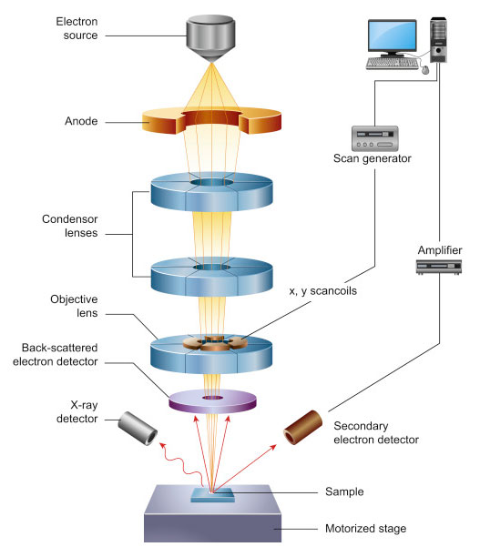
Classic Scanning Electron Microscopy (SEM)
Overview:
SEM is a microscopy technique that uses a focused beam of electrons to image the surface of a sample with high resolution
It provides detailed three-dimensional topographical information and structural analysis of the sample surface
Principle of Operation:
SEM operates by scanning a focused beam of electrons across the surface of the sample
When the electrons interact with the atoms in the sample, various signals such as secondary electrons, backscattered electrons, and X-rays are generated and detected to create an image

Slide 49
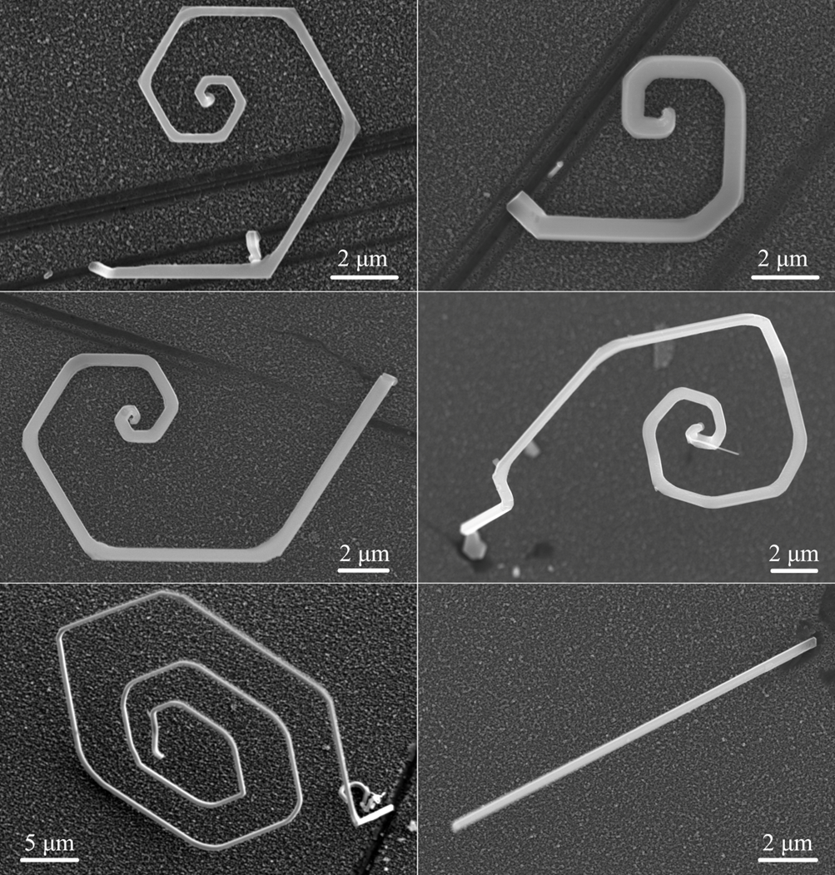
Classic Scanning Electron Microscopy (SEM)
Modes of Operation:
Secondary Electron Imaging:
Detects secondary electrons emitted from the surface, providing topographical information with high resolution
Backscattered Electron Imaging:
Measures the intensity of backscattered electrons, which is correlated with the atomic number and density of the sample
Applications:
Surface morphology analysis of materials in various fields including materials science, nanotechnology, and biology
Characterization of particle size, shape, and distribution in materials such as powders and nanoparticles
Elemental analysis and mapping of samples using EDS for compositional analysis

Slide 50
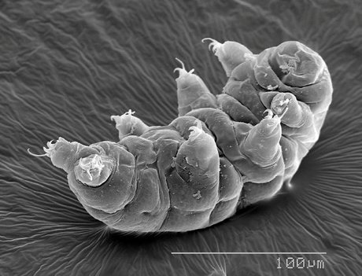
Classic Scanning Electron Microscopy (SEM)
Advantages:
High-resolution imaging of sample surfaces with magnifications ranging from tens to millions of times
Versatility in imaging a wide range of materials including conductive and non-conductive samples
Capable of providing elemental analysis alongside imaging through EDS
Limitations:
Vacuum requirement for operation limits the analysis of samples sensitive to vacuum conditions
Sample preparation is often required, including coating with conductive materials for non-conductive samples
Depth information is limited, as SEM primarily provides surface imaging

Slide 51
Classic Scanning Electron Microscopy (SEM)
Further Reading:
Cheney, B. (n.d.). Introduction to scanning electron microscopy. https://www.sjsu.edu/people/anastasia.micheals/courses/MatE143/s1/SEM_GUIDE.pdf
Dunlap, M., & Adaskaveg, J. E. (1997). Introduction to the scanning electron microscope. Theory, Practice, and Procedures. https://imf.ucmerced.edu/sites/imf.ucmerced.edu/files/documents/sem_manual_06102019.pdf
Anwar Ul-Hamid. A Beginners' Guide to Scanning Electron Microscopy. eBook ISBN: 978-3-319-98482-7. DOI: https://doi.org/10.1007/978-3-319-98482-7
Joseph I. Goldstein, Dale E. Newbury, Patrick Echlin, David C. Joy, Charles E. Lyman, Eric Lifshin, Linda Sawyer, Joseph R. Michael. Scanning Electron Microscopy and X-Ray Microanalysis, Third Edition. eBook ISBN: 978-1-4615-0215-9. DOI: https://doi.org/10.1007/978-1-4615-0215-9
TemGym Basic - a ray-tracing software that models and visualises the first order behaviour of components inside an electron microscope - https://temgymbasic.readthedocs.io/en/latest/

Slide 52
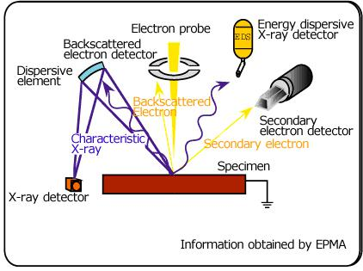
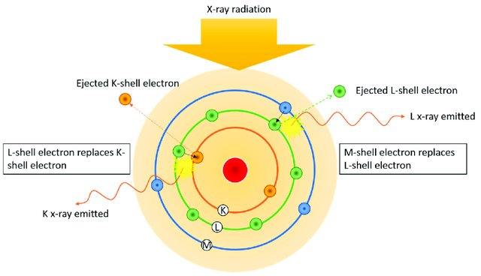
Energy Dispersive X-ray Spectroscopy (EDS)
Overview:
EDS is an analytical technique used to determine the elemental composition of a sample by analyzing the characteristic X-rays emitted when the sample is bombarded with electrons or X-rays
It provides quantitative information about the elemental composition and distribution within a sample
Principle of Operation:
EDS operates by detecting the characteristic X-rays emitted from the sample when it is excited by an electron beam or X-ray source
Each element emits characteristic X-rays with unique energies, allowing for identification and quantification of elements present in the sample

Slide 53
Energy Dispersive X-ray Spectroscopy (EDS)
Modes of Operation:
Point Analysis:
Analyzes the elemental composition at a specific point on the sample surface
Mapping:
Generates elemental maps by scanning the electron beam across the sample surface, providing spatial distribution of elements
Line Scan:
Measures elemental composition along a line on the sample surface, useful for analyzing compositional gradients or interfaces
Applications:
Elemental analysis of materials in various fields including materials science, geology, metallurgy, and biology
Identification of trace elements, impurities, and contaminants in samples
Characterization of thin films, coatings, and multi-layered structures in semiconductor and nanotechnology research

Slide 54
Energy Dispersive X-ray Spectroscopy (EDS)

Slide 55
Energy Dispersive X-ray Spectroscopy (EDS)
Advantages:
Provides quantitative elemental analysis with high sensitivity and spatial resolution
Versatile technique applicable to a wide range of sample types, including solids, powders, thin films, and biological specimens
Capable of simultaneous analysis of multiple elements without the need for extensive sample preparation
Limitations:
Limited depth profiling capability, primarily analyzing the surface layers of the sample
Vulnerable to spectral interferences and background noise, particularly in samples with complex matrices
Resolution may be limited in samples with overlapping peaks or low concentrations of elements

Slide 56
Energy Dispersive X-ray Spectroscopy (EDS)
Further Reading:
Reed, S. J. B. (1995). Introduction to Energy Dispersive X-ray Spectrometry (EDS). https://cfamm.ucr.edu/media/126/download?attachment
Vaughan, D. (2008). Energy Dispersive X-ray Microanalysis: An Introduction. https://assets.thermofisher.com/TFS-Assets/CAD/Product-Bulletins/D17000~.pdf
Hodoroaba, V.-D., Rades, S., Salge, T., Mielke, J., Ortel, E., & Schmidt, R. (2016). Characterisation of nanoparticles by means of high-resolution SEM/EDS in transmission mode. IOP Conference Series: Materials Science and Engineering, 109, 012006. https://doi.org/10.1088/1757-899x/109/1/012006
Prencipe, I., Dellasega, D., Zani, A., Rizzo, D., & Passoni, M. (2015). Energy dispersive X-ray spectroscopy for nanostructured thin film density evaluation. Science and Technology of Advanced Materials, 16(2), 025007. https://doi.org/10.1088/1468-6996/16/2/025007

Slide 57
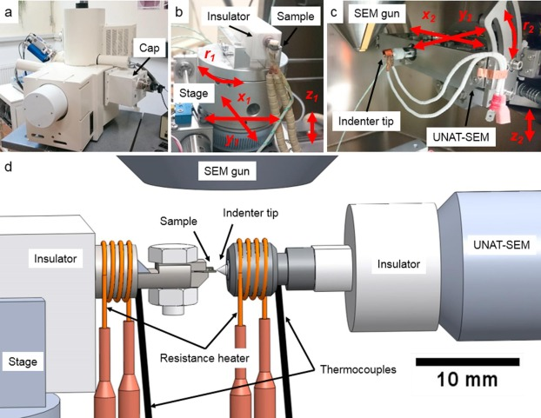
In-Situ SEM Material Testing
Overview:
In-Situ SEM material testing involves performing mechanical, electrical, or thermal tests on materials inside the SEM chamber while simultaneously imaging the sample's response in real-time
It allows for the direct observation and analysis of material behavior under controlled conditions
Principle of Operation:
In-Situ SEM material testing combines SEM imaging capabilities with specialized in-situ testing equipment, such as micro/nano-manipulators, micro-electro-mechanical systems (MEMS), or heating/cooling stages
The SEM provides high-resolution imaging of the sample while the in-situ equipment applies mechanical, electrical, or thermal stimuli to the sample

Slide 58
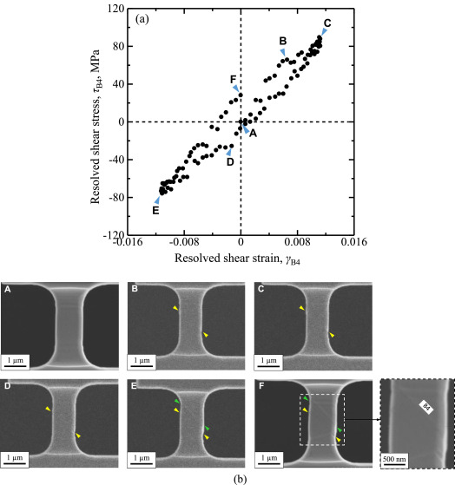
In-Situ SEM Material Testing
Modes of Operation:
Mechanical Testing
Applies controlled mechanical loads to the sample, allowing for the study of mechanical properties such as tensile strength, fracture toughness, and deformation behavior
Electrical Testing
Measures electrical properties such as conductivity, resistivity, and electrical breakdown under various conditions
Thermal Testing
Controls sample temperature to study thermal properties such as thermal conductivity, expansion coefficients, and phase transitions

Slide 59
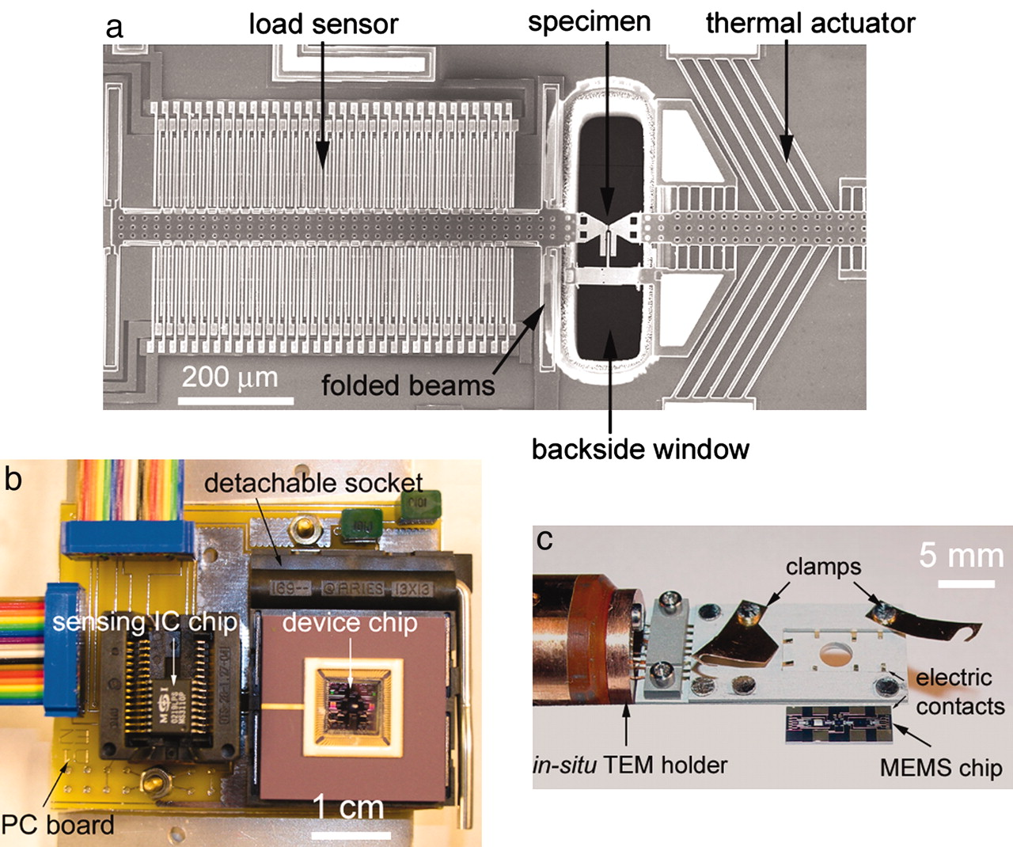
In-Situ SEM Material Testing
Applications:
Mechanical characterization of materials for quality control, failure analysis, and material development in industries such as aerospace, automotive, and microelectronics
Investigation of electrical properties in semiconductors, nanomaterials, and electronic devices for optimizing performance and reliability
Study of thermal behavior in materials for thermal management, heat dissipation, and thermal interface materials in electronic and energy storage applications

Slide 60
In-Situ SEM Material Testing

Slide 61
In-Situ SEM Material Testing
Advantages:
Real-time imaging enables direct observation of material responses under various stimuli, providing valuable insights into structure-property relationships
Controlled experimental conditions allow for precise testing and reproducible results
Versatile technique applicable to a wide range of materials, including metals, ceramics, polymers, and composites
Limitations:
Complexity and cost of specialized in-situ equipment may limit accessibility for some research groups or facilities
Limited to analyzing material behavior at the micro/nanoscale within the SEM chamber, which may not fully represent macroscale behavior
Potential artifacts from electron beam interactions with the sample during testing may affect results

Slide 62
In-Situ SEM Material Testing
Further Reading:
Podor, R., Ravaux, J., & Brau, H.-P. (2012, March 9). In situ experiments in the Scanning Electron Microscope Chamber. IntechOpen. https://www.intechopen.com/chapters/30892
Torres, E. A., & Ramírez, A. J. (2011). In situ scanning electron microscopy. Science and Technology of Welding and Joining, 16(1), 68–78. https://doi.org/10.1179/136217110x12785889550028
Zheng, H., Meng, Y. S., & Zhu, Y. (2015). Frontiers of in situ electron microscopy. MRS Bulletin, 40(1), 12–18. https://doi.org/10.1557/mrs.2014.305

Slide 63
Technique Classification I – By Type
Scanning Electron Microscopy (SEM)
Ultra High Vacuum (UHV) Spectroscopy
In-Situ SEM Material Testing
X-ray Photoelectron Spectroscopy
Classic SEM
Auger Electron Spectroscopy
Energy Dispersive X-Ray Spectroscopy
Time-of Flight
Secondary Ion Mass Spectrometry
Scanning/Transmission Electron Microscopy
Ultraviolet Photoelectron Spectroscopy
Scanning Probe Microscopy (SPM)
Light Spectroscopy
Atomic Force Microscopy
UV-vis Spectroscopy
FTIR Spectroscopy
Scanning Near-Field Optical Microscopy
Infrared and Near-Infrared Spectroscopy
Force-distance Curve Measurements
Scanning Tunneling Microscopy
Raman Spectroscopy
Kelvin Probe Force Microscopy
Photoluminescence Spectroscopy

Slide 64
Ultra High Vacuum (UHV) Spectroscopy
A set of techniques that are performed under extremely low-pressure conditions, typically in the range of 10⁻⁹ to 10⁻¹² torr
These conditions are necessary to avoid contamination of the sample surface, to provide a clean environment for the spectroscopic measurements, and to provide as large a mean free path* as possible
Some of the key UHV spectroscopy techniques include
X-ray Photoelectron Spectroscopy (XPS)
Ultraviolet Photoelectron Spectroscopy (UPS)
Auger Electron Spectroscopy (AES)
Secondary Ion Mass Spectrometry (SIMS)
Notes:
*https://en.wikipedia.org/wiki/Mean_free_path

Slide 65
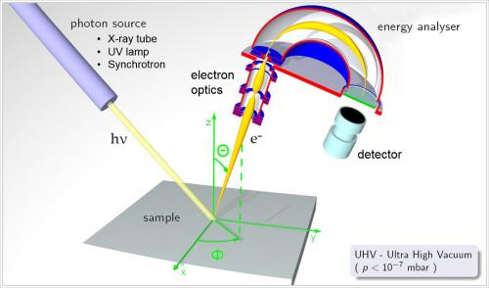
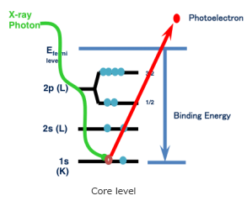
X-ray Photoelectron Spectroscopy (XPS)
Overview:
XPS is a surface-sensitive analytical technique used to characterize the elemental composition, chemical state, and electronic structure of materials
It involves the excitation of core-level electrons by X-rays, leading to the emission of photoelectrons whose kinetic energy is measured to obtain information about the sample
Principle of Operation:
XPS operates based on the photoelectric effect, where X-rays are used to excite core-level electrons from atoms in the sample
The kinetic energy of emitted photoelectrons is characteristic of the element and chemical environment from which they originate
By measuring the kinetic energies of photoelectrons, XPS provides information about the elemental composition and chemical bonding in the sample

Slide 66
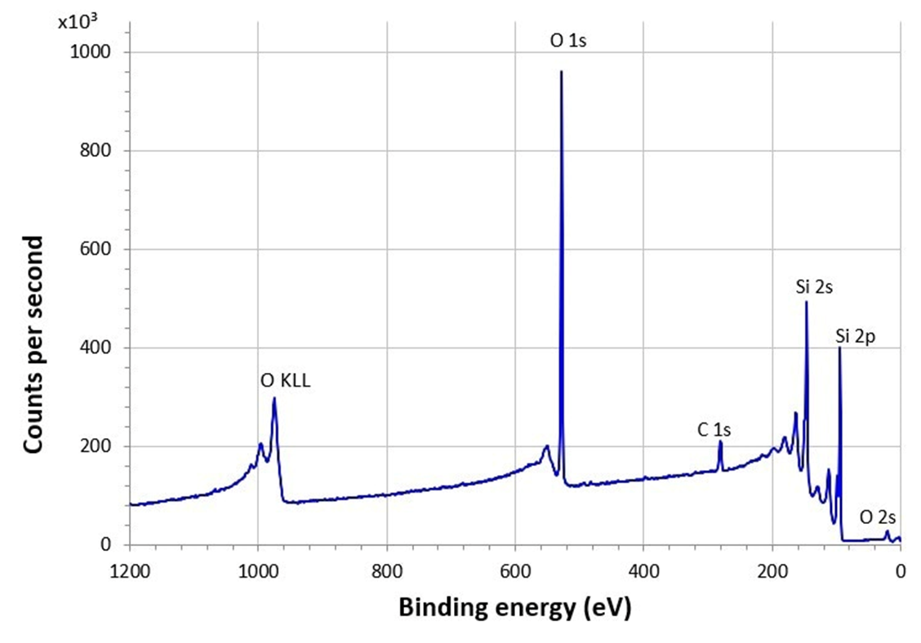
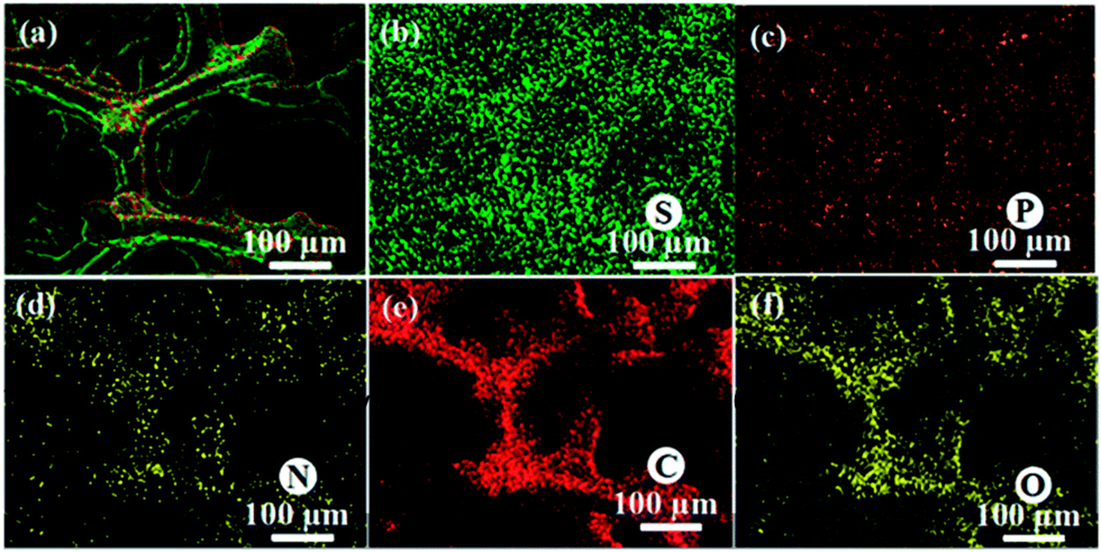
X-ray Photoelectron Spectroscopy (XPS)
Modes of Operation:
Survey Scan Mode:
Used for rapid elemental analysis over a wide energy range
Provides an overview of the elemental composition of the sample
High-Resolution Scan Mode:
Used for detailed analysis of specific elements or chemical states
Provides higher sensitivity and resolution for identifying and quantifying chemical species
Mapping Mode:
Used for spatially resolved analysis of elemental distribution or chemical states across the sample surface.
Provides two-dimensional maps showing the distribution of elements or chemical species, allowing for the visualization of compositional variations.

Slide 67
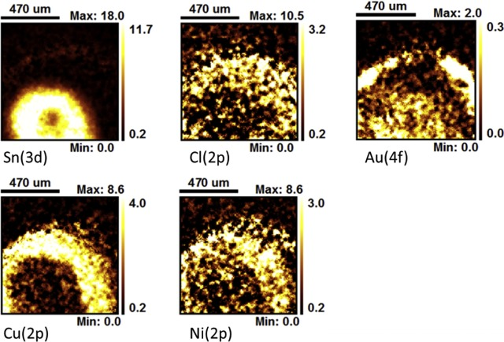
X-ray Photoelectron Spectroscopy (XPS)
Applications:
Characterization of surface composition and chemistry of diverse materials.
Assessment of thickness, composition, and interface properties of thin films.
Studies of surface reactions, degradation, and catalysis as well as the mechanisms of these processes in materials
Can analyze biomaterials, implants, and drug delivery systems
Can be used to study pollutants, contaminants, and environmental interfaces
Can be used to identify and characterize trace evidence in criminal investigations

Slide 68
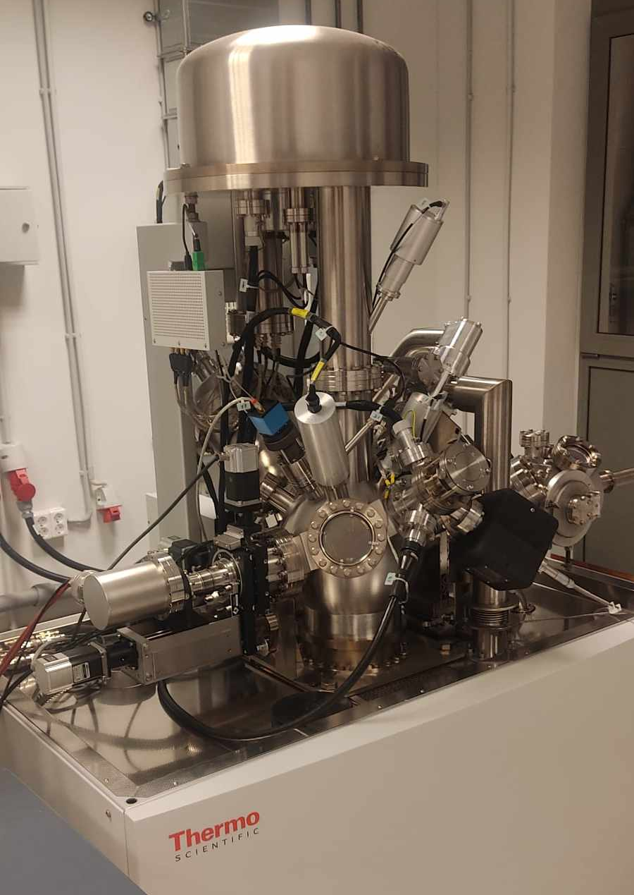
X-ray Photoelectron Spectroscopy (XPS)
Advantages:
High sensitivity to surface composition and chemical states
Non-destructive technique that requires minimal sample preparation
Provides quantitative information about elemental composition and chemical bonding
Limitations:
Limited depth sensitivity, primarily probing the top few nanometers of the sample surface
Requires ultra-high vacuum conditions for operation, limiting sample types and experimental setups
Limited to analyzing solid or vacuum-compatible samples, excluding analysis of liquids or gases

Slide 69
X-ray Photoelectron Spectroscopy (XPS)
Further Reading:
Stevie, F. A., & Donley, C. L. (2020, September 24). Introduction to x-ray photoelectron spectroscopy. https://mmrc.caltech.edu/XPS Info/Practical Guides to XPS/Intro to XPS.pdf
McArthur, S. L. (2006). Applications of XPS in bioengineering. Surface and Interface Analysis, 38(11), 1380–1385. https://doi.org/10.1002/sia.2498
McArthur, S. L., Mishra, G., & Easton, C. D. (2014). Applications of XPS in biology and biointerface analysis. Surface Analysis and Techniques in Biology, 9–36. https://doi.org/10.1007/978-3-319-01360-2_2
Desimoni, E., & Brunetti, B. (2015). X-ray photoelectron spectroscopic characterization of chemically modified electrodes used as chemical sensors and biosensors: A Review. Chemosensors, 3(2), 70–117. https://doi.org/10.3390/chemosensors3020070
Shchukarev, A., & Ramstedt, M. (2016). Cryo-XPS: Probing intact interfaces in nature and life. Surface and Interface Analysis, 49(4), 349–356. https://doi.org/10.1002/sia.6025
Kingshott, P., Andersson, G., McArthur, S. L., & Griesser, H. J. (2011). Surface modification and chemical surface analysis of biomaterials. Current Opinion in Chemical Biology, 15(5), 667–676. https://doi.org/10.1016/j.cbpa.2011.07.012

Slide 70
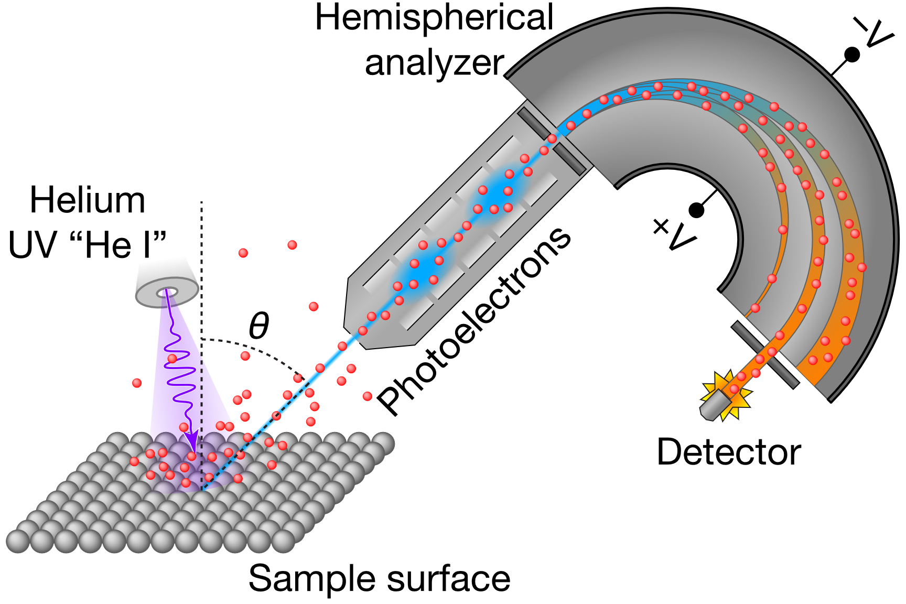
Ultraviolet Photoelectron Spectroscopy (UPS)
Overview:
UPS is a surface-sensitive analytical technique used to study the electronic structure of materials
It involves the excitation of valence electrons by ultraviolet (UV) photons, leading to the emission of photoelectrons whose kinetic energy is measured to obtain information about the sample's electronic properties
Principle of Operation:
UPS operates based on the photoelectric effect, where UV photons are used to excite valence electrons from atoms in the sample
The kinetic energy of emitted photoelectrons is characteristic of the energy states and band structure of the material
By measuring the kinetic energies of photoelectrons, UPS provides information about the electronic band structure and Fermi level of the sample
Because of the similarities in the electron analysis and detection systems, UPS can be easily combined with XPS within one machine

Slide 71
Ultraviolet Photoelectron Spectroscopy (UPS)
Applications:
Electronic structure analysis of solids, surfaces, thin films, and nanostructures
Investigation of energy band alignment, electronic states, and surface chemistry in materials science and semiconductor research
Study of interface properties, heterojunctions, and electronic devices, including organic electronics and photovoltaics

Slide 72
Ultraviolet Photoelectron Spectroscopy (UPS)
He I UPS data of polycrystalline gold at 130 K

Slide 73
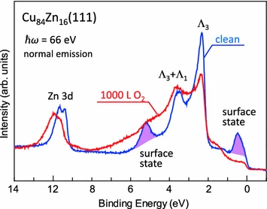
Ultraviolet Photoelectron Spectroscopy (UPS)
Advantages:
High sensitivity to electronic structure and energy levels of materials
Provides valuable information about band structure, Fermi level, and electronic states near the surface
Non-destructive technique that requires minimal sample preparation
Limitations:
Limited to surface analysis, primarily probing the top few nanometers of the sample
Requires ultra-high vacuum conditions for operation, limiting sample types and experimental setups
Limited to analyzing solid or vacuum-compatible samples, excluding analysis of liquids or gases

Slide 74
Ultraviolet Photoelectron Spectroscopy (UPS)
Further Reading:
Scudiero, L. (n.d.). Ultraviolet Photoelectron Spectroscopy (UPS)-1. https://mmrc.caltech.edu/XPS%20Info/571-UPS-Lecture1_005%20Scudiero.pdf
Ueno, N., & Kera, S. (2008). Electron spectroscopy of functional organic thin films: Deep insights into valence electronic structure in relation to charge transport property. Progress in Surface Science, 83(10–12), 490–557. https://doi.org/10.1016/j.progsurf.2008.10.002
Salaneck, W. R., Lögdlund, M., Fahlman, M., Greczynski, G., & Kugler, T. (2001). The electronic structure of polymer–metal interfaces studied by Ultraviolet Photoelectron Spectroscopy. Materials Science and Engineering: R: Reports, 34(3), 121–146. https://doi.org/10.1016/s0927-796x(01)00036-5
Yang, J.-P., Bussolotti, F., Kera, S., & Ueno, N. (2017). Origin and role of gap states in organic semiconductor studied by UPS: As the nature of organic molecular crystals. Journal of Physics D: Applied Physics, 50(42), 423002. https://doi.org/10.1088/1361-6463/aa840f
UENO, N., & KERA, S. (2011). Electronic states of organic semiconductors and their interfaces: Unraveling electrical conduction. Hyomen Kagaku, 32(1), 3–8. https://doi.org/10.1380/jsssj.32.3
Bolli, E., Mezzi, A., Burratti, L., Prosposito, P., Casciardi, S., & Kaciulis, S. (2020). X‐Ray and UV photoelectron spectroscopy of Ag Nanoclusters. Surface and Interface Analysis, 52(12), 1017–1022. https://doi.org/10.1002/sia.6783

Slide 75
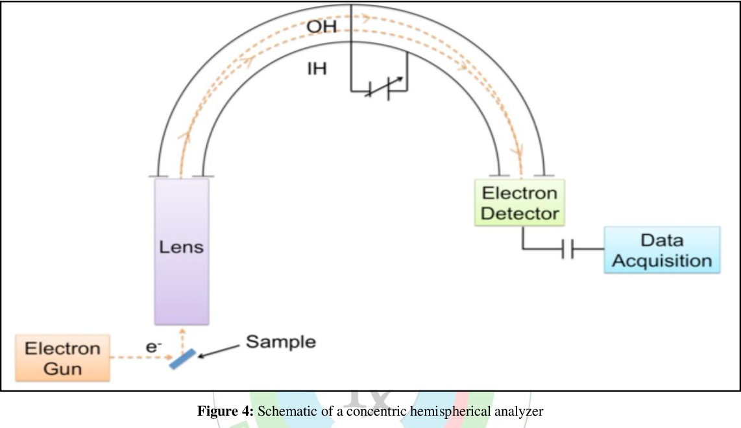
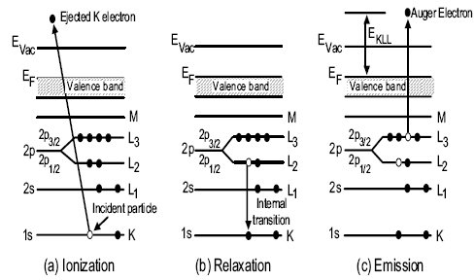
Auger Electron Spectroscopy (AES)
Overview:
AES is a surface-sensitive analytical technique used to characterize elemental composition and chemical state of materials
It involves the excitation of core electrons by electron beam, leading to the emission of Auger electrons whose kinetic energy is measured to obtain information about the sample's elemental composition and chemical bonding
Principle of Operation:
AES operates based on the Auger effect, where an electron from a higher energy level fills a core hole created by the excitation of another electron
The energy released in this process is transferred to a third electron, which is emitted as an Auger electron
By measuring the kinetic energies of Auger electrons, AES provides information about the elemental composition and chemical states of the sample

Slide 76
Auger Electron Spectroscopy (AES)
Modes of Operation:
Elemental Analysis Mode:
Measures the energy spectrum of Auger electrons emitted from the sample, allowing identification and quantification of elements present
Chemical State Analysis Mode:
Analyzes the energy shifts and relative intensities of Auger electron peaks to determine chemical bonding and electronic structure of the sample
Imaging Mode
Utilizes AES in conjunction with scanning electron microscopy (SEM) or transmission electron microscopy (TEM) to obtain spatially resolved chemical maps of the sample surface
Applications:
Surface analysis and characterization of thin films, coatings, and surfaces
Investigation of elemental composition, chemical state, and contamination in materials science, metallurgy, and semiconductor industries
Study of surface reactions, catalysis, and corrosion processes

Slide 77
Auger Electron Spectroscopy (AES)
Auger spectrum of a Mo sample contaminated by O and C

Slide 78
Auger Electron Spectroscopy (AES)
High-resolution SEM and Auger maps for Fe, O, Mn, C, and B of an annealed alloy steel surface

Slide 79
Auger Electron Spectroscopy (AES)
Advantages:
High sensitivity to surface composition and chemical bonding
Provides quantitative elemental analysis and chemical state information
Non-destructive technique that requires minimal sample preparation
Limitations:
Limited depth sensitivity, primarily probing the top few nanometers of the sample
Requires ultra-high vacuum conditions for operation, limiting sample types and experimental setups
Resolution and sensitivity may be reduced in complex multilayer structures or heterogeneous samples

Slide 80
Auger Electron Spectroscopy (AES)
Further Reading:
Ong, J. L., & Lucas, L. C. (1998b). Auger electron spectroscopy and its use for the characterization of titanium and hydroxyapatite surfaces. Biomaterials, 19(4–5), 455–464. https://doi.org/10.1016/s0142-9612(97)00224-x
Raman, S. N., Paul, D. F., Hammond, J. S., & Bomben, K. D. (2011). Auger electron spectroscopy and its application to nanotechnology. Microscopy Today, 19(2), 12–15. https://doi.org/10.1017/s1551929511000083
Unger, W. E. S., Wirth, T., & Hodoroaba, V.-D. (2020). Auger electron spectroscopy. Characterization of Nanoparticles, 373–395. https://doi.org/10.1016/b978-0-12-814182-3.00020-1

Slide 81
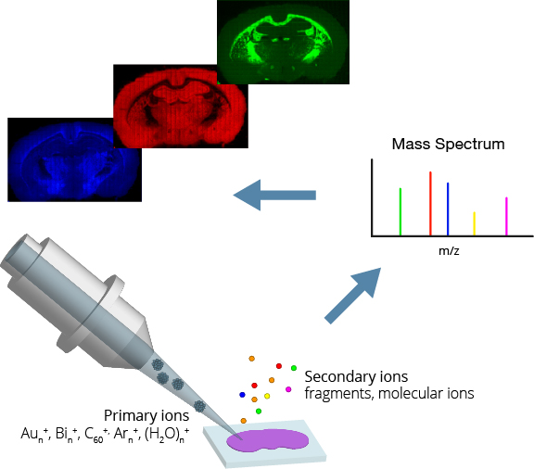
Time-of-Flight Secondary Ion Mass Spectrometry (ToF-SIMS)
Overview:
TOF-SIMS is a surface-sensitive analytical technique used for chemical analysis and imaging of materials
It involves bombarding the sample surface with a primary ion beam, which generates secondary ions that are then analyzed by mass spectrometry
Principle of Operation:
TOF-SIMS operates based on the principle of secondary ionization, where primary ions collide with the sample surface, causing the ejection of secondary ions
The mass-to-charge ratio (m/z) of these secondary ions is measured to determine the elemental and molecular composition of the sample

Slide 82
Time-of-Flight Secondary Ion Mass Spectrometry (ToF-SIMS)
Modes of Operation:
Static Mode:
Analyzes the chemical composition of a specific region of interest on the sample surface
Provides detailed information about the spatial distribution of elements and molecules
Dynamic Mode:
Scans the primary ion beam across the sample surface to generate chemical maps of elemental and molecular distribution
Allows for high-resolution imaging and analysis of large sample areas
Imaging Mode:
Captures spatially resolved chemical images of the sample surface
Provides visual representation of elemental and molecular distribution across the sample area
Enables detailed analysis of surface features, defects, and composition variations
Notes:
Further reading:

Slide 83
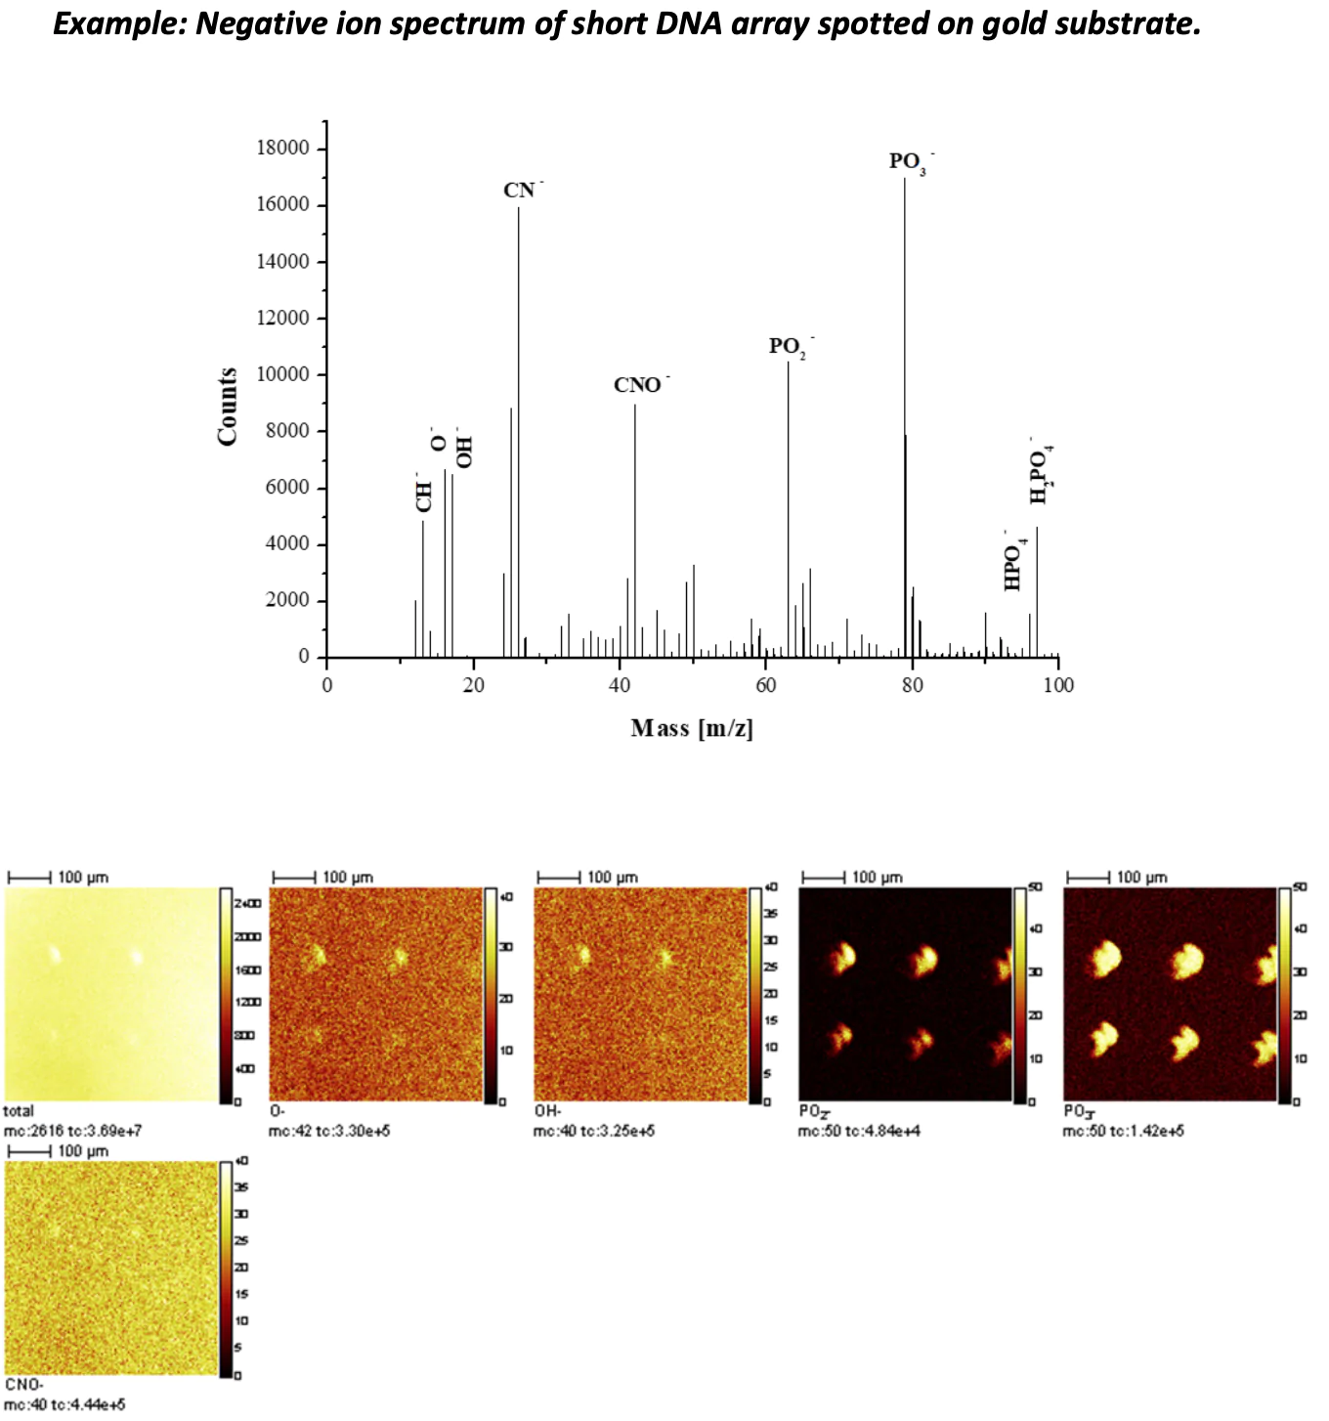
Time-of-Flight Secondary Ion Mass Spectrometry (ToF-SIMS)
Applications:
Surface analysis and characterization of materials in various fields, including semiconductor, pharmaceuticals, biomaterials, and forensics
Identification and mapping of surface contaminants, trace elements, and molecular species
Investigation of surface reactions, catalysis, and molecular dynamics
Notes:
Further reading:

Slide 84
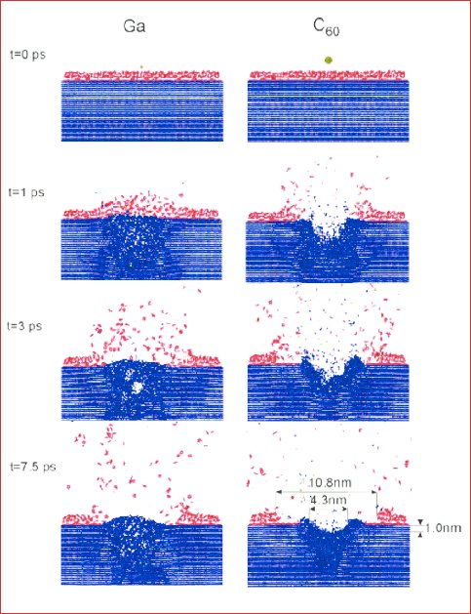
Time-of-Flight Secondary Ion Mass Spectrometry (ToF-SIMS)
Advantages:
High sensitivity and spatial resolution for elemental and molecular analysis
Allows for 3D imaging and depth profiling of samples
Capable of analyzing a wide range of sample types, including organic and inorganic materials
Limitations:
Limited depth resolution, primarily probing the top few nanometers of the sample surface
Requires ultra-high vacuum conditions for operation, limiting sample types and experimental setups
Complex data analysis and interpretation may be required due to the complexity of mass spectra and molecular fragmentation patterns
Notes:
Further reading:

Slide 85
Time-of-Flight Secondary Ion Mass Spectrometry (ToF-SIMS)
Further Reading:
Mogk, D. W. (2023, October 19). Time-of-flight secondary ion mass spectrometry (TOF-Sims). https://serc.carleton.edu/msu_nanotech/methods/ToFSIMS.html#:~:text=(ToF%2DSIMS)-,Time%2Dof%2DFlight%20Secondary%20Ion%20Mass%20Spectrometry%20(ToF%2D,the%20surface%20(secondary%20ions).
Fearn, S. (2015, October). An Introduction to Time-of-Flight Secondary Ion Mass Spectrometry (ToF-SIMS) and its Application to Materials Science. https://iopscience.iop.org/book/mono/978-1-6817-4088-1/chapter/bk978-1-6817-4088-1ch1
Linford, M. R. (2013, February). An Introduction to Time-of-Flight Secondary Ion Mass Spectrometry (ToF-SIMS). https://www.researchgate.net/profile/Matthew-Linford/publication/261595438_An_Introduction_to_Time-of-Flight_Secondary_Ion_Mass_Spectrometry_ToF-SIMS/links/00b7d534bfeaea62b9000000/An-Introduction-to-Time-of-Flight-Secondary-Ion-Mass-Spectrometry-ToF-SIMS.pdf
Fearn, S. (2015). Characterisation of biological material with TOF-Sims: A Review. Materials Science and Technology, 31(2), 148–161. https://doi.org/10.1179/1743284714y.0000000668
Belu, A. M., Graham, D. J., & Castner, D. G. (2003). Time-of-flight secondary ion mass spectrometry: Techniques and applications for the characterization of biomaterial surfaces. Biomaterials, 24(21), 3635–3653. https://doi.org/10.1016/s0142-9612(03)00159-5
Passarelli, M. K., & Winograd, N. (2011). Lipid imaging with time-of-flight secondary ion mass spectrometry (TOF-Sims). Biochimica et Biophysica Acta (BBA) - Molecular and Cell Biology of Lipids, 1811(11), 976–990. https://doi.org/10.1016/j.bbalip.2011.05.007
Notes:
Further reading:

Slide 86
Technique Classification I – By Type
Scanning Electron Microscopy (SEM)
Ultra High Vacuum (UHV) Spectroscopy
In-Situ SEM Material Testing
X-ray Photoelectron Spectroscopy
Classic SEM
Auger Electron Spectroscopy
Energy Dispersive X-Ray Spectroscopy
Time-of Flight
Secondary Ion Mass Spectrometry
Scanning/Transmission Electron Microscopy
Ultraviolet Photoelectron Spectroscopy
Scanning Probe Microscopy (SPM)
Light Spectroscopy
Atomic Force Microscopy
UV-vis Spectroscopy
FTIR Spectroscopy
Scanning Near-Field Optical Microscopy
Infrared and Near-Infrared Spectroscopy
Force-distance Curve Measurements
Scanning Tunneling Microscopy
Raman Spectroscopy
Kelvin Probe Force Microscopy
Photoluminescence Spectroscopy

Slide 87
Scanning Probe Microscopy (SPM)
Introduction to SPM:
Scanning Probe Microscopy (SPM) is a microscopy technique that images surfaces using a physical probe.
Developed with the scanning tunneling microscope in the 1980s.
Capabilities:
Provides high-resolution imaging of surfaces, capable of reaching atomic-level detail
Utilized across various scientific fields, including physics, chemistry, biology, and materials science
Operational Principle:
The core mechanism involves the interaction between a sharp probe and the specimen's surface
The probe is part of a flexible cantilever system
As the probe moves over the surface, it experiences deflections due to interactions with the surface
These deflections are recorded and translated into a detailed map of the surface's properties

Slide 88
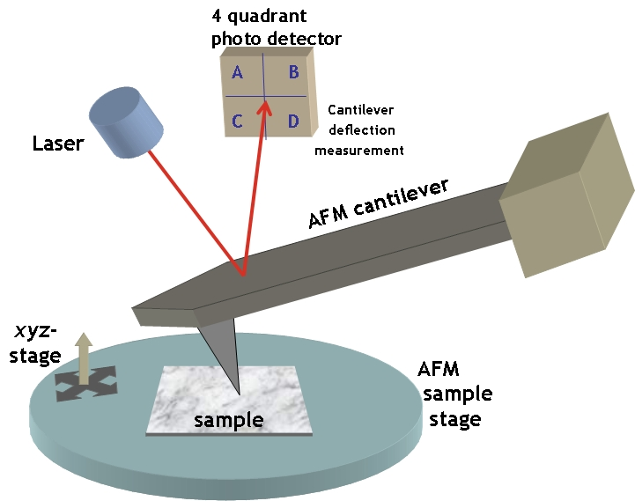
Atomic Force Microscopy (AFM)
Overview of AFM:
A type of Scanning Probe Microscopy (SPM) offering high-resolution nanoscale imaging
Capable of atomic-level resolution in some cases
Operates under ambient, liquid, or varied temperature conditions, unlike electron microscopy which requires vacuum
Principle of Operation:
Involves a cantilever with a sharp tip (probe) at its end which is used to scan the surface of a sample
The cantilever deflects due to forces between the tip and the sample during scanning. The forces that can affect the deflection of the tip include van der Waals, electrostatic, capillary, chemical bonding, magnetic, Coulombic, quantum mechanical forces like the Casimir force, and mechanical contact forces
Deflections are measured by reflecting a laser beam off the cantilever into a four-segment photodetector
Notes:
Author Attribution:
By yashvant - http://kristian.molhave.dkThis illustration was made for the Opensource Handbook of Nanoscience and Nanotechnology The image also appears on the Commons/nanotechnology page, CC BY 2.5, https://commons.wikimedia.org/w/index.php?curid=1389346

Slide 89
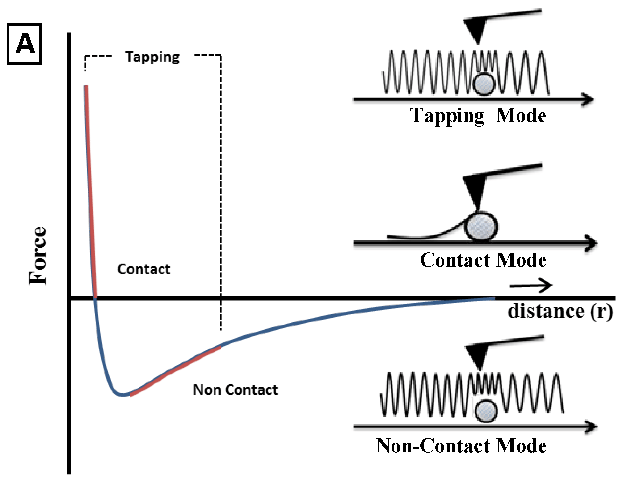
Atomic Force Microscopy (AFM)
Modes of Operation:
Contact Mode: Direct contact between the tip and sample, suitable for high-resolution images but may damage soft samples
Tapping Mode: Scanning is performed with a cantilever oscillating at its resonant frequency and slightly touching the sample surface. This reduces damage to the sample and is ideal for imaging soft/sticky surfaces
Non-contact Mode: Tip oscillates near the surface without touching, used for fragile samples.
Applications:
Surface analysis of polymers, metals, semiconductors, and thin films
Mechanical property measurement (hardness, elasticity, adhesion) at the nanoscale
Imaging of biological samples (DNA, proteins, cells) in native environments

Slide 90
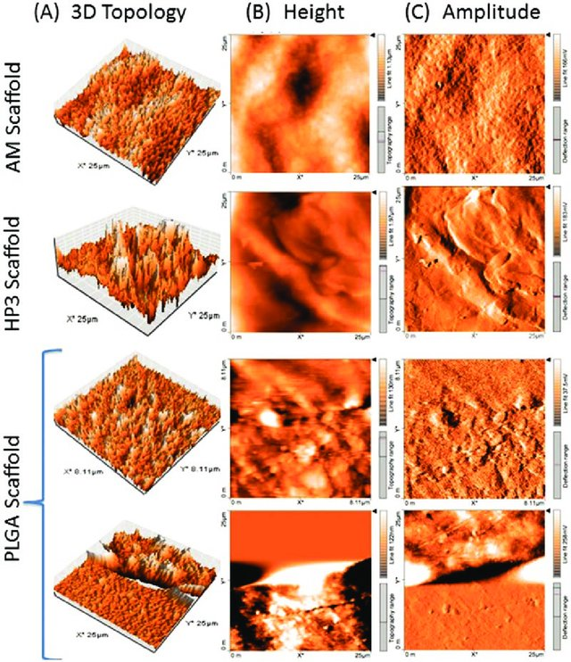
Atomic Force Microscopy (AFM)
Advantages:
High-resolution imaging capability
Versatile operating environments
Measurement of mechanical, electrical, and magnetic properties at the nanoscale
Limitations:
Surface imaging is generally limited to a few micrometers in depth
Data interpretation can be complex for heterogeneous samples
Slower scanning speeds compared to some microscopy techniques
Notes:
Image Source: https://www.researchgate.net/publication/305343305_Decellularized_Amniotic_Membrane_Scaffold_Compared_to_Synthetic_PLGA_and_Hybrid_Scaffolds_Exhibit_Superlative_Biomechanical_Properties_for_Tissue_Engineering_Applications

Slide 91
Atomic Force Microscopy (AFM)
Further Reading:
Marrese, M., Guarino, V., & Ambrosio, L. (2017). Atomic Force Microscopy: A powerful tool to address scaffold design in tissue engineering. Journal of Functional Biomaterials, 8(1), 7. https://doi.org/10.3390/jfb8010007
Johnson, D., & Hilal, N. (2015). Characterisation and quantification of membrane surface properties using atomic force microscopy: A comprehensive review. Desalination, 356, 149–164. https://doi.org/10.1016/j.desal.2014.08.019
Maver, U., Velnar, T., Gaberšček, M., Planinšek, O., & Finšgar, M. (2016). Recent progressive use of atomic force microscopy in biomedical applications. TrAC Trends in Analytical Chemistry, 80, 96–111. https://doi.org/10.1016/j.trac.2016.03.014
Alunda, B. O., & Lee, Y. J. (2020). Review: Cantilever-based sensors for High Speed Atomic Force Microscopy. Sensors, 20(17), 4784. https://doi.org/10.3390/s20174784

Slide 92
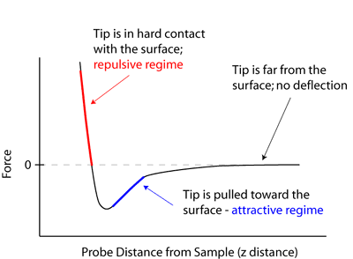
Force-Distance Curve Measurements
Overview:
AFM technique used to probe mechanical properties of materials at the nanoscale
Involves measuring the interaction forces between the AFM tip and sample as a function of tip-sample separation distance

Slide 93
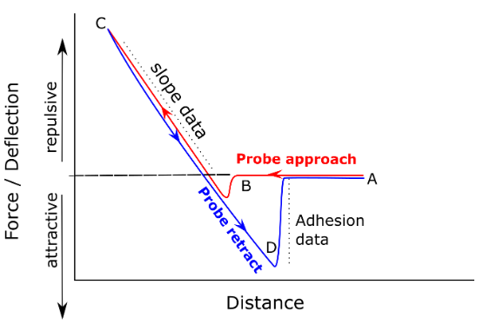
Force-Distance Curve Measurements
Principle of Operation:
AFM tip approaches the sample surface until it makes contact
As the tip nears the surface, intermolecular forces cause it to deflect
Deflection is measured by a laser reflected off the cantilever to a photodetector
As the tip is retracted, cantilever deflection reduces, indicating weaker interaction between tip and sample
By plotting the measured force as a function of the tip-sample separation distance, a force-distance curve is generated
Can be used to measure adhesion, stiffness, and elasticity of the sample

Slide 94
Force-Distance Curve Measurements
Modes of Operation:
Force Volume Mode:
AFM tip scans across the sample surface while simultaneously acquiring force-distance curves at each pixel
Provides spatial maps of mechanical properties across the sample surface
Single Curve Mode:
AFM tip probes a specific location on the sample surface, generating a single force-distance curve
Used for detailed analysis of mechanical properties at specific points on the sample
Applications:
Characterization of mechanical properties of various materials, including polymers, biomolecules, and nanocomposites
Study of biological samples to understand cell mechanics, protein unfolding, and molecular interactions
Quality control in nanotechnology for assessing material properties and device performance

Slide 95
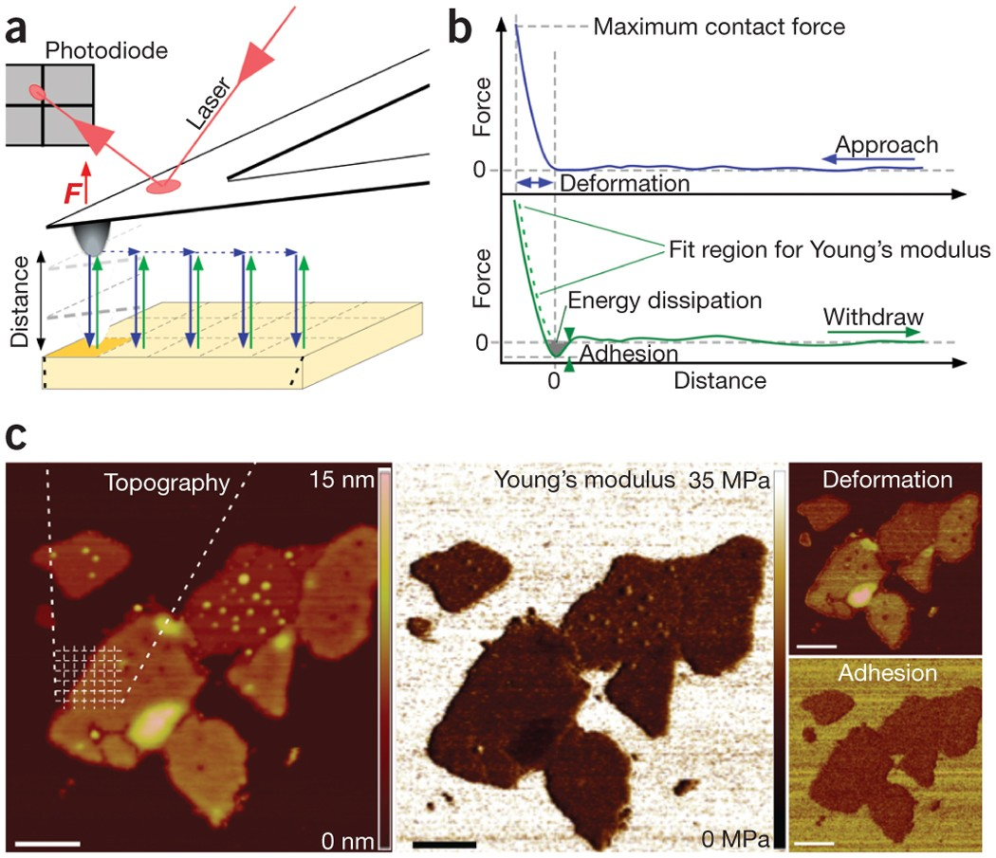
Force-Distance Curve Measurements
Advantages:
Provides quantitative measurements of mechanical properties at the nanoscale
Non-destructive technique that can be performed under ambient conditions
High spatial resolution allows for detailed analysis of local variations in mechanical properties
Limitations:
Requires careful calibration and optimization to ensure accurate force measurements
Time-consuming process, especially for acquiring force-volume maps over large areas
Limited to surface characterization and cannot probe bulk material properties

Slide 96
Force-Distance Curve Measurements
Further Reading:
Cappella, B., & Dietler, G. (1999). Force-distance curves by atomic force microscopy. https://infoscience.epfl.ch/record/147743/files/
AFMWorkshop. (n.d.). Measuring and understanding force distance curves. https://www.afmworkshop.com/images/news2019/01/Measuring-and-understanding-force-distance-curves-v2.pdf
Butt, H.-J., Cappella, B., & Kappl, M. (2005). Force measurements with the atomic force microscope: Technique, interpretation and applications. Surface Science Reports, 59(1–6), 1–152. https://doi.org/10.1016/j.surfrep.2005.08.003
Goss, J. W., & Volle, C. B. (2019). Using atomic force microscopy to illuminate the biophysical properties of microbes. ACS Applied Bio Materials, 3(1), 143–155. https://doi.org/10.1021/acsabm.9b00973
Chyasnavichyus, M., Young, S. L., & Tsukruk, V. V. (2015). Recent advances in micromechanical characterization of polymer, biomaterial, and cell surfaces with atomic force microscopy. Japanese Journal of Applied Physics, 54(8S2). https://doi.org/10.7567/jjap.54.08la02

Slide 97
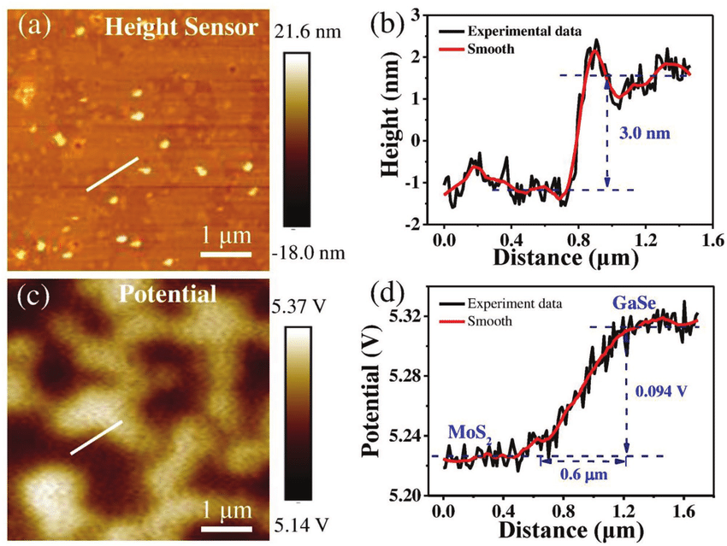
Kelvin Probe Force Microscopy (KPFM)
Overview:
KPFM is a technique used to measure local surface potential variations with nanoscale resolution
It combines the principles of atomic force microscopy (AFM) with Kelvin probe technology to study electrical properties of surfaces

Slide 98
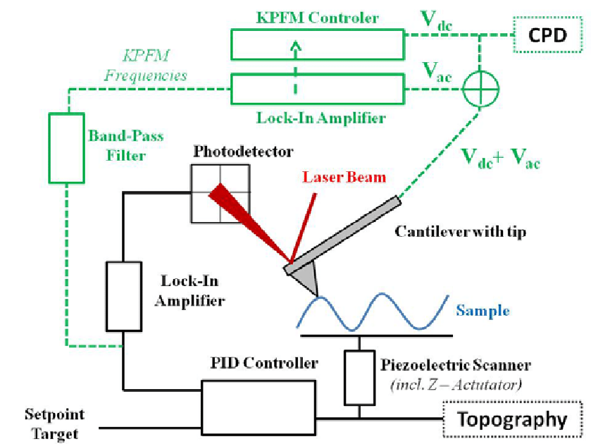
Kelvin Probe Force Microscopy (KPFM)
Principle of Operation:
KPFM measures surface potential difference between a conductive AFM tip and the sample surface
Applying AC voltage induces electrostatic force between AFM tip and sample due to surface potential difference
Amplitude or frequency shift of AFM tip's oscillation correlates with local surface potential
Scanning the AFM tip along the surface creates a nanoscale-resolution map of surface potential variations
KPFM detects changes in local surface potential due to factors like charge accumulation or surface doping, offering insights into nanoscale electronic properties and material behavior

Slide 99
Kelvin Probe Force Microscopy (KPFM)
Modes of Operation:
Frequency Modulation Mode:
AFM tip oscillates at its resonant frequency while in contact with the sample surface.
The frequency shift caused by the electrostatic force is detected and used to map surface potential variations.
Amplitude Modulation Mode:
AFM tip maintains constant oscillation amplitude while scanning the sample surface.
Changes in the amplitude due to the electrostatic force provide surface potential information.
Applications:
Characterization of semiconductor materials to understand electrical properties and device performance.
Study of local charge distribution on surfaces, including organic materials, thin films, and nanomaterials.
Investigation of surface potential variations in electronic devices and energy-related materials.

Slide 100
Kelvin Probe Force Microscopy (KPFM)
Advantages:
Provides nanoscale resolution of surface potential variations
Non-destructive technique that can be performed under ambient conditions
Compatible with a wide range of materials and sample environments
Limitations:
Requires careful calibration and optimization to ensure accurate surface potential measurements
Sensitivity to environmental factors such as temperature and humidity may affect measurements
Limited to surface characterization and cannot probe bulk electrical properties

Slide 101
Kelvin Probe Force Microscopy (KPFM)
Notes:
Results from scanning Kelvin probe microscopy of the samples. The panels (a-c) show the AFM height images of the PbS films at 0, 0.5 and 2.0 at% Cu-doping. (d-f) is the corresponding apparent WF, i.e. calculated from the measured contact potential difference acquired at a lift of 50 nm, of the same areas as in a-c. The apparent WFs for all the samples are shown in (g) as probability histograms and in (h) as a function of doping. The trend line in h is just as a guide for the eye.

Slide 102
Kelvin Probe Force Microscopy (KPFM)
Further Reading:
Park Systems (n.d.). Kelvin Probe Force Microscopy (KPFM). https://www.parksystems.com/index.php/park-spm-modes/93-dielectric-piezoelectric/232-kelvin-probe-force-microscopy-kpfm
Jankov, I. R., Goldman, I. D., & Szente, R. N. (2000, August 22). Principles of the Kelvin Probe Force Microscopy. https://www.sbfisica.org.br/rbef/pdf/v22_503.pdf
Melitz, W., Shen, J., Kummel, A. C., & Lee, S. (2011). Kelvin Probe Force Microscopy and its Application. Surface Science Reports, 66(1), 1–27. http://kummelgroup.ucsd.edu/pubs/paper/110.pdf
Palermo, V., Palma, M., & Samorì, P. (2006). Electronic characterization of organic thin films by Kelvin Probe Force Microscopy. Advanced Materials, 18(2), 145–164. https://doi.org/10.1002/adma.200501394
Lee, H., Lee, W., Lee, J. H., & Yoon, D. S. (2016). Surface potential analysis of nanoscale biomaterials and devices using Kelvin Probe Force Microscopy. Journal of Nanomaterials, 2016, 1–21. https://doi.org/10.1155/2016/4209130

Slide 103
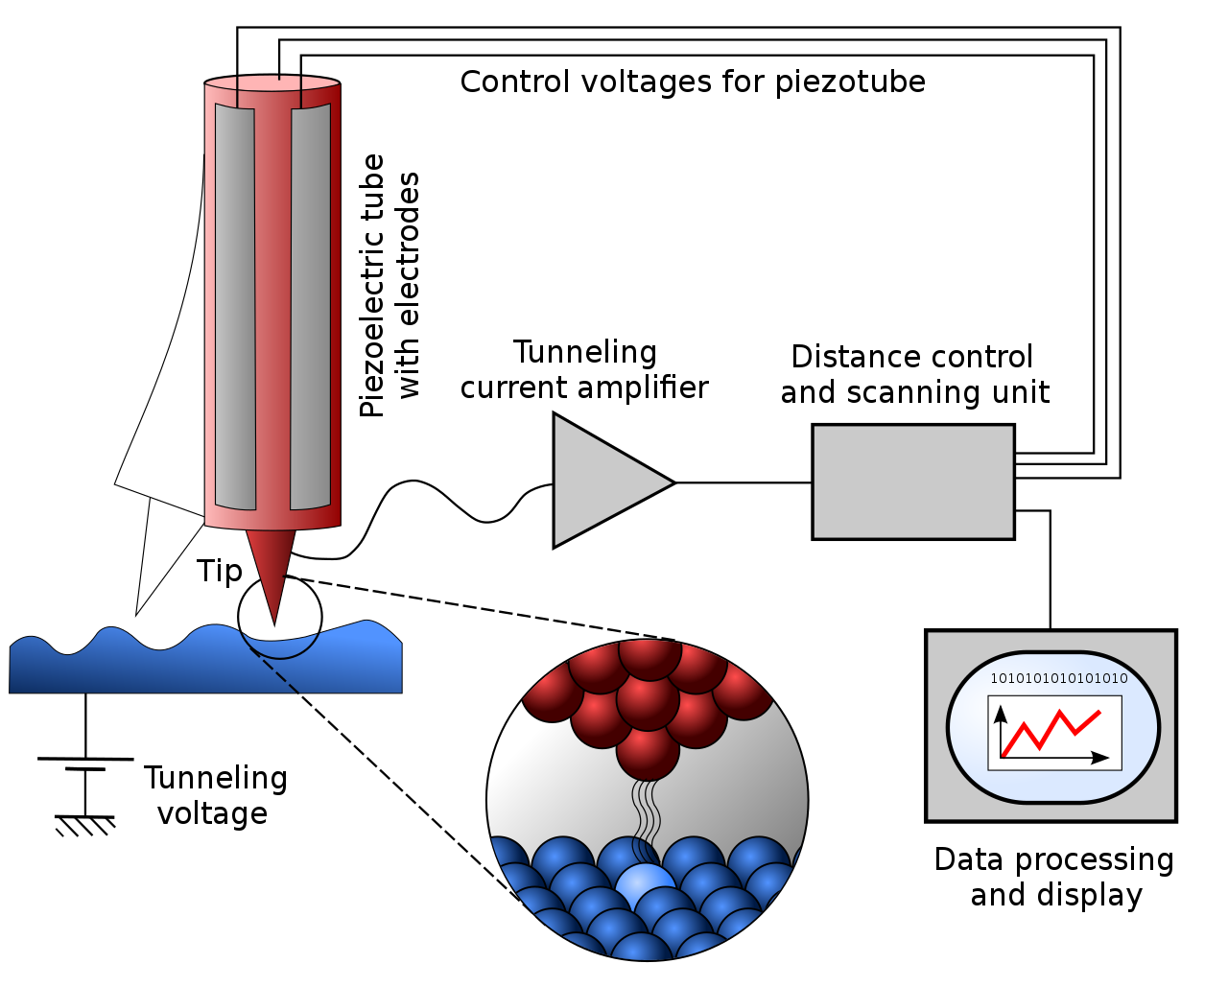
Scanning Tunneling Microscopy (STM)
Overview:
STM is an advanced imaging technique used in scientific research
It enables scientists to see and manipulate individual atoms and molecules on surfaces
Developed in the 1980s, it has become a key tool in physics, chemistry, materials science, and nanotechnology
Principle of Operation:
STM works by positioning a sharp metallic tip very close to a sample surface
Applying a small voltage between the tip and the sample causes electrons to tunnel between them
The resulting electric current is sensitive to the tip-sample distance, allowing precise measurements
Notes:
Image By Michael Schmid and Grzegorz Pietrzak - Rastertunnelmikroskop-schema.svg, CC BY-SA 2.0 at, https://commons.wikimedia.org/w/index.php?curid=89194170

Slide 104
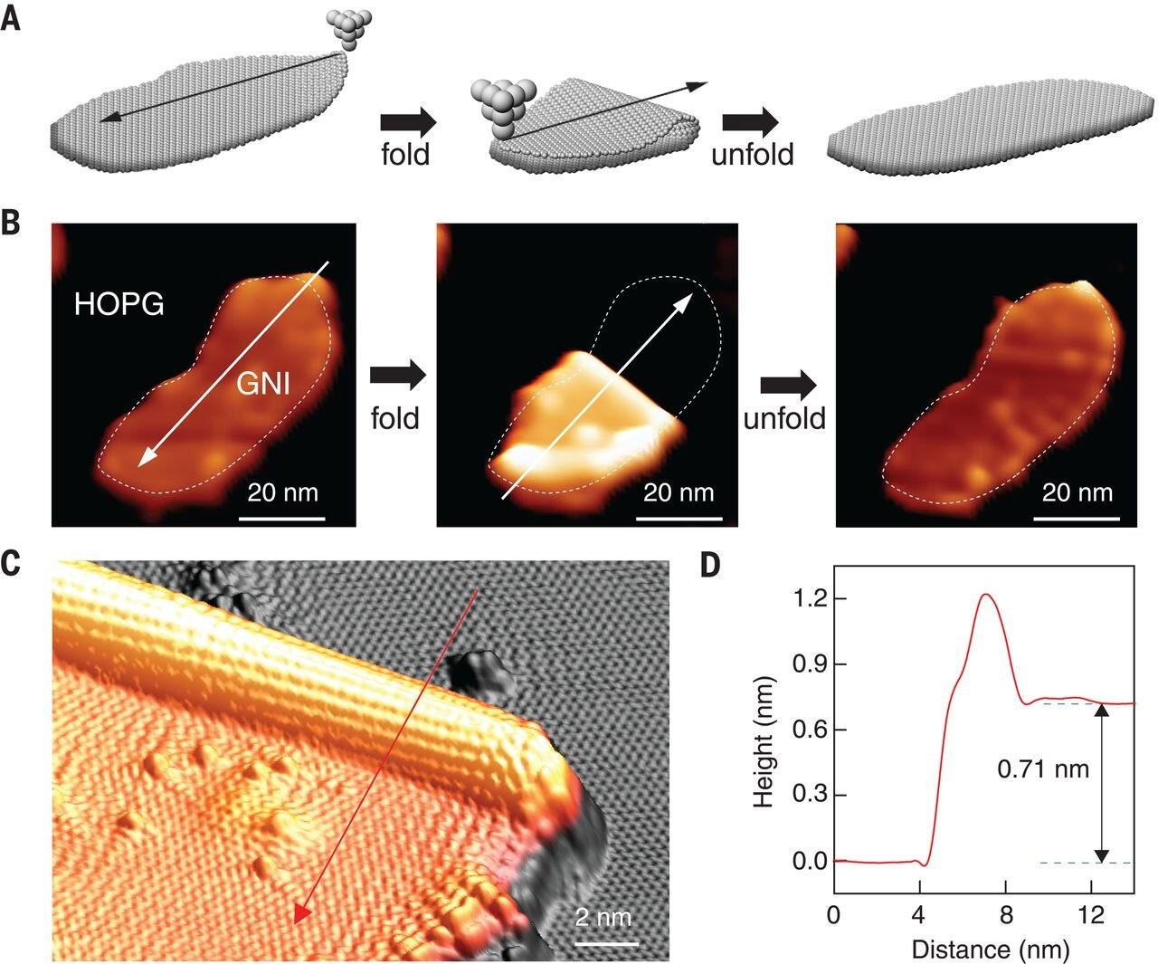
Scanning Tunneling Microscopy (STM)
Modes of Operation:
Constant Height Mode: the tip stays at a fixed distance above the surface, and as it scans, changes in tunneling current create a topographic image of the surface
Constant Current Mode: adjustments to the tip-sample distance maintain a constant tunneling current; this mode provides information about the sample's electronic properties
Applications:
STM is used to image atomic structures, molecules, and defects on surfaces
It helps study processes like adsorption, desorption, and surface diffusion
Also used to investigate electronic properties of materials
Can be used as a nanofabrication tool
Notes:
Construction of atomically well-defined folded GNSs by STM origami. (A) Schematic graphic of folding and unfolding a GNI along an arbitrary direction (black arrows). (B) Experimental realization of (A). The series of STM images shows a sequence of the folding and unfolding of a GNI along the direction indicated by the white arrows. HOPG, highly ordered pyrolytic graphite. (C) 3D STM topography of a typical folded GNS. (D) Line profile along the red arrow in (C) showing the formation of both the 1D tubular edge and the 2D stacked graphene flatland with height comparable to the distance between two graphene layers (0.70 nm). Settings for (B): tunneling current It = 10 pA; bias voltage Vs = −3 V. Settings for (C): It = 100 pA; Vs = 1 V. The GNIs were manipulated by using lateral tip-induced manipulation with a typical current of ~100 pA and a voltage of ~3 mV. All results were acquired at temperature T = 4.2 K. Credit: Science (2019). DOI: 10.1126/science.aax7864

Slide 105
Scanning Tunneling Microscopy (STM)

Slide 106
Scanning Tunneling Microscopy (STM)
Advantages:
Provides high-resolution imaging and precise measurements at the atomic scale
Sensitive to surface features and electronic properties, making it versatile for research
Operates without damaging the sample surface, allowing for repeated measurements and analysis of dynamic processes
Limitations:
Works only with conductive or semi-conductive samples
Sample preparation is crucial, requiring clean surfaces for accurate results
It's sensitive to vibrations and environmental changes, requiring stable conditions for reliable measurements
Imaging can be time-consuming, especially for large-area scans or complex samples, limiting its efficiency for certain applications

Slide 107
Scanning Tunneling Microscopy (STM)
Further Reading:
Chen, C. J. (2008). Introduction to scanning tunneling microscopy. https://www.columbia.edu/~jcc2161/documents/STM_book.pdf
Sharma, K. (2023, May 3). Scanning tunneling microscope (STM): Principle, instrumentation, advantage. https://scienceinfo.com/scanning-tunneling-microscope/
Baker, G., Lantagne-Hurtubise, É., & Can, O. (2016, November 26). Scanning tunneling microscopy. https://phas.ubc.ca/~berciu/TEACHING/PHYS502/PROJECTS/STM16.pdf
Bolotov, L., & Kanayama, T. (2016). Advanced scanning tunneling microscopy for nanoscale analysis of Semiconductor Devices. Microscopy and Analysis. https://doi.org/10.5772/62552
Marti, O., Colchero, J., Bielefeldt, H., Hipp, M., & Linder, A. (1993). Scanning probe microscopy: Applications in biology and physics. Microscopy Microanalysis Microstructures, 4(5), 429–440. https://doi.org/10.1051/mmm:0199300405042900

Slide 108
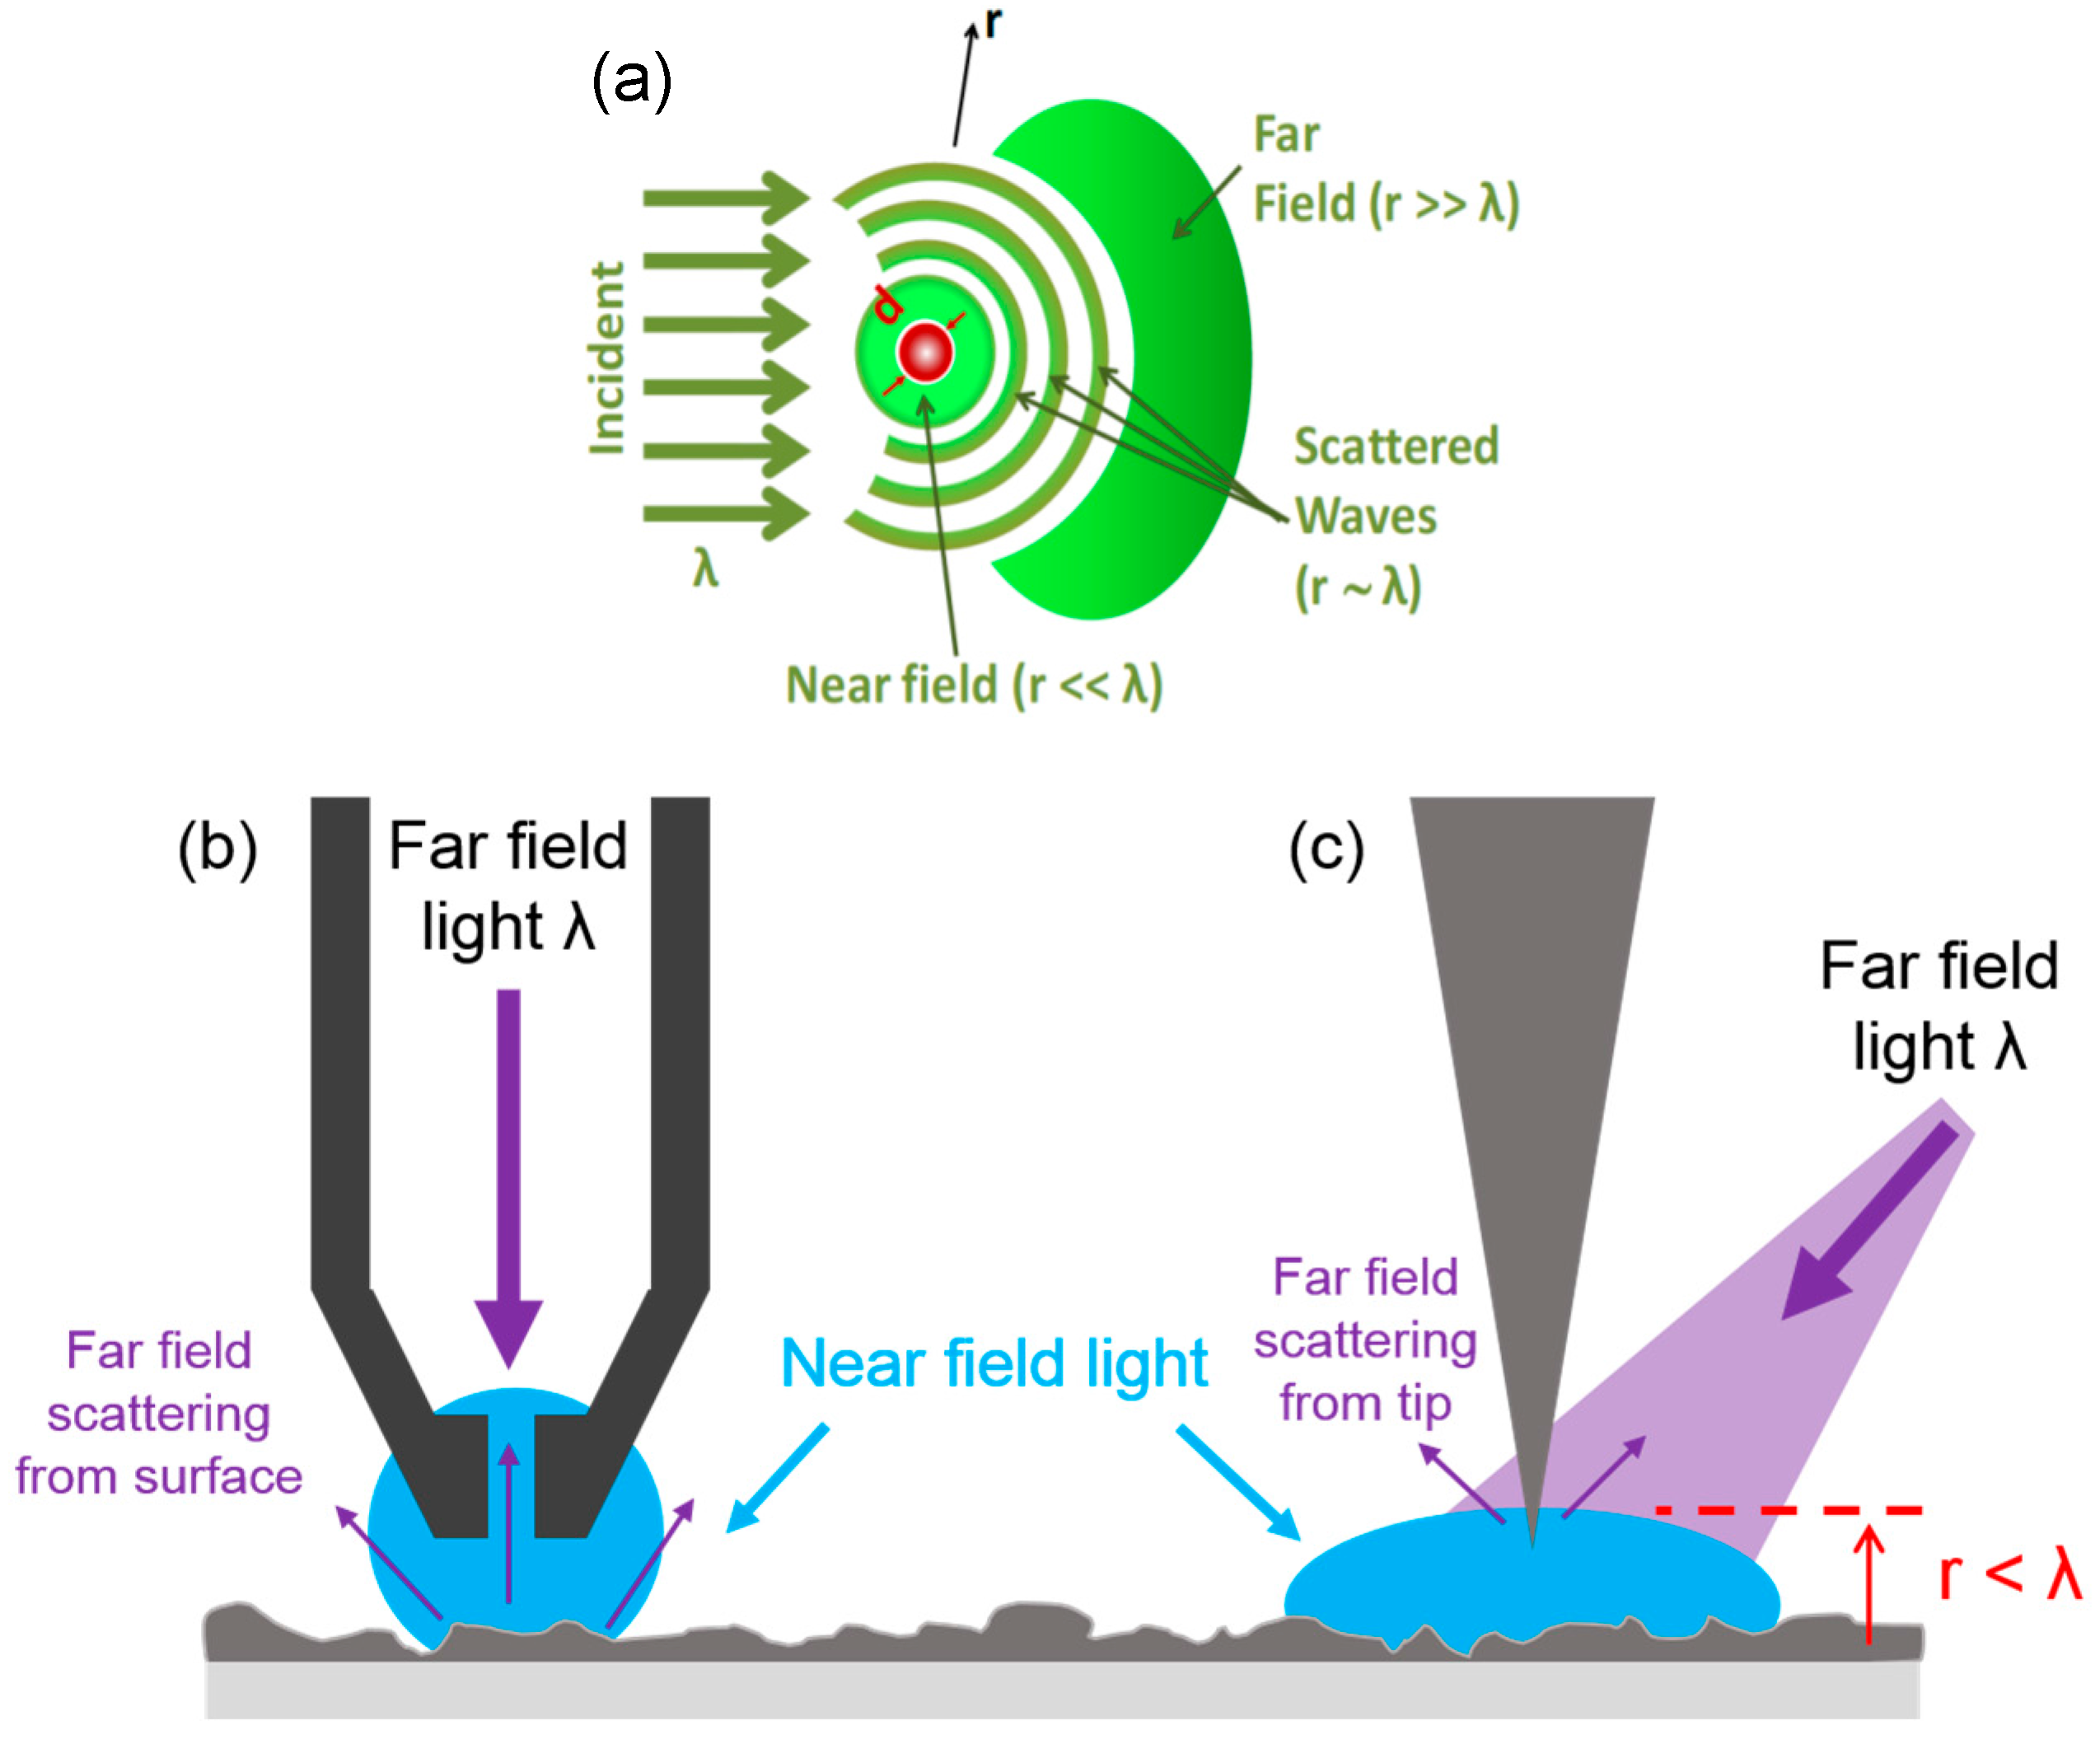
Scanning Near-Field Optical Microscopy (SNOM)
Overview:
SNOM is a technique used for optical imaging and spectroscopy at the nanoscale
It enables imaging and manipulation of optical fields with spatial resolution beyond the diffraction limit
Principle of Operation:
SNOM operates based on the principle of near-field optics, where light is confined and manipulated at nanometer-scale distances from the sample surface
A sharp tip, typically coated with a metal film, is brought into proximity with the sample surface
Light is coupled into or out of the tip-sample region, creating an optical near-field
Interaction between the near-field and the sample surface provides information about the sample's optical properties with high spatial resolution

Slide 109
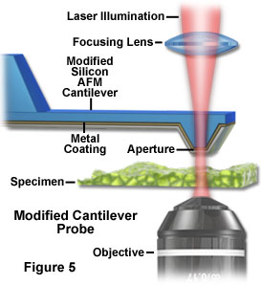
Scanning Near-Field Optical Microscopy (SNOM)
Modes of Operation:
Transmission Mode:
Light is transmitted through the sample, and the near-field interaction is detected either in transmission or reflection
Useful for imaging and spectroscopy of thin samples or surfaces
Reflection Mode:
Light is directed onto the sample surface, and the near-field interaction is detected in the reflected light
Suitable for imaging and characterization of opaque samples or surfaces
Applications:
Imaging of nanostructures, surfaces, and devices with optical resolution beyond the diffraction limit
Study of plasmonic phenomena, optical waveguiding, and photonic devices at the nanoscale
Investigation of optical properties of materials, including fluorescence, luminescence, and Raman scattering

Slide 110
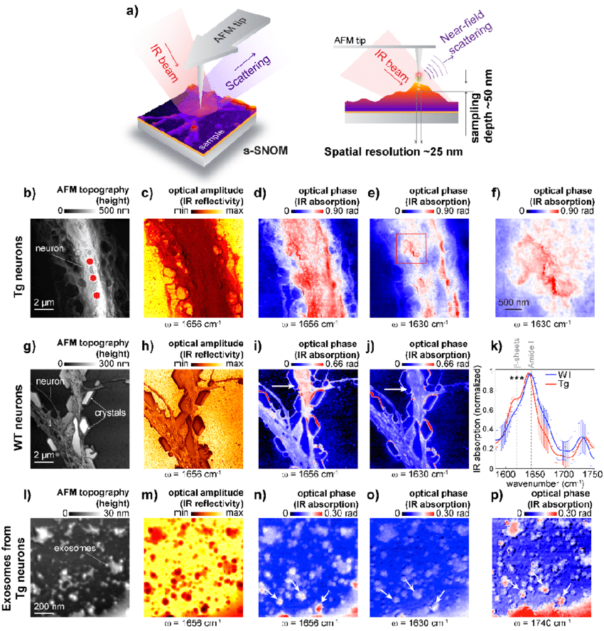
Scanning Near-Field Optical Microscopy (SNOM)
Advantages:
Provides optical imaging and spectroscopy with nanometer-scale resolution
Enables characterization of optical properties of materials at the nanoscale
Compatible with a wide range of samples, including opaque and transparent materials
Limitations:
Complex experimental setup and operation
Limited to imaging and characterization of surfaces or thin samples
Sensitivity to environmental factors such as temperature and vibrations may affect measurements
Achieving high signal-to-noise ratio in SNOM measurements can be challenging, particularly when studying weak optical signals or low-concentration samples

Slide 111
Scanning Near-Field Optical Microscopy (SNOM)
Further Reading:
Cummings, J. R., Fellers, T. J., & Davidson, M. W. (n.d.). Near-Field Scanning Optical Microscopy - Introduction. Near-Field Scanning Optical Microscopy - Introduction | Olympus LS. https://www.olympus-lifescience.com/en/microscope-resource/primer/techniques/nearfield/nearfieldintro/
Vobornik, D., & Vobornik, S. (2008). Scanning near-field optical microscopy. Bosnian Journal of Basic Medical Sciences, 8(1), 63–71. https://doi.org/10.17305/bjbms.2008.3000
Sobat, Z., & Sadegh Hassani, S. (2014). An overview of scanning near-field optical microscopy in characterization of nano-materials. http://jointlab.upol.cz/soubusta/NNE/Prednasky/45/An%20overview%20of%20scanning%20near-field%20optical%20microscopy.pdf
Schuck, P. J., Weber‐Bargioni, A., Ashby, P. D., Ogletree, D. F., Schwartzberg, A., & Cabrini, S. (2013). Life beyond diffraction: Opening new routes to materials characterization with next‐generation optical near‐field approaches. Advanced Functional Materials, 23(20), 2539–2553. https://doi.org/10.1002/adfm.201203432
Reineck, P., & Gibson, B. C. (2016). Near‐infrared fluorescent nanomaterials for bioimaging and sensing. Advanced Optical Materials, 5(2). https://doi.org/10.1002/adom.201600446

Slide 112
Technique Classification I – By Type
Scanning Electron Microscopy (SEM)
Ultra High Vacuum (UHV) Spectroscopy
In-Situ SEM Material Testing
X-ray Photoelectron Spectroscopy
Classic SEM
Auger Electron Spectroscopy
Energy Dispersive X-Ray Spectroscopy
Time-of Flight
Secondary Ion Mass Spectrometry
Scanning/Transmission Electron Microscopy
Ultraviolet Photoelectron Spectroscopy
Scanning Probe Microscopy (SPM)
Light Spectroscopy
Atomic Force Microscopy
UV-vis Spectroscopy
FTIR Spectroscopy
Scanning Near-Field Optical Microscopy
Infrared and Near-Infrared Spectroscopy
Force-distance Curve Measurements
Scanning Tunneling Microscopy
Raman Spectroscopy
Kelvin Probe Force Microscopy
Photoluminescence Spectroscopy

Slide 113
Light Spectroscopy
Light spectroscopy analyzes matter's interaction with electromagnetic radiation across wavelengths, revealing properties and behavior
Techniques include absorption, emission, and scattering spectroscopy, which provide insights into molecular structure, composition, and interactions
Widely used in chemistry, physics, astronomy, and medicine, spectroscopy aids in compound identification, reaction kinetics, celestial object analysis, and medical diagnostics
Modern spectroscopic instruments, like spectrometers and spectrographs, offer precise measurement and analysis, advancing our understanding of the natural world

Slide 114
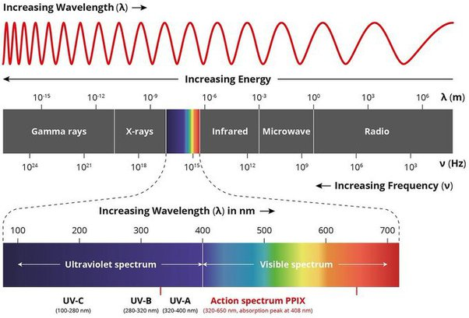
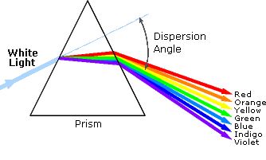
UV-vis Spectroscopy
Overview:
UV-vis spectroscopy involves measuring the absorption of ultraviolet and visible light by molecules in a sample
It provides information about the electronic transitions and energy levels of molecules, aiding in the characterization of chemical composition and structure
Principle of Operation:
UV-vis spectroscopy measures the absorption of ultraviolet and visible light (200-800 nm) by molecules in a sample
It relies on the principle that molecules absorb specific wavelengths of light corresponding to electronic transitions
The amount of light absorbed at each wavelength provides information about the concentration and chemical structure of the molecules in the sample

Slide 115
UV-vis Spectroscopy
Modes of Operation:
Absorption Mode:
Measures the absorbance of light by the sample across a range of wavelengths
Provides information about the absorption spectrum, revealing the presence and concentration of absorbing species
Transmittance Mode:
Measures the amount of light transmitted through the sample at each wavelength
Used for quantitative analysis and determining the optical properties of materials

Slide 116
UV-vis Spectroscopy

Slide 117
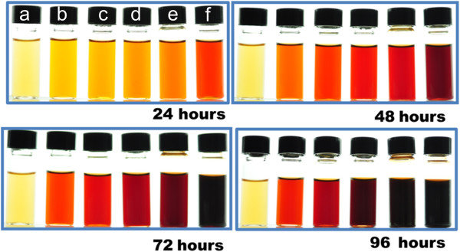
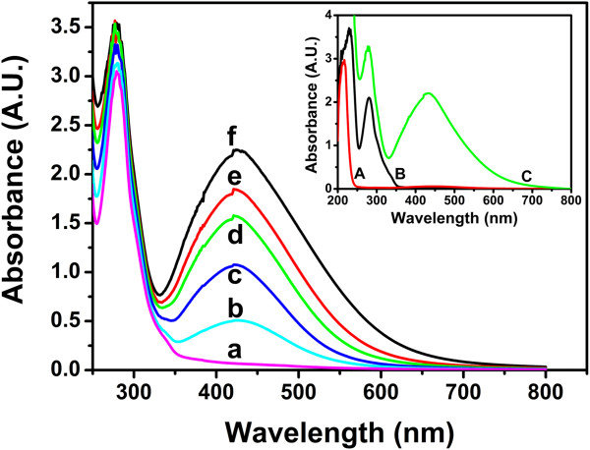
UV-vis Spectroscopy
Applications:
Quantitative analysis of compounds in solution, including drugs, proteins, and environmental pollutants
Qualitative analysis of chemical composition, identification of functional groups, and monitoring of chemical reactions
Characterization of electronic transitions, energy levels, and stability of materials in materials science and semiconductor research

Slide 118
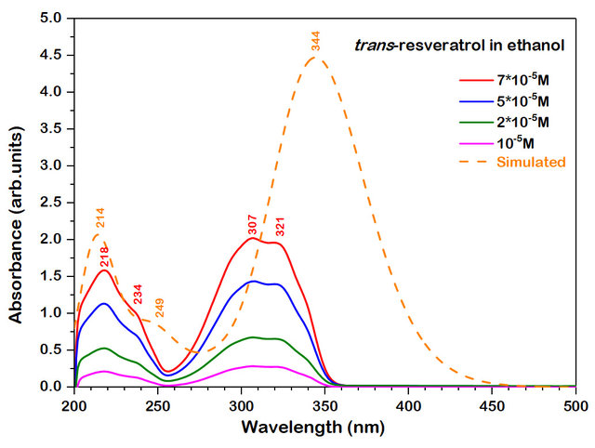
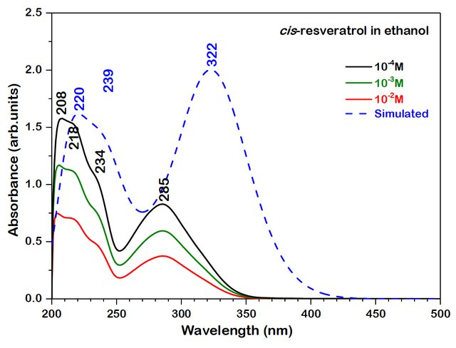
UV-vis Spectroscopy
Advantages:
Non-destructive and rapid technique for analyzing samples in solution or as solids
Wide range of applications in chemistry, biology, environmental science, and materials research
Simple and cost-effective instrumentation with high sensitivity and reproducibility
Limitations:
Limited information about molecular structure and interactions compared to other spectroscopic techniques
Vulnerable to interference from impurities, solvent effects, and scattering
Limited sensitivity for detecting low concentrations and weakly absorbing species

Slide 119
UV-vis Spectroscopy
Further Reading:
Agilent. (2021). The basics of UV-VIS spectroscopy - A Primer. https://www.agilent.com/cs/library/primers/public/primer-uv-vis-basics-5980-1397en-agilent.pdf
Reusch, W. (n.d.). Visible and Ultraviolet Spectroscopy. https://www2.chemistry.msu.edu/faculty/reusch/virttxtjml/spectrpy/uv-vis/spectrum.htm
Libretexts. (2022b, October 4). Introduction to UV spectroscopy. Chemistry LibreTexts. Link.
Jain, N. (2021, October 27). UV-vis spectroscopy: A step in the light direction. ICJS. https://icjs.us/uv-vis-spectroscopy-a-step-in-the-light-direction/
Wonorahardjo, S. (2019). Spectroscopy for characterization and application of silica-cellulose biomaterials, a brief review article about Analytical Methods. IOP Conference Series: Materials Science and Engineering, 515, 012102. https://doi.org/10.1088/1757-899x/515/1/012102
Tissue, B. M. (2012). Ultraviolet and visible absorption spectroscopy. Characterization of Materials, 1–13. https://doi.org/10.1002/0471266965.com059.pub2

Slide 120
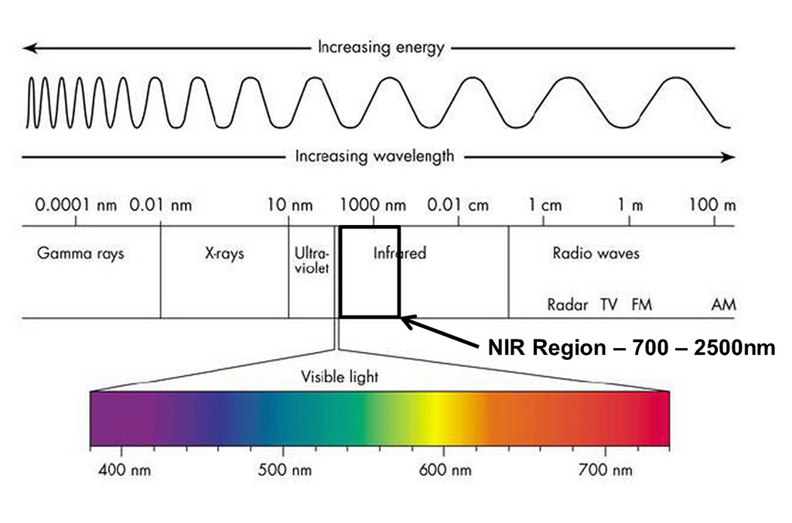
Near-Infrared (NIR) Spectroscopy
Overview:
NIR spectroscopy is a non-destructive analytical technique used to analyze the molecular composition of materials by measuring the absorption of near-infrared light
Principle of Operation:
Near-infrared light in the wavelength range of approximately 700 to 2500 nanometers is passed through a sample
The sample absorbs certain wavelengths of NIR light, resulting in characteristic absorption spectra that reveal information about the molecular structure and composition of the sample

Slide 121
Near-Infrared (NIR) Spectroscopy

Slide 122
Near-Infrared (NIR) Spectroscopy
Modes of Operation:
Transmission Mode: NIR light is transmitted through the sample, and the absorbance spectrum is measured on the opposite side
Reflectance Mode: NIR light is reflected off the sample surface, and the reflectance spectrum is measured, often used for analyzing solid samples without the need for sample preparation
Applications:
Analysis of chemical composition, including quantification of major and minor constituents in various industries such as pharmaceuticals, agriculture, food and beverage, and environmental monitoring
Quality control and process monitoring in manufacturing processes, such as pharmaceutical tablet formulation, agricultural product grading, and food authentication
Research and development of new materials, formulations, and processes requiring rapid and non-destructive chemical analysis

Slide 123
Near-Infrared (NIR) Spectroscopy
Advantages:
Non-destructive technique suitable for analyzing samples in their native state without the need for extensive sample preparation
Rapid analysis with high throughput capabilities, enabling real-time monitoring and process control in industrial applications
Wide applicability to a diverse range of sample types, including liquids, solids, and powders, providing versatility in analytical tasks
Limitations:
Limited sensitivity to certain functional groups and low-concentration analytes compared to other spectroscopic techniques like infrared spectroscopy
Overlapping absorbance bands and spectral interferences may complicate data interpretation and require advanced chemometric methods for analysis
Susceptibility to sample heterogeneity and variations in sample properties, which may affect measurement reproducibility and accuracy

Slide 124
Near-Infrared (NIR) Spectroscopy
Further Reading:
Pasquini, C. (2003). Near infrared spectroscopy: Fundamentals, practical aspects and analytical applications. Journal of the Brazilian Chemical Society, 14(2), 198–219. https://doi.org/10.1590/s0103-50532003000200006
AZo Materials. (2023, May 29). Near infrared spectroscopy (NIRS) - an overview of benefits and applications. https://www.azom.com/article.aspx?ArticleID=20445
HandWiki. (2022, November 15). Near-infrared spectroscopy. https://encyclopedia.pub/entry/34663
Davies, A. M. C. (n.d.). An introduction to near infrared (NIR) spectroscopy. IM Publications Open. https://www.impopen.com/introduction-near-infrared-nir-spectroscopy
Manley, M. (2014). Near-infrared spectroscopy and hyperspectral imaging: Non-destructive analysis of Biological Materials. Chem. Soc. Rev., 43(24), 8200–8214. https://doi.org/10.1039/c4cs00062e
Beć, K. B., Grabska, J., & Huck, C. W. (2020). Near-infrared spectroscopy in bio-applications. Molecules, 25(12), 2948. https://doi.org/10.3390/molecules25122948
Roldán, M., & Kyriacou, P. A. (2021). Near-infrared spectroscopy (NIRS) in traumatic brain injury (TBI). Sensors, 21(5), 1586. https://doi.org/10.3390/s21051586

Slide 125
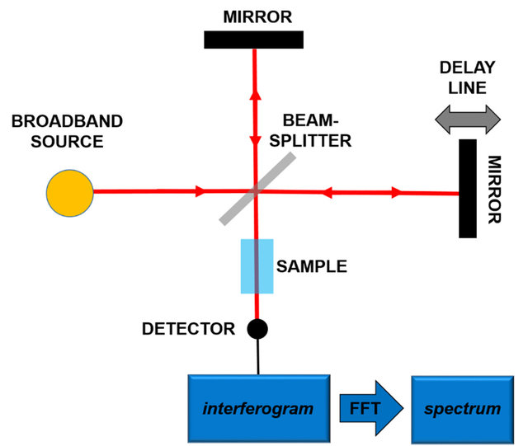
Fourier Transform Infrared (FTIR) Spectroscopy
Overview:
FTIR spectroscopy measures the absorption of infrared light by molecules in a sample
It provides information about molecular vibrations, functional groups, and chemical composition
Principle of Operation:
FTIR spectroscopy operates based on the principle that molecules absorb specific wavelengths of infrared light (2500 – 25000 nm) corresponding to vibrational transitions
The absorption spectrum reflects the molecular structure and chemical bonds present in the sample

Slide 126
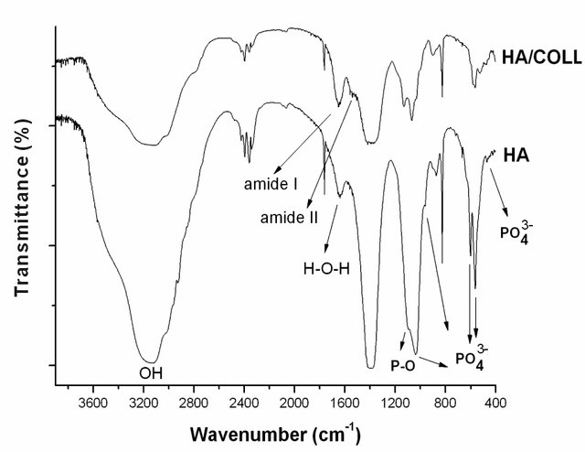
Fourier Transform Infrared (FTIR) Spectroscopy
Modes of Operation:
Transmission Mode
Measures the amount of infrared light transmitted through the sample
Attenuated Total Reflectance (ATR) Mode
Analyzes the infrared light reflected at the sample surface
Reflection Mode
Reflects infrared light off the sample surface for analysis
Applications:
Identification and characterization of organic and inorganic compounds in various matrices, including polymers, pharmaceuticals, and biomolecules
Analysis of chemical composition, structure, and properties of materials in materials science, forensics, and environmental science
Monitoring of chemical reactions, process control, and quality assurance in industrial applications

Slide 127
Fourier Transform Infrared (FTIR) Spectroscopy
Advantages:
Non-destructive and rapid analysis of samples with minimal sample preparation
Wide applicability across diverse fields, including chemistry, biology, pharmaceuticals, and materials science
Provides detailed information about molecular structure, functional groups, and chemical interactions
Limitations:
Limited resolution and specificity for complex mixtures or overlapping bands
Vulnerable to interference from water vapor and atmospheric gases
Requires careful calibration and data analysis to account for baseline drift and spectral artifacts

Slide 128
Fourier Transform Infrared (FTIR) Spectroscopy

Slide 129
Fourier Transform Infrared (FTIR) Spectroscopy
Further Reading:
Thain, S. (2022, August 16). IR spectroscopy and FTIR SPECTROSCOPY: How an FTIR spectrometer works and FTIR analysis. https://www.technologynetworks.com/analysis/articles/ir-spectroscopy-and-ftir-spectroscopy-how-an-ftir-spectrometer-works-and-ftir-analysis-363938
ThermoFisher Scientific. (n.d.). FTIR Spectroscopy Academy. https://www.thermofisher.com/lv/en/home/industrial/spectroscopy-elemental-isotope-analysis/molecular-spectroscopy/fourier-transform-infrared-spectroscopy/resources/ftir-spectroscopy-academy.html
Libretexts. (2023, April 10). How an FTIR Spectrometer operates. Chemistry LibreTexts. Link.
Notingher, I., Jones, J. R., Verrier, S., Bisson, I., Embanga, P., Edwards, P., Polak, J. M., & Hench, L. L. (2003). Application of FTIR and Raman spectroscopy to characterisation of bioactive materials and living cells. Spectroscopy, 17(2–3), 275–288. https://doi.org/10.1155/2003/893584
Kowalczuk, D., & Pitucha, M. (2019). Application of FTIR method for the assessment of immobilization of active substances in the Matrix of Biomedical Materials. Materials, 12(18), 2972. https://doi.org/10.3390/ma12182972
Mester, L., Govyadinov, A. A., Chen, S., Goikoetxea, M., & Hillenbrand, R. (2020). Subsurface Chemical nanoidentification by Nano-FTIR spectroscopy. Nature Communications, 11(1). https://doi.org/10.1038/s41467-020-17034-6

Slide 130
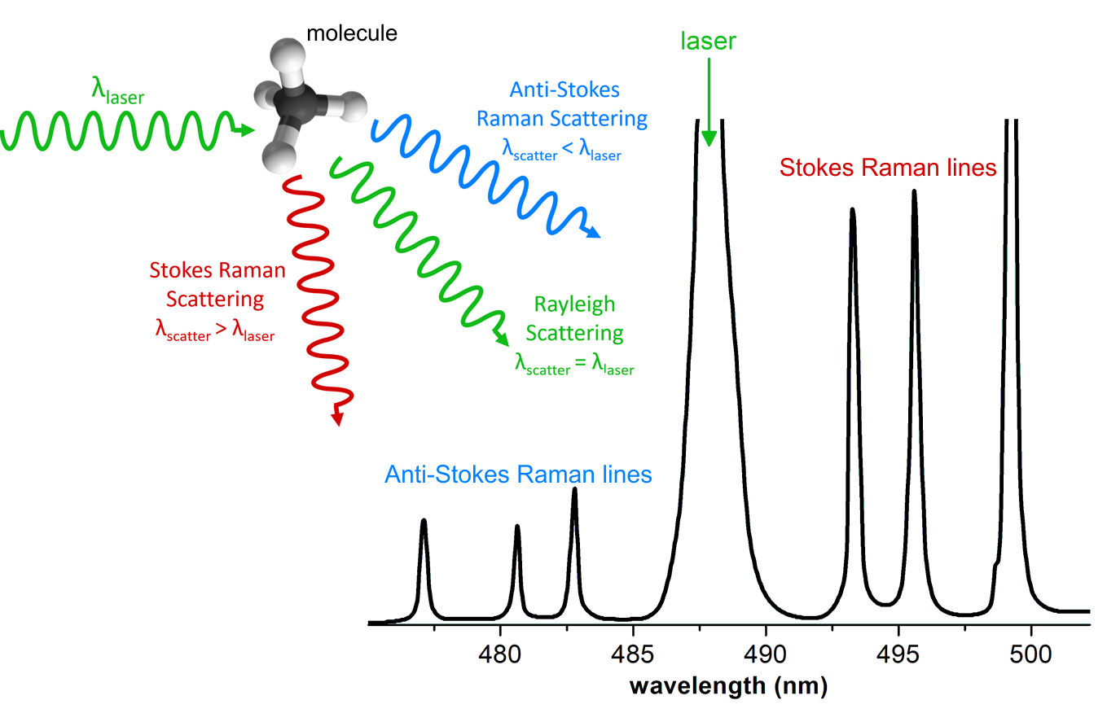
Raman Spectroscopy
Overview:
Raman spectroscopy involves the inelastic scattering of monochromatic light by molecules in a sample
It provides information about molecular vibrations, rotational states, and crystal structures, aiding in material characterization
Principle of Operation:
Raman spectroscopy measures the frequency shift of scattered light caused by molecular vibrations
The energy difference between incident and scattered photons corresponds to the energy of the molecular vibration

Slide 131
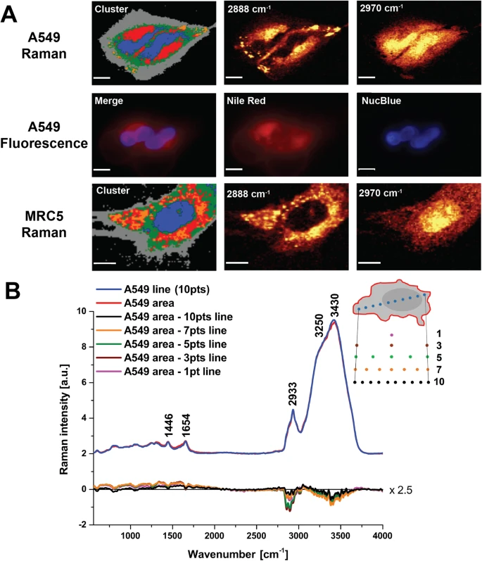
Raman Spectroscopy
Modes of Operation:
Conventional Mode: measures Raman scattering intensity as a function of wavenumber
Micro-Raman Mode: provides spatially resolved analysis of samples at the microscale
Surface-Enhanced Raman Spectroscopy (SERS): amplifies Raman signals using metallic nanostructures
Applications:
Identification and characterization of organic and inorganic compounds in various matrices, including chemicals, pharmaceuticals, and biological samples
Analysis of molecular structure, polymorphism, and crystallography in materials science and pharmaceutical research
Detection and imaging of biomolecules, nanoparticles, and surface coatings in biomedical and nanotechnology applications

Slide 132
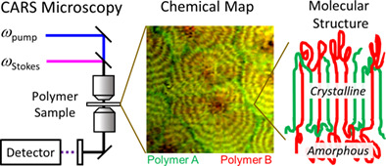
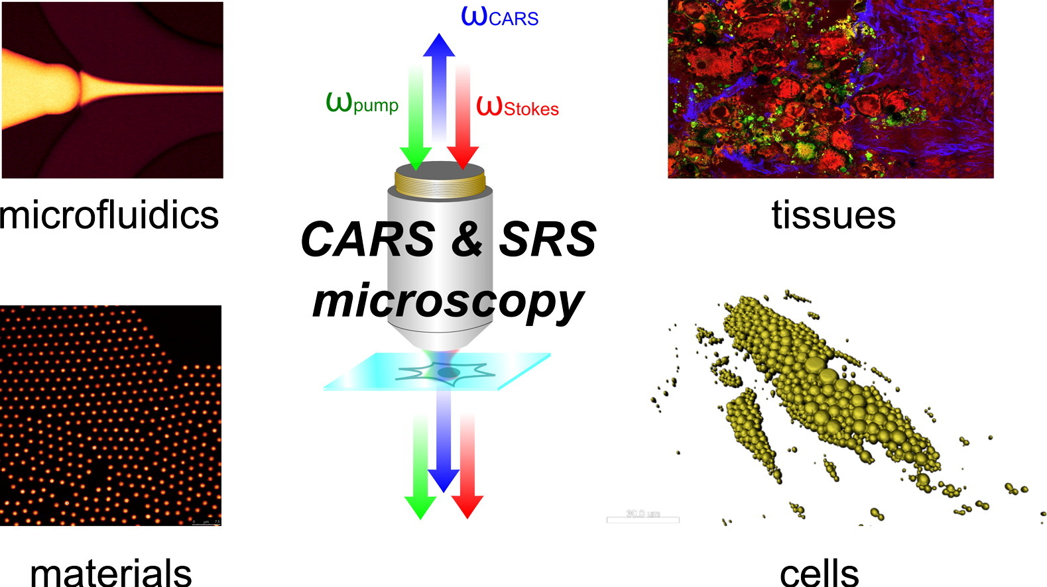
Raman Spectroscopy
Advantages:
Non-destructive and label-free technique for analyzing samples with minimal sample preparation
High sensitivity to molecular vibrations and chemical bonding, providing detailed structural information
Versatile and applicable to a wide range of materials, including solids, liquids, and gases
Limitations:
Fluorescence interference from samples can mask Raman signals, limiting sensitivity and accuracy
Long acquisition times may be required for weak Raman signals, especially for trace analysis
Sample heating and laser-induced damage can occur at high laser powers, affecting sample integrity

Slide 133
Raman Spectroscopy
Further Reading:
AZo Materials. (2021, December 2). Raman knowledge - an introduction to Raman spectroscopy. https://www.azom.com/article.aspx?ArticleID=13372
PerkinElmer, Inc. (2007). Introduction to Raman Spectroscopy: Top 20 Questions Answered. https://resources.perkinelmer.com/corporate/cmsresources/images/46-74565man_raman20questions.pdf
B&W Tek. (2019, March 4). Introduction to Raman spectroscopy. https://bwtek.com/raman-introduction-to-raman-spectroscopy/
Nascimento, G. D. (2018). Raman Spectroscopy. https://doi.org/10.5772/intechopen.68928
Orlando, A., Franceschini, F., Muscas, C., Pidkova, S., Bartoli, M., Rovere, M., & Tagliaferro, A. (2021). A comprehensive review on Raman spectroscopy applications. Chemosensors, 9(9), 262. https://doi.org/10.3390/chemosensors9090262

Slide 134
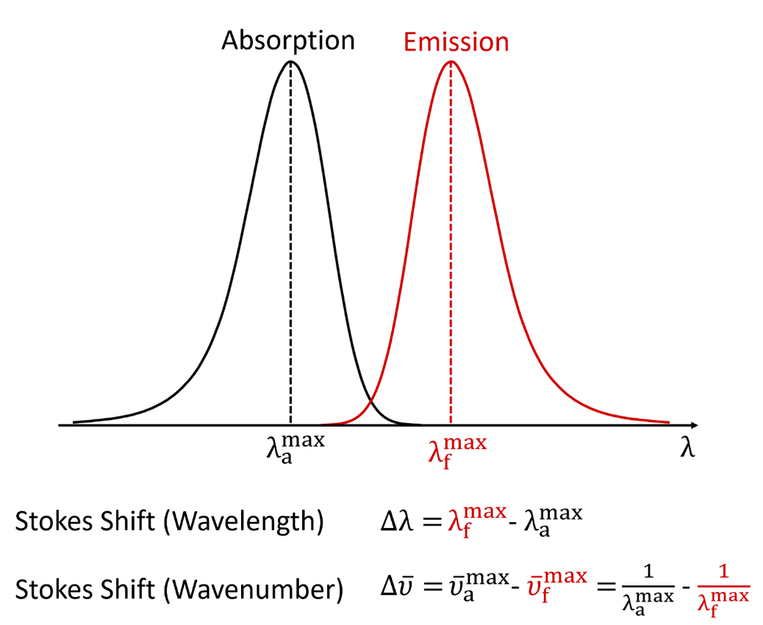
Photoluminescence Spectroscopy
Overview:
Photoluminescence spectroscopy measures the emission of photons (light) from a sample after it has been excited by external light sources
It provides valuable insights into the electronic structure, bandgap, and optical properties of materials
Principle of Operation:
Photoluminescence spectroscopy measures the emission of photons (light) from a sample after it has been excited by external light sources
It provides information about the electronic structure, bandgap, and optical properties of materials

Slide 135
Photoluminescence Spectroscopy
Modes of Operation:
Steady-state Mode: measures the photoluminescence intensity as a function of excitation wavelength or energy
Time-resolved Mode: analyzes the dynamics of photoluminescence emission over time, providing insights into carrier lifetimes and recombination processes
Applications:
Semiconductor characterization, including analysis of bandgap energy, defect states, and carrier dynamics
Study of optoelectronic properties in materials for photovoltaics, light-emitting diodes (LEDs), and lasers
Investigation of luminescent properties in nanomaterials, quantum dots, and fluorescent probes for biological imaging and sensing

Slide 136
Photoluminescence Spectroscopy
Advantages:
Non-destructive and sensitive technique for probing electronic and optical properties of materials
Provides information about band structure, energy levels, and carrier dynamics with high resolution
Suitable for analyzing a wide range of materials, including semiconductors, polymers, and nanomaterials
Limitations:
Limited depth penetration, primarily probing the surface or near-surface regions of the sample
Vulnerable to interference from background noise, scattering, and sample impurities
Requires careful control of experimental conditions, such as temperature and excitation power, to avoid artifacts

Slide 137
Photoluminescence Spectroscopy
Further Reading:
Libretexts. (2022a, August 28). Photoluminescence, phosphorescence, and fluorescence spectroscopy. Chemistry LibreTexts. https://chem.libretexts.org/Bookshelves/Analytical_Chemistry/Physical_Methods_in_Chemistry_and_Nano_Science_%28Barron%29/04%3A_Chemical_Speciation/4.05%3A_Photoluminescence_Phosphorescence_and_Fluorescence_Spectroscopy
Libretexts. (2020, August 11). Photoluminescence Spectroscopy. Chemistry LibreTexts. https://chem.libretexts.org/Courses/Northeastern_University/10%3A_Spectroscopic_Methods/10.6%3A_Photoluminescence_Spectroscopy
Eaton-Magana, S., & Breeding, C. M. (2016). An introduction to photoluminescence spectroscopy for Diamond and its applications in gemology. Gems &amp; Gemology, 52(1), 2–17. https://doi.org/10.5741/gems.52.1.2
Ibarra-Ruiz, A. M., Rodríguez Burbano, D. C., & Capobianco, J. A. (2016). Photoluminescent nanoplatforms in biomedical applications. Advances in Physics: X, 1(2), 194–225. https://doi.org/10.1080/23746149.2016.1165629

Slide 138
Technique Classification II – By Discipline
Microbiological
Techniques and Equipment
Electrical Measurement
Techniques and Equipment
Confocal Microscopy
Electrochemical Impedance Spectroscopy
Fluorescent Microscopy
Cell Adhesion Assays
Dead/Live Staining
Four-Point Probe Technique
Metabolic Assays
Material Science
Techniques and Equipment
Wettability Measurement
Techniques and Equipment
White Light Interferometry
Contact Angle Measurements
Stylus Profilometry
Tensile Tests
Wilhelmy Plate Method
Nanoindentation
Capillary Rise Method
Pull-off Tests
Ellipsometry
Scratch Tests

Slide 139
Bright-Field Microscopy
Overview:
Bright-field microscopy is a basic optical microscopy technique where specimens are observed under white light illumination
It provides contrast based on the absorption and scattering of light by the specimen, producing a dark image against a bright background
Principle of Operation:
Bright-field microscopy operates by passing light from the illumination source through the specimen
The specimen absorbs or scatters some of the light, resulting in regions of varying intensity that form the image observed through the objective lens

Slide 140
Bright-Field Microscopy
Modes of Operation:
Transmission Mode: light passes through the specimen, and the resulting image is formed by the light that is transmitted through the sample. This mode is commonly used for observing thin, transparent specimens such as stained cells or tissue sections
Reflection Mode: the specimen is illuminated from above, and the image is formed by the light that is reflected off the specimen's surface. This mode is suitable for observing opaque or reflective specimens such as metal surfaces or thick biological samples
Applications:
Observation of stained or unstained biological samples such as cells, tissues, and microorganisms
Examination of fixed or live specimens in various fields including microbiology, histology, and material science
Basic educational and routine laboratory use for specimen visualization and analysis

Slide 141
Bright-Field Microscopy
Advantages:
Simple and easy to use, requiring minimal sample preparation
Wide availability and compatibility with a variety of specimens and staining techniques
Provides good resolution and contrast for observation of cellular morphology and structural details
Limitations:
Limited contrast and sensitivity, particularly for transparent or low-contrast specimens
Cannot distinguish between different cellular components without staining
Prone to artifacts such as glare, halos, and uneven illumination, which may affect image quality

Slide 142
Bright-Field Microscopy
Further Reading:
Schädler, K. (2021, September). An introduction to the light microscope, light microscopy techniques and applications. TechnologyNetworks. https://www.technologynetworks.com/analysis/articles/an-introduction-to-the-light-microscope-light-microscopy-techniques-and-applications-351924
PhDNest. (2021, September 28). Bright field microscope: Definition, parts, diagram, principle, application. PhDNest. https://www.phdnest.com/bright-field-microscope-definition-parts-diagram/
Ingle, R. (2022, October 25). How does bright-field microscopy allow images to be visualized? AZoOptics. https://www.azooptics.com/Article.aspx?ArticleID=2343

Slide 143
Phase Contrast Microscopy
Overview:
Phase contrast microscopy is an optical microscopy technique that enhances the contrast of transparent, unstained specimens by converting phase shifts into intensity differences
It allows for the visualization of transparent specimens, such as living cells, without the need for staining
Principle of Operation:
Phase contrast microscopy operates by introducing a phase shift between direct and diffracted light passing through the specimen
This phase shift is converted into intensity differences by phase contrast optics, resulting in enhanced contrast in the final image

Slide 144
Phase Contrast Microscopy
Modes of Operation:
Standard Phase Contrast
Observes transparent specimens with enhanced contrast under bright-field illumination
Dark-field Phase Contrast
Illuminates the specimen with oblique or annular light to further increase contrast and reveal fine details
Applications:
Live cell imaging and observation of dynamic processes in cell culture, microbiology, and developmental biology
Examination of unstained biological specimens such as cells, tissues, and microorganisms with minimal sample preparation
Education and research in biological sciences, particularly for studying cellular morphology and behavior in vitro

Slide 145
Phase Contrast Microscopy
Advantages:
Enhances contrast and visibility of transparent specimens without the need for staining or labeling
Enables real-time observation of live cells and dynamic biological processes
Compatible with standard bright-field microscopy setups, making it accessible and easy to use
Limitations:
Limited resolution compared to fluorescence microscopy techniques for visualizing specific cellular components or molecules
Prone to optical artifacts such as halos and glare, which may affect image quality and interpretation
Less effective for specimens with thick or uneven regions, where phase contrast may be less pronounced

Slide 146
Phase Contrast Microscopy
Further Reading:
Murphy, D. B., Oldfield, R., Schwartz, S., & Davidson, M. W. (n.d.). Introduction to phase contrast microscopy. Nikon’s MicroscopyU. https://www.microscopyu.com/techniques/phase-contrast/introduction-to-phase-contrast-microscopy
Abramowitz, M., & Davidson, M. W. (n.d.). Introduction to phase contrast. Olympus LS. https://www.olympus-lifescience.com/en/microscope-resource/primer/techniques/phasecontrast/phase/
Teledyne Photometrics. (2020, March 23). It’s not just a phase – learn more about phase-contrast microscopy. https://www.photometrics.com/learn/microscopy-basics/phase-contrast-microscopy
Sanderson, J. B. (2001). Phase contrast microscopy. Encyclopedia of Life Sciences. https://www.researchgate.net/publication/229834793_Phase_Contrast_Microscopy
Zabler, S. (2018). Phase-contrast and dark-field imaging. Journal of Imaging, 4(10), 113. https://doi.org/10.3390/jimaging4100113

Slide 147
Fluorescence Microscopy
Overview:
Fluorescence microscopy is a technique used to visualize fluorescently labeled specimens by exciting them with specific wavelengths of light and capturing emitted fluorescence
It allows for high-resolution imaging of biological samples and fluorescently labeled molecules
Principle of Operation:
Fluorescence microscopy operates by illuminating the sample with light of a specific wavelength, known as the excitation wavelength, which excites fluorescent molecules in the sample
These molecules then emit light at longer wavelengths, known as the emission wavelength, which is captured by the microscope to generate an image

Slide 148
Fluorescence Microscopy
Applications:
Visualization of cellular structures, organelles, and molecular interactions in biology and biomedical research
Tracking and quantification of fluorescently labeled molecules in live cells and tissues
Fluorescence imaging in neuroscience, immunology, oncology, and developmental biology for understanding disease mechanisms and cellular processes

Slide 149
Fluorescence Microscopy
Advantages:
High sensitivity and specificity for detecting fluorescently labeled molecules, even at low concentrations
Compatibility with a wide range of fluorescent dyes and probes for multiplexed imaging of multiple targets
Versatile technique applicable to various sample types, including cells, tissues, and thin sections
Limitations:
Limited resolution compared to techniques such as electron microscopy, particularly in samples with high background fluorescence or autofluorescence
Photobleaching and phototoxicity effects can occur, leading to reduced signal intensity and sample damage during prolonged imaging
Depth penetration is limited in thick samples or tissues due to light scattering and absorption

Slide 150
Fluorescence Microscopy
Further Reading:
Spring, K. R., & Davidson, M. W. (n.d.). Introduction to fluorescence microscopy. Nikon’s MicroscopyU. https://www.microscopyu.com/techniques/fluorescence/introduction-to-fluorescence-microscopy
Chakravarty, P. R. (n.d.). Fluorescence microscopy: A basic introduction. GoldBio. https://goldbio.com/articles/article/fluorescence-microscopy-a-basic-introduction
Sanderson, M. J., Smith, I., Parker, I., & Bootman, M. D. (2014). Fluorescence microscopy. Cold Spring Harbor Protocols, 2014(10). https://doi.org/10.1101/pdb.top071795
Ockenga, W., & DeRose, J. (2011, June 13). An introduction to fluorescence. Science Lab | Leica Microsystems. https://www.leica-microsystems.com/science-lab/life-science/an-introduction-to-fluorescence/
Elson, D., Requejo-Isidro, J., Munro, I., Reavell, F., Siegel, J., Suhling, K., Tadrous, P., Benninger, R., Lanigan, P., McGinty, J., Talbot, C., Treanor, B., Webb, S., Sandison, A., Wallace, A., Davis, D., Lever, J., Neil, M., Phillips, D., … French, P. (2004). Time-domain fluorescence lifetime imaging applied to biological tissue. Photochemical &amp; Photobiological Sciences, 3(8), 795–801. https://www.researchgate.net/publication/8414654_Time-domain_fluorescence_lifetime_imaging_applied_to_biological_tissue
Piwoński, H., Nozue, S., & Habuchi, S. (2022). The pursuit of shortwave infrared-emitting nanoparticles with bright fluorescence through molecular design and excited-state engineering of molecular aggregates. ACS Nanoscience Au, 2(4), 253–283. https://doi.org/10.1021/acsnanoscienceau.1c00038
Pansare, V. J., Hejazi, S., Faenza, W. J., & Prud’homme, R. K. (2012). Review of long-wavelength optical and NIR imaging materials: Contrast Agents, fluorophores, and multifunctional nano carriers. Chemistry of Materials, 24(5), 812–827. https://doi.org/10.1021/cm2028367

Slide 151
Confocal Microscopy
Overview:
Confocal microscopy is an optical imaging technique that uses point illumination and a pinhole aperture to improve image resolution and contrast
It provides three-dimensional imaging of fluorescently labeled specimens with optical sectioning capabilities
Principle of Operation:
Confocal microscopy operates by scanning a focused laser beam across the sample and collecting emitted fluorescence through a pinhole aperture placed in front of the detector
The pinhole eliminates out-of-focus light, resulting in improved optical sectioning and resolution

Slide 152
Confocal Microscopy
Modes of Operation:
Single-point Scanning
Scans a focused laser beam point-by-point across the sample to generate an image
Multipoint Scanning
Simultaneously scans multiple points across the sample to improve imaging speed
Line Scanning
Scans a line across the sample to capture images with faster acquisition times

Slide 153
Confocal Microscopy
Applications:
Visualization of cellular structures, organelles, and molecular interactions in biology and biomedical research
Three-dimensional imaging of live cells and tissues for studying dynamic processes and cellular dynamics
High-resolution imaging of thick samples and tissues with optical sectioning capabilities in neuroscience, developmental biology, and oncology

Slide 154
Confocal Microscopy
Advantages:
Improved resolution and contrast compared to conventional widefield fluorescence microscopy, particularly in thick samples
Optical sectioning capability allows for the reconstruction of three-dimensional structures and elimination of out-of-focus blur
Versatile technique applicable to various sample types, including cells, tissues, and small organisms
Limitations:
Complex instrumentation and image processing techniques may require specialized training for operation and analysis
Reduced penetration depth in thick samples compared to techniques such as two-photon microscopy
Potential photobleaching and phototoxicity effects on samples during prolonged imaging sessions

Slide 155
Confocal Microscopy
Further Reading:
Paddock, S. W., Fellers, T. J., & Davidson, M. W. (n.d.). Introductory confocal concepts. Nikon’s MicroscopyU. https://www.microscopyu.com/techniques/confocal/introductory-confocal-concepts
Fellers, T. J., & Davidson, M. W. (n.d.). Introduction to confocal microscopy. Olympus LS. https://www.olympus-lifescience.com/en/microscope-resource/primer/techniques/confocal/confocalintro/
Ziegler, U., Bittermann, A. G., & Hoechli, M. (n.d.). Introduction to Confocal Laser Scanning Microscopy (Leica). UMass Chan Medical School. https://www.umassmed.edu/globalassets/maps/documents/confocal-explanation.pdf
Teledyne Photometrics. (2021, March 17). Introduction to spinning disk confocal microscopy. https://www.photometrics.com/learn/spinning-disk-confocal-microscopy/introduction-to-spinning-disk-confocal
St. Croix, C. M., Shand, S. H., & Watkins, S. C. (2005). Confocal Microscopy: Comparisons, applications, and Problems. BioTechniques, 39(6S). https://doi.org/10.2144/000112089
Villani, E., Baudouin, C., Efron, N., Hamrah, P., Kojima, T., Patel, S. V., Pflugfelder, S. C., Zhivov, A., & Dogru, M. (2013). In vivo confocal microscopy of the ocular surface: From bench to bedside. Current Eye Research, 39(3), 213–231. https://doi.org/10.3109/02713683.2013.842592
Jenkins, M. C., & Egelhaaf, S. U. (2008). Confocal microscopy of colloidal particles: Towards reliable, optimum coordinates. Advances in Colloid and Interface Science, 136(1–2), 65–92. https://arxiv.org/abs/0709.4052

Slide 156
Two-Photon Microscopy
Overview:
Two-Photon Microscopy is an advanced fluorescence imaging technique that utilizes two-photon excitation to visualize specimens with high spatial resolution and minimal photodamage
It is based on the nonlinear optical process where two photons of lower energy combine to excite a fluorophore
Principle of Operation:
Two-Photon Microscopy operates by focusing pulsed laser light onto the specimen, where two photons simultaneously excite a fluorophore to a higher energy state
The emitted fluorescence is detected and used to construct an image, typically in three dimensions

Slide 157
Two-Photon Microscopy
Modes of Operation:
Point Scanning
Utilizes a focused laser beam to raster scan the specimen point-by-point, generating images with high spatial resolution
Multiphoton Imaging
Allows simultaneous excitation of multiple fluorophores, enabling multicolor imaging and colocalization studies
Applications:
Imaging of thick and scattering specimens such as brain tissue, embryos, and organoids with high penetration depth and reduced photobleaching
Live cell imaging of dynamic processes including neuronal activity, cell migration, and intracellular signaling
Visualization of subcellular structures, organelles, and molecular interactions in biological samples

Slide 158
Two-Photon Microscopy
Advantages:
Enables deep tissue imaging with reduced photodamage and photobleaching compared to conventional fluorescence microscopy techniques
Provides superior optical sectioning and resolution, allowing for clear visualization of structures within thick samples
Compatible with various fluorophores and fluorescent proteins for multicolor imaging and functional studies
Limitations:
Requires specialized equipment including femtosecond pulsed lasers and nonlinear optical components, making it relatively expensive and complex
Steeper learning curve for setup and operation compared to conventional microscopy techniques
Limited availability of commercial fluorophores optimized for two-photon excitation compared to single-photon excitation

Slide 159
Two-Photon Microscopy
Further Reading:
Piston, D. W., Fellers, T. J., & Davidson, M. W. (n.d.). Multiphoton microscopy. Nikon’s MicroscopyU. https://www.microscopyu.com/techniques/multi-photon/multiphoton-microscopy
Surat, P. (2021, February 1). Two-photon microscopy principles and methodology. AZoLifeSciences. https://www.azolifesciences.com/article/Two-photon-Microscopy-Principles-and-Methodology.aspx
Teledyne Photometrics. (2021b, June 1). Two-Photon Microscopy. https://www.photometrics.com/learn/physics-and-biophysics/two-photon
Svoboda, K., & Yasuda, R. (2006). Principles of two-photon excitation microscopy and its applications to neuroscience. Neuron, 50(6), 823–839. https://doi.org/10.1016/j.neuron.2006.05.019
Lim, C. S., & Cho, B. R. (2013). Two-photon probes for biomedical applications. BMB Reports, 46(4), 188–194. https://doi.org/10.5483/bmbrep.2013.46.4.045
Ricard, C., Arroyo, E. D., He, C. X., Portera-Cailliau, C., Lepousez, G., Canepari, M., & Fiole, D. (2018). Two-photon probes for in vivo multicolor microscopy of the structure and signals of brain cells. Brain Structure and Function, 223(7), 3011–3043. https://doi.org/10.1007/s00429-018-1678-1

Slide 160
Dead/Live Staining
Overview:
Dead/live staining is a technique used to distinguish between viable (live) and non-viable (dead) cells in a sample based on their membrane integrity or metabolic activity
It involves the use of fluorescent dyes or probes that selectively label live and dead cells, allowing for their visualization and quantification under a microscope
Principle of Operation:
Dead/live staining relies on the differential permeability of fluorescent dyes or probes to live and dead cells
Live cells with intact membranes exclude certain dyes, while dead cells with compromised membranes allow dye entry and staining

Slide 161
Dead/Live Staining

Slide 162
Dead/Live Staining
Applications:
Assessment of cell viability and cytotoxicity in cell culture studies, drug screening, and toxicology assays
Identification and quantification of live and dead cells in microbial samples, environmental samples, and food products
Monitoring cell health and viability in biomedical research, tissue engineering, and regenerative medicine

Slide 163
Dead/Live Staining
Advantages:
Provides a rapid and convenient method for distinguishing between live and dead cells in heterogeneous cell populations
Compatible with various fluorescence microscopy and flow cytometry techniques for high-throughput analysis
Allows for real-time monitoring of cell viability and response to experimental treatments
Limitations:
Some dyes may exhibit non-specific staining or interference with cellular functions, leading to false-positive or false-negative results
The staining protocol may require optimization for different cell types and experimental conditions
Limited information about the specific mechanisms of cell death or the functional status of live cells beyond membrane integrity or metabolic activity

Slide 164
Dead/Live Staining
Further Reading:
Ortiz-Mateos, C. (2022, January 3). Introduction to live and dead assays. Araceli Biosciences. https://www.aracelibio.com/articles/introduction-to-live-and-dead-assays/
AAT Bioquest. (n.d.). Live or Dead Cell Viability Assays. https://www.aatbio.com/catalog/live-or-dead-cell-assays
Hu, C., He, S., Lee, Y. J., He, Y., Kong, E. M., Li, H., Anastasio, M. A., & Popescu, G. (2022). Live-dead assay on unlabeled cells using phase imaging with computational specificity. Nature Communications, 13(1). https://doi.org/10.1038/s41467-022-28214-x
Berney, M., Hammes, F., Bosshard, F., Weilenmann, H.-U., & Egli, T. (2007). Assessment and interpretation of bacterial viability by using the live/dead baclight kit in combination with flow cytometry. Applied and Environmental Microbiology, 73(10), 3283–3290. https://doi.org/10.1128/aem.02750-06
Elliott, D. T., & Tang, K. W. (2009). Simple staining method for differentiating live and Dead Marine Zooplankton in field samples. Limnology and Oceanography: Methods, 7(8), 585–594. https://doi.org/10.4319/lom.2009.7.585

Slide 165
Metabolic Assays
Overview:
Metabolic assays are analytical techniques used to measure various metabolic processes within cells or biological samples
They provide insights into cellular metabolism, energy production, and biochemical pathways
Principle of Operation:
Metabolic assays rely on detecting changes in metabolite levels, enzyme activity, or metabolic fluxes in response to experimental conditions or treatments
They utilize specific biochemical reactions, enzyme-substrate interactions, or fluorescent probes to quantify metabolic parameters

Slide 166
Metabolic Assays
Modes of Operation:
Enzyme Activity Assays
Measure the activity of specific enzymes involved in metabolic pathways using colorimetric, fluorometric, or luminescent substrates
Metabolite Assays
Quantify the levels of metabolites such as glucose, lactate, ATP, or NAD(P)H using enzymatic reactions coupled with detection methods
Metabolic Flux Analysis
Track the flow of metabolites through metabolic pathways using isotopic labeling techniques combined with mass spectrometry or nuclear magnetic resonance spectroscopy

Slide 167
Metabolic Assays
Applications:
Assessment of cellular viability, proliferation, and apoptosis in cell culture models and tissue samples
Evaluation of drug efficacy, toxicity, and metabolism in drug discovery and pharmacology studies
Investigation of metabolic dysregulation in disease states such as cancer, diabetes, and metabolic disorders

Slide 168
Metabolic Assays
Advantages:
Provides quantitative measurements of metabolic parameters with high sensitivity and specificity
Enables real-time monitoring of dynamic changes in cellular metabolism under different experimental conditions
Versatile technique applicable to various sample types, including cells, tissues, biofluids, and microbial cultures
Limitations:
Some assays may require specialized equipment, reagents, or expertise for implementation and data analysis
Limited throughput and scalability in high-throughput screening applications compared to other assay formats
Potential interference from endogenous substances or experimental artifacts may affect assay accuracy and reproducibility

Slide 169
Metabolic Assays
Further Reading:
Braissant, O., Astasov-Frauenhoffer, M., Waltimo, T., & Bonkat, G. (2020). A review of methods to determine viability, vitality, and metabolic rates in microbiology. Frontiers in Microbiology, 11. https://doi.org/10.3389/fmicb.2020.547458
Vidugiriene, J. (n.d.). Cellular metabolism assays. Promega. https://www.promega.com/-/media/files/promega-worldwide/europe/promega-benelux/webinars-and-events/discoverglo2018/metabolism-jolanta-vidugiriene.pdf?la=en
Surat , P. (2019, February 26). Cell metabolism assays. News-Medical. https://www.news-medical.net/life-sciences/Cell-Metabolism-Assays.aspx
Prosser, G. A., Larrouy‐Maumus, G., & de Carvalho, L. P. (2014). Metabolomic strategies for the identification of new enzyme functions and metabolic pathways. EMBO Reports, 15(6), 657–669. https://doi.org/10.15252/embr.201338283

Slide 170
Cell Adhesion Assays
Overview:
Cell adhesion assays are experimental techniques used to quantify the attachment of cells to surfaces or other cells
They provide insights into cell-substrate interactions, cell-cell interactions, and the regulation of cell adhesion molecules
Principle of Operation:
Cell adhesion assays typically involve seeding cells onto a substrate or a monolayer of adherent cells and quantifying the extent of cell attachment
They utilize various methods to assess cell adhesion, including microscopy-based imaging, biochemical assays, and biophysical measurements

Slide 171
Cell Adhesion Assays
Modes of Operation:
Microscopy-based Assays
Visualize and quantify adherent cells using bright-field, phase contrast, or fluorescence microscopy
Biochemical Assays
Measure the expression levels or activity of cell adhesion molecules (CAMs) using techniques such as enzyme-linked immunosorbent assay (ELISA) or flow cytometry
Biophysical Assays
Assess cell-substrate interactions and cell mechanical properties using techniques like atomic force microscopy (AFM) or traction force microscopy

Slide 172
Cell Adhesion Assays
Applications:
Study of cell adhesion dynamics, migration, and invasion in cancer biology, immunology, and developmental biology
Evaluation of biomaterial biocompatibility, cell-material interactions, and tissue engineering scaffolds
Screening and characterization of therapeutic agents targeting cell adhesion molecules for drug discovery and development

Slide 173
Cell Adhesion Assays
Advantages:
Provides quantitative measurements of cell adhesion strength, kinetics, and morphology
Versatile technique adaptable to various cell types, substrates, and experimental conditions
Enables the assessment of cell adhesion in real-time or high-throughput formats
Limitations:
Assay complexity and variability may require optimization for different cell types and experimental setups
Limited ability to mimic the complexity of the in vivo microenvironment, including spatial and biochemical cues influencing cell adhesion
Potential artifacts from non-specific interactions, surface modifications, or experimental manipulations may affect assay accuracy and reproducibility

Slide 174
Cell Adhesion Assays
Further Reading:
Khalili, A., & Ahmad, M. (2015). A review of cell adhesion studies for Biomedical and biological applications. International Journal of Molecular Sciences, 16(8), 18149–18184. https://doi.org/10.3390/ijms160818149
Ungai-Salánki, R., Peter, B., Gerecsei, T., Orgovan, N., Horvath, R., & Szabó, B. (2019). A practical review on the measurement tools for cellular adhesion force. Advances in Colloid and Interface Science, 269, 309–333. https://arxiv.org/pdf/1905.12329.pdf
Creative Bioarray. (n.d.). Cell adhesion assays. https://cell.creative-bioarray.com/cell-adhesion-assays.html
Friedrichs, J., Legate, K. R., Schubert, R., Bharadwaj, M., Werner, C., Müller, D. J., & Benoit, M. (2013). A practical guide to quantify cell adhesion using single-cell force spectroscopy. Methods, 60(2), 169–178. https://doi.org/10.1016/j.ymeth.2013.01.006

Slide 175
Technique Classification II – By Discipline
Microbiological
Techniques and Equipment
Electrical Measurement
Techniques and Equipment
Confocal Microscopy
Fluorescent Microscopy
Electrochemical Impedance Spectroscopy
Cell Adhesion Assays
Dead/Live Staining
Four-Point Probe Technique
Metabolic Assays
Material Science
Techniques and Equipment
“Fluid-adjacent”
Techniques and Equipment
White Light Interferometry
Contact Angle Measurements
Stylus Profilometry
Tensile Tests
Wilhelmy Plate Method
Nanoindentation
Capillary Rise Method
Pull-off Tests
Ellipsometry
Scratch Tests
Salt Spray Test (ASTM B117)

Slide 176
Electrochemical Impedance Spectroscopy (EIS)
Overview of Electrochemical Impedance Spectroscopy (EIS):
EIS is an electrochemical technique used to analyze the electrical properties of electrochemical systems over a range of frequencies
It provides information about processes occurring at electrode surfaces, including charge transfer kinetics, double layer capacitance, and mass transport
Principle of Operation:
EIS applies a small amplitude alternating current (AC) signal to the electrochemical system and measures the resulting voltage response
The impedance, which represents the opposition to the flow of AC current, is calculated as the ratio of the applied voltage to the current

Slide 177
Electrochemical Impedance Spectroscopy (EIS)

Slide 178
Electrochemical Impedance Spectroscopy (EIS)
Modes of Operation:
Frequency Sweep:
Sweeps the frequency of the applied AC signal over a defined range to measure impedance as a function of frequency
Potential Step:
Applies a step change in potential and measures the resulting impedance response as a function of time
Applications:
Study of corrosion processes and corrosion protection strategies in materials science and engineering
Characterization of electrochemical reactions, including electrode kinetics and reaction mechanisms in electrocatalysis and fuel cells
Analysis of biological systems, such as biosensors and bioelectrochemical systems, for medical diagnostics and environmental monitoring

Slide 179
Electrochemical Impedance Spectroscopy (EIS)
Advantages:
Provides detailed information about the electrochemical behavior of materials and systems under various conditions
Non-destructive technique that can be applied to both solid-state and liquid-phase electrochemical systems
Enables quantitative analysis of electrochemical processes and parameters, including resistance, capacitance, and charge transfer kinetics
Limitations:
Requires specialized instrumentation and expertise for data acquisition, analysis, and interpretation
Complex impedance spectra may be difficult to interpret, particularly for systems with multiple electrochemical processes
Limited to steady-state conditions and may not capture transient or non-linear behavior in dynamic systems

Slide 180
Electrochemical Impedance Spectroscopy (EIS)
Further Reading:
Lazanas, A. Ch., & Prodromidis, M. I. (2023). Electrochemical impedance spectroscopy─a tutorial. ACS Measurement Science Au, 3(3), 162–193. https://doi.org/10.1021/acsmeasuresciau.2c00070
Gamry Instruments. (n.d.). Basics of electrochemical impedance spectroscopy. Gamry Instruments. https://www.gamry.com/application-notes/EIS/basics-of-electrochemical-impedance-spectroscopy/
Magar, H. S., Hassan, R. Y., & Mulchandani, A. (2021). Electrochemical impedance spectroscopy (EIS): Principles, construction, and Biosensing Applications. Sensors, 21(19), 6578. https://doi.org/10.3390/s21196578
Wang, H., Long, X., Sun, Y., Wang, D., Wang, Z., Meng, H., Jiang, C., Dong, W., & Lu, N. (2022). Electrochemical impedance spectroscopy applied to microbial fuel cells: A Review. Frontiers in Microbiology, 13. https://doi.org/10.3389/fmicb.2022.973501
Magar, H. S., Hassan, R. Y., & Mulchandani, A. (2021a). Electrochemical impedance spectroscopy (EIS): Principles, construction, and Biosensing Applications. Sensors, 21(19), 6578. https://doi.org/10.3390/s21196578

Slide 181
Four-Point Probe Technique
Overview:
The Four-Point Probe Technique is an electrical characterization method used to measure the sheet resistance and conductivity of thin films and semiconductor materials
It involves passing a known current through two outer probes and measuring the voltage drop across two inner probes to determine the resistance
Principle of Operation:
The Four-Point Probe Technique relies on Ohm's Law, which states that the voltage drop across a conductor is directly proportional to the current passing through it and the resistance of the conductor
By using four evenly spaced probes, the technique minimizes errors due to contact resistance and lead wire resistance, providing accurate measurements of the material's resistance

Slide 182
Four-Point Probe Technique
Modes of Operation:
Constant Current Mode: applies a constant current through the outer probes while measuring the voltage drop across the inner probes
Constant Voltage Mode: maintains a constant voltage across the inner probes while measuring the current passing through the outer probes
Applications:
Characterization of thin films and semiconductor materials for quality control and process optimization in semiconductor manufacturing
Determination of sheet resistance and conductivity in photovoltaic devices, flat panel displays, and microelectronics
Measurement of resistivity and carrier concentration in materials research and development

Slide 183
Four-Point Probe Technique
Advantages:
Provides accurate and reliable measurements of sheet resistance with high precision
Minimizes errors associated with contact resistance and lead wire resistance, resulting in more reliable data
Non-destructive and non-invasive technique suitable for both research and production environments
Limitations:
Limited to materials with relatively uniform thickness and homogeneity over the measurement area
Requires careful probe alignment and calibration to ensure accurate and repeatable measurements
May not be suitable for highly resistive or highly conductive materials where the measurement range of the instrument is exceeded

Slide 184
Four-Point Probe Technique
Further Reading:
Miccoli, I., Edler, F., Pfnür, H., & Tegenkamp, C. (2015). The 100th anniversary of the four-point probe technique: The role of probe geometries in isotropic and anisotropic systems. Journal of Physics: Condensed Matter, 27(22), 223201. https://doi.org/10.1088/0953-8984/27/22/223201
Waremra, R. S., & Betaubun, P. (2018). Analysis of electrical properties using the four-point probe method. E3S Web of Conferences, 73, 13019. https://doi.org/10.1051/e3sconf/20187313019
Kikken, S. P. (2018, July). Measuring film resistivity understanding and refining the four-point probe set-up. Eindhoven University of Technology. https://pure.tue.nl/ws/portalfiles/portal/148467863/Kikken_BEP_verslag.pdf

Slide 185
Technique Classification II – By Discipline
Microbiological
Techniques and Equipment
Electrical Measurement
Techniques and Equipment
Confocal Microscopy
Fluorescent Microscopy
Electrochemical Impedance Spectroscopy
Cell Adhesion Assays
Dead/Live Staining
Four-Point Probe Technique
Metabolic Assays
Material Science
Techniques and Equipment
Wettability Measurement
Techniques and Equipment
White Light Interferometry
Contact Angle Measurements
Stylus Profilometry
Tensile Tests
Wilhelmy Plate Method
Nanoindentation
Capillary Rise Method
Pull-off Tests
Ellipsometry
Scratch Tests

Slide 186
White Light Interferometry (WLI)
Overview:
White Light Interferometry (WLI) is an optical surface metrology technique used to measure the surface profile and roughness of materials with high precision
It utilizes interference patterns generated by the interference of white light reflected from the sample surface and a reference surface
Principle of Operation:
WLI operates based on the principle of optical interference, where light waves combine to create interference patterns that reveal information about the surface topography
White light is split into two beams, with one directed towards the sample surface and the other towards a reference surface. The reflected light from both surfaces is combined to create interference fringes

Slide 187
White Light Interferometry (WLI)
Modes of Operation:
Height Mode: measures the height variations of the sample surface relative to a reference plane, providing detailed information about surface roughness, step heights, and surface features
Phase Mode: utilizes phase-shifting techniques to extract additional information about surface properties such as surface profile, film thickness, and surface morphology
Applications:
Surface roughness measurement and characterization in manufacturing processes such as semiconductor fabrication, optics, and precision engineering
Inspection of microelectronic devices, MEMS/NEMS devices, and optical components for defects, surface quality, and dimensional analysis
Analysis of biological samples, MEMS devices, and thin films in research and development applications

Slide 188
White Light Interferometry (WLI)
Advantages:
Provides high-resolution, non-contact surface metrology with sub-nanometer vertical resolution and sub-micrometer lateral resolution
Capable of measuring transparent, reflective, and rough surfaces with complex geometries and features
Enables fast and accurate surface profiling and roughness measurements without the need for sample preparation or contact probes
Limitations:
Sensitive to environmental vibrations, temperature fluctuations, and optical noise, which may affect measurement accuracy and repeatability
Limited depth of field and working distance compared to other surface metrology techniques, making it less suitable for large-scale or three-dimensional objects
High initial cost and complexity of instrumentation may be prohibitive for some applications and users

Slide 189
White Light Interferometry (WLI)
Further Reading:
Wyant, J. C. (n.d.). White Light Interferometry. University of Arizona Optics Science Center. https://wp.optics.arizona.edu/jcwyant/wp-content/uploads/sites/13/2016/08/WhiteLightInterferometry.pdf
Pavliček, P., & Mikeska, E. (2020). White-Light Interferometer Without Mechanical Scanning. Optics and Lasers in Engineering, 124, 105800. https://doi.org/10.1016/j.optlaseng.2019.105800
Butterfly, B. (2023, August 31). White Light Interferometry: A comprehensive guide. FindLight Blog. https://www.findlight.net/blog/white-light-interferometry-a-comprehnsive-guide/
Paschotta, R. (2005). White Light Interferometers - an encyclopedia article. RP Photonics Encyclopedia. https://doi.org/10.61835/vv2

Slide 190
Ellipsometry
Overview:
Ellipsometry is a non-destructive optical technique used to measure the thickness, refractive index, and optical properties of thin films and surfaces
It relies on the analysis of changes in polarization state as light interacts with a sample surface
Principle of Operation:
Ellipsometry measures changes in the polarization state of light upon reflection from a sample surface
By analyzing the change in amplitude ratio and phase difference between polarized light components, ellipsometry provides information about the optical properties of the sample

Slide 191
Ellipsometry
Modes of Operation:
Spectroscopic Ellipsometry: measures the change in polarization state over a range of wavelengths, providing detailed information about the optical properties of materials
Variable Angle Ellipsometry: measures the change in polarization state at different incident angles, enabling analysis of thin film thickness and optical constants
Applications:
Thin film characterization in semiconductor fabrication, photovoltaics, and optical coatings
Surface functionalization and biomolecular interaction studies in biochemistry and biophysics
Quality control and process optimization in materials science, nanotechnology, and thin film deposition

Slide 192
Ellipsometry
Advantages:
High sensitivity and precision in measuring thin film thickness and optical properties
Non-destructive and non-contact technique suitable for analyzing delicate or sensitive samples
Versatility in analyzing a wide range of materials, including transparent, opaque, and patterned surfaces
Limitations:
Requires knowledge of optical constants and sophisticated modeling algorithms for accurate data interpretation
Limited to optically smooth surfaces and thin films with thicknesses within the measurement range of the instrument
Sensitivity to surface roughness, morphology, and sample alignment may affect measurement accuracy

Slide 193
Ellipsometry
Further reading:
Azzam, R. M. (1996). Ellipsometry for the characterization of optical coatings. The Review of Laser Engineering, 24(2), 209–219. https://www.jstage.jst.go.jp/article/lsj1973/24/2/24_2_209/_pdf
Garcia-Caurel, E., De Martino, A., Gaston, J.-P., & Yan, L. (2013). Application of spectroscopic ellipsometry and Mueller ellipsometry to optical characterization. Applied Spectroscopy, 67(1), 1–21. https://doi.org/10.1366/12-06883
AZoOptics. (2023b, July 24). What is spectroscopic ellipsometry and why is it useful? https://www.azooptics.com/Article.aspx?ArticleID=1918
Quantum Design,Inc. (n.d.). Short introduction: Ellipsometry. Quantum Design. https://qd-europe.com/at/en/product/short-introduction-ellipsometry/
Pedersen, K., Jung, J., Bork, J., Holmgaard, T., & Kortbek, N. A. (n.d.). Ellipsometry. AALBORG UNIVERSITY Institute of Physics and Nanotechnology. http://homes.nano.aau.dk/kp/Ellipsometry/main.pdf

Slide 194
Stylus Profilometry
Overview:
Stylus Profilometry is a surface metrology technique used to measure surface topography and roughness by scanning a stylus probe across a sample surface
Principle of Operation:
A stylus probe with a sharp tip is brought into contact with the sample surface and moved laterally across it
Vertical movement of the stylus in response to surface variations is converted into electrical signals, which are then processed to reconstruct the surface profile

Slide 195
Stylus Profilometry
Modes of Operation:
Contact Mode
The stylus probe maintains constant contact with the sample surface during scanning, providing high-resolution measurements of surface features
Non-contact Mode
The stylus probe approaches the surface without physical contact, allowing for gentle surface profiling without risk of damaging delicate samples
Applications:
Surface roughness measurement and characterization in materials science, engineering, and manufacturing processes
Quality control and inspection of machined components, precision optics, semiconductor wafers, and thin films
Analysis of surface wear, corrosion, and degradation in tribology, coatings, and surface treatments

Slide 196
Stylus Profilometry
Advantages:
Provides accurate and repeatable measurements of surface topography with sub-nanometer vertical resolution and sub-micrometer lateral resolution
Versatile technique applicable to a wide range of materials and surface geometries, including flat, curved, and rough surfaces
Compatible with various sample sizes and shapes, from microscale features to macroscopic components
Limitations:
Limited to measuring surface features within the reach of the stylus probe, typically up to a few millimeters in depth
Susceptible to tip wear and contamination, which may affect measurement accuracy and introduce artifacts
Relatively slow scanning speed compared to some other surface metrology techniques, making it less suitable for large-area mapping or high-throughput applications

Slide 197
Stylus Profilometry
Further Reading:
Keyence. (n.d.). Contact-type surface roughness/profile measuring instruments. https://www.keyence.eu/ss/products/microscope/roughness/equipment/line_01.jsp
Mahadeshwara, M. R. (2018, May 21). Stylus profilometer. TriboNet. https://www.tribonet.org/wiki/stylus-profilometera-stylus-profilometer-is-a-contact-based-profilometer-that-brings-its-stylus-tip-into-direct-contact-with-the-measuring-surface-and-traces-the-desired-path-to-determine-the-topograp/
Adamczak, S., Świdersk, J., Krzysztof, S., Dobrowolski, T., & Chmielik, I. P. (2015, September). COMPARATIVE ANALYSIS OF SURFACE ROUGHNESS MEASUREMENTS OBTAINED WITH THE USE OF CONTACT STYLUS PROFILOMETRY AND COHERENCE SCANNING INTERFEROMETRY. XXI IMEKO World Congress. https://www.imeko.org/publications/wc-2015/IMEKO-WC-2015-TC14-316.pdf
Conroy, M., & Armstrong, J. (2005). A comparison of surface metrology techniques. Journal of Physics: Conference Series, 13, 458–465. https://doi.org/10.1088/1742-6596/13/1/106
Leach, R., & Hart, A. (2002, March). A comparison of stylus and optical methods for measuring 2D surface texture. UK National Physical Laboratory (NPL). https://eprintspublications.npl.co.uk/2209/1/CBTLM15.pdf

Slide 198
Scratch Tests
Overview:
Scratch tests are mechanical tests used to evaluate the adhesion, hardness, and durability of thin films and coatings by applying controlled scratches or abrasions to the surface
Principle of Operation:
A sharp or pointed indenter is used to apply a controlled load or force to the surface, inducing plastic deformation, cracking, or delamination

Slide 199
Scratch Tests
Modes of Operation:
Constant Load Scratch Test
Applies a constant load as the indenter is drawn across the surface, measuring critical loads for different failure modes
Progressive Load Scratch Test
Applies increasing loads to the indenter, assessing the coating's resistance to deformation and failure at higher loads
Applications:
Assessment of coating adhesion and cohesion in industries such as automotive, aerospace, and electronics
Evaluation of surface treatments, protective coatings, and wear-resistant materials
Research and development of new materials and coatings for improved performance and durability

Slide 200
Scratch Tests
Advantages:
Provides quantitative measurements of coating adhesion, hardness, and resistance to wear and abrasion
Versatile technique applicable to a wide range of materials and coatings, including metallic, ceramic, and polymer-based coatings
Enables systematic evaluation of coating performance under controlled conditions, aiding in material selection and process optimization
Limitations:
Interpretation of scratch test results can be complex and influenced by factors such as indenter geometry, scratching speed, and substrate properties
Limited applicability to thin films and coatings with sufficient thickness to withstand scratching without substrate interference
Scratch tests may not fully replicate real-world wear and abrasion conditions, necessitating complementary testing methods for comprehensive material characterization

Slide 201
Scratch Tests
Further Reading:
Brostow, W., Darmarla, G., Howe, J., & Pietkiewicz, D. (2004). Determination of wear of surfaces by scratch testing. E-Polymers, 4(1). https://www.researchgate.net/publication/267769466_Determination_of_wear_of_surfaces_by_scratch_testing
KADLÍČEK, T. (2014). Scratch test. Czech Technical University in Prague. http://ksm.fsv.cvut.cz/~nemecek/teaching/dmpo/clanky/2015/Kadlicek_zav%20prace_Scratch%20test.pdf
Jennett, N. M., & Owen-Jones, S. (2002). The scratch test: Calibration, verification and the use of a certified reference material. UK National Physical Laboratory (NPL). https://eprintspublications.npl.co.uk/2716/1/mgpg54.pdf

Slide 202
Pull-off Tests
Overview:
Pull-off tests are mechanical tests used to assess the adhesion strength of coatings and bonded materials by applying a tensile force perpendicular to the surface
Principle of Operation:
A specialized instrument applies a controlled tensile load to a test specimen, causing the coating or adhesive to detach from the substrate

Slide 203
Pull-off Tests
Modes of Operation:
Manual Pull-Off Test
Operator-controlled application of force using handheld equipment.
Automated Pull-Off Test
Controlled application of force using motorized or hydraulic testing machines for precise and repeatable measurements.
Applications:
Evaluation of coating adhesion in industries such as automotive, aerospace, marine, and construction.
Quality control and inspection of surface treatments, paints, adhesives, and protective coatings.
Research and development of new materials and bonding techniques for improved adhesion performance.

Slide 204
Pull-off Tests
Advantages:
Provides quantitative measurements of adhesion strength, expressed in units such as megapascals (MPa) or pounds per square inch (psi)
Non-destructive technique suitable for evaluating adhesion without damaging the substrate or coating
Versatile method applicable to a wide range of materials and surface geometries, including flat, curved, and irregular surfaces
Limitations:
Interpretation of pull-off test results may be influenced by factors such as substrate preparation, surface roughness, and adhesive properties
Adhesion strength measured by pull-off tests may not fully represent real-world performance under dynamic or environmental conditions
Standardized test methods and equipment calibration are essential for ensuring consistent and reliable results across different testing scenarios

Slide 205
Pull-off Tests
Further reading:
Korozyon Uzmanı. (2016, November 10). Pull Off Test. https://www.korozyonuzmani.com/en/pull-off-testi/
Croll, S. G., Siripirom, C., & Keil, B. D. (2014). Pull-off adhesion test for coatings on large pipes. Northwest Pipe Company. https://www.nwpipe.com/app/uploads/2020/08/Adhesion-Testing-Croll.pdf
Industrial Physics. (2023, October 31). Guide to pull-off adhesion testing. https://industrialphysics.com/knowledgebase/articles/complete-guide-to-pull-off-adhesion-testing-astm-d4541/#:~:text=Pull%2Doff%20adhesion%20testing%20is%20a%20method%20of%20measuring%20the,%2C%20concrete%2C%20wood%20and%20glass
DeFelsko Inspection Instruments. (n.d.). Test methods for coating adhesion. https://www.defelsko.com/resources/test-methods-for-coating-adhesion
Zhang, B., Yan, X., Xu, Y., Zhao, H.-S., Yu, M., & Long, Y.-Z. (2020). Measurement of adhesion of in situ electrospun nanofibers on different substrates by a direct pulling method. Advances in Materials Science and Engineering, 2020, 1–8. https://doi.org/10.1155/2020/7517109

Slide 206
Tensile Tests
Overview:
Tensile tests are mechanical tests used to evaluate the mechanical properties of materials by subjecting them to axial tensile forces until failure occurs
Principle of Operation:
A specimen is gripped at both ends and subjected to a gradually increasing tensile load until it fractures
The applied load and resulting deformation are measured to determine properties such as ultimate tensile strength, yield strength, and elongation

Slide 207
Tensile Tests
Modes of Operation:
Static Tensile Test: applies a constant tensile load to the specimen until failure, providing information on material strength and deformation behavior
Dynamic Tensile Test: applies cyclic or oscillating loads to the specimen to assess fatigue, creep, and other time-dependent mechanical properties
Applications:
Characterization of mechanical properties in materials science, engineering, and manufacturing processes
Quality control and material certification in industries such as aerospace, automotive, and construction
Research and development of new materials and structures for improved performance and reliability

Slide 208
Tensile Tests
Advantages:
Provides comprehensive information on material behavior under tensile loading, including strength, ductility, and deformation mechanisms
Standardized test methods and equipment enable consistent and reliable comparisons between different materials and manufacturing processes
Versatile technique applicable to a wide range of materials, including metals, polymers, ceramics, and composites
Limitations:
Requires careful specimen preparation and alignment to ensure accurate and reproducible results
Interpretation of tensile test data may be influenced by factors such as specimen geometry, loading rate, and environmental conditions
Limited applicability to materials with isotropic properties and linear stress-strain behavior, necessitating complementary testing methods for complex materials and structures

Slide 209
Tensile Tests
Further Reading:
Darko, C., & Zadoroshnyj, A. (2021). An introduction to conventional tensile testing: Constructionism approach for constructivism learning. European Scientific Journal ESJ, 17(03). https://doi.org/10.19044/esj.2021.v17n3p328
AZoM. (2023, December 9). What is tensile testing? The theory and applications. https://www.azom.com/article.aspx?ArticleID=5551
Instron. (n.d.). Tensile testing machines. https://www.instron.com/en/resources/test-types/tensile-test
Olsson, R. (2011). A survey of test methods for multiaxial and out-of-plane strength of composite laminates. Composites Science and Technology, 71(6), 773–783. https://hal.science/hal-00736295/document
Ismail, K. I., Haji Hameed Sultan, M. T., Shah, A. U., Mazlan, N., & Ariffin, A. H. (2018). Tensile properties of hybrid biocomposite reinforced epoxy modified with carbon nanotube (CNT). BioResources, 13(1). https://doi.org/10.15376/biores.13.1.1787-1800

Slide 210
Nanoindentation
Overview:
Nanoindentation is a technique used to measure mechanical properties, such as hardness and elastic modulus, of materials at the nanoscale by applying a controlled load to a sharp indenter
Principle of Operation:
A sharp indenter, typically made of diamond, is pressed into the sample surface with precise control of force and displacement
The depth of indentation and the load applied are measured to calculate mechanical properties based on indentation mechanics models

Slide 211
Nanoindentation
Modes of Operation:
Continuous Loading: applies a continuously increasing load to the indenter until a predetermined depth or maximum load is reached, allowing for characterization of deformation behavior
Cyclic Loading: applies cyclic loads to the indenter, enabling the study of fatigue, creep, and time-dependent mechanical properties
Applications:
Evaluation of mechanical properties in thin films, coatings, nanocomposites, and nanostructured materials
Quality control and material characterization in microelectronics, MEMS devices, and biomedical implants
Research and development of advanced materials for nanotechnology, surface engineering, and biomaterials

Slide 212
Nanoindentation

Slide 213
Nanoindentation
Advantages:
Provides precise and localized measurements of mechanical properties at the nanoscale with high resolution and accuracy
Versatile technique applicable to a wide range of materials, including metals, ceramics, polymers, and biological tissues
Enables quantitative analysis of material behavior under small-scale mechanical loading conditions, offering insights into nanoscale phenomena and material performance
Limitations:
Requires careful calibration and consideration of factors such as surface roughness, sample preparation, and environmental conditions
Interpretation of nanoindentation data may be influenced by indentation size effects, pile-up, and substrate effects, leading to complexities in data analysis
Limited applicability to materials with homogeneous and isotropic properties, as well as challenges in characterizing soft and compliant materials

Slide 214
Nanoindentation
Further Reading:
Nili, H., Kalantar-zadeh, K., Bhaskaran, M., & Sriram, S. (2013). In situ nanoindentation: Probing nanoscale multifunctionality. Progress in Materials Science, 58(1), 1–29. https://doi.org/10.1016/j.pmatsci.2012.08.001
Anjaneya Prasad, B., Kumaraswamy, A., & Sridhar Babu, B. (2013). Relevance of nanoindentation experiments in Materials Research-A Review. International Journal of Advanced Materials Manufacturing and Characterization, 3(1), 169–171. https://doi.org/10.11127/ijammc.2013.02.029
Pharr, G. M. (2015). Recent advances in small-scale mechanical property measurement by nanoindentation. Current Opinion in Solid State and Materials Science, 19(6), 315–316. https://www.osti.gov/pages/servlets/purl/1242671
Kim, D. K. (n.d.). Nanoindentation. KAIST Department of Materials Science and Engineering. https://wcnt.wisc.edu/wp-content/uploads/sites/882/2016/01/Nano_indentation.pdf
Schuh, C. A. (2006). Nanoindentation studies of materials. Materials Today, 9(5), 32–40. https://doi.org/10.1016/s1369-7021(06)71495-x
Oyen, M. L., & Cook, R. F. (2009). A practical guide for analysis of Nanoindentation Data. Journal of the Mechanical Behavior of Biomedical Materials, 2(4), 396–407. https://doi.org/10.1016/j.jmbbm.2008.10.002

Slide 215
Technique Classification II – By Discipline
Microbiological
Techniques and Equipment
Electrical Measurement
Techniques and Equipment
Confocal Microscopy
Fluorescent Microscopy
Electrochemical Impedance Spectroscopy
Cell Adhesion Assays
Dead/Live Staining
Four-Point Probe Technique
Metabolic Assays
Material Science
Techniques and Equipment
Wettability Measurement
Techniques and Equipment
White Light Interferometry
Contact Angle Measurements
Stylus Profilometry
Tensile Tests
Nanoindentation
Wilhelmy Plate Method
Pull-off Tests
Scratch Tests
Capillary Rise Method
Ellipsometry

Slide 216
Contact Angle Measurements
Overview:
Contact Angle Measurements are used to quantify the wetting behavior of a liquid droplet on a solid surface, providing insights into surface properties such as surface energy, roughness, and chemistry
They involve measuring the angle formed between the tangent to the droplet's interface and the solid surface at the point of contact
Principle of Operation:
Contact Angle Measurements are based on the balance between adhesive and cohesive forces at the solid-liquid interface
Young's equation relates the contact angle to the interfacial tensions between the liquid, solid, and gas phases

Slide 217
Contact Angle Measurements
Modes of Operation:
Static Contact Angle Measurement:
Measures the equilibrium contact angle of a droplet deposited on a solid surface
Dynamic Contact Angle Measurement:
Analyzes the change in contact angle over time, such as during droplet spreading or retraction
Applications:
Surface characterization and quality control in material science, coatings, and surface modification processes.
Evaluation of surface wettability and adhesion properties in biomedical devices, textiles, and microfluidic systems.
Optimization of surface treatments and coatings for improved wetting or repellency in industrial applications.

Slide 218
Contact Angle Measurements

Slide 219
Contact Angle Measurements
Advantages:
Provides a simple and non-destructive method for assessing surface wettability and interfacial properties
Offers quantitative insights into surface chemistry, roughness, and functionality based on contact angle measurements
Versatile technique applicable to a wide range of materials and surface conditions, including flat, curved, and rough surfaces
Limitations:
Requires careful sample preparation and handling to ensure accurate and reproducible measurements
Sensitivity to environmental conditions such as humidity and temperature may affect measurement consistency
Limited applicability for highly porous or irregular surfaces where droplet penetration or instability may occur

Slide 220
Contact Angle Measurements
Further Reading:
Huhtamäki, T., Tian, X., Korhonen, J. T., & Ras, R. H. (2018). Surface-wetting characterization using contact-angle measurements. Nature Protocols, 13(7), 1521–1538. https://doi.org/10.1038/s41596-018-0003-z
Akbari, R., & Antonini, C. (2021). Contact angle measurements: From existing methods to an open-source tool. Advances in Colloid and Interface Science, 294, 102470. https://doi.org/10.1016/j.cis.2021.102470
Ponomar, M., Krasnyuk, E., Butylskii, D., Nikonenko, V., Wang, Y., Jiang, C., Xu, T., & Pismenskaya, N. (2022). Sessile drop method: Critical analysis and optimization for measuring the contact angle of an ion-exchange membrane surface. Membranes, 12(8), 765. https://doi.org/10.3390/membranes12080765
Williams, D. L., Kuhn, A. T., Amann, M. A., Hausinger, M. B., Konarik, M. M., & Nesselrode, E. I. (2010). Computerised measurement of contact angles. Sam Houston State University. https://www.shsu.edu/academics/chemistry/cleanresearch/documents/Williams-2010-Galvanotechnik.pdf
Libretexts. (2023a, February 28). Contact angles. Chemistry LibreTexts. https://chem.libretexts.org/Bookshelves/Physical_and_Theoretical_Chemistry_Textbook_Maps/Supplemental_Modules_(Physical_and_Theoretical_Chemistry)/Physical_Properties_of_Matter/States_of_Matter/Properties_of_Liquids/Contact_Angles

Slide 221
Capillary Rise Method
Overview:
The Capillary Rise Method is a technique used to measure surface tension and characterize the wettability of a liquid on a solid surface by observing the height to which the liquid rises in a capillary tube or thin channel
Principle of Operation:
Capillary rise occurs due to the balance between cohesive forces within the liquid and adhesive forces between the liquid and the solid surface
Surface tension drives the liquid upward in narrow channels or capillary tubes, resulting in a measurable rise height

Slide 222
Capillary Rise Method
Modes of Operation:
Static Capillary Rise
Measures the equilibrium height reached by the liquid in the capillary tube or channel
Dynamic Capillary Rise
Analyzes the rate of rise or the time-dependent behavior of the liquid as it wets the solid surface
Applications:
Determination of surface tension and interfacial properties in materials science, surface chemistry, and fluid mechanics.
Assessment of surface wettability and adhesion properties in coatings, adhesives, and microfluidic devices.
Quality control and process optimization in industries such as pharmaceuticals, cosmetics, and food science.

Slide 223
Capillary Rise Method
Advantages:
Simple and inexpensive method requiring minimal equipment and sample preparation
Provides quantitative measurements of surface tension and wettability with high accuracy and reproducibility
Versatile technique applicable to a wide range of liquids and solid surfaces, including porous materials
Limitations:
Limited to liquids that exhibit capillary rise behavior and have measurable surface tension
Sensitivity to environmental factors such as temperature, humidity, and surface contamination may affect measurement accuracy
Requires careful calibration and consideration of capillary tube dimensions to ensure accurate results

Slide 224
Capillary Rise Method
Further Reading:
Mugele, F., & Heikenfeld, J. (2019). Introduction to capillarity and wetting phenomena. Wiley-VCH. https://application.wiley-vch.de/books/sample/3527412298_c01.pdf
Panter, J. R., Konicek, A. R., King, M. A., Jusufi, A., Yeganeh, M. S., & Kusumaatmaja, H. (2023). Rough capillary rise. Communications Physics, 6(1). https://doi.org/10.1038/s42005-023-01160-w
Galet, L., Patry, S., & Dodds, J. (2010). Determination of the wettability of powders by the Washburn capillary rise method with bed preparation by a centrifugal packing technique. Journal of Colloid and Interface Science, 346(2), 470–475. https://doi.org/10.1016/j.jcis.2010.02.051
Molinier, V., Pauliet, L., Klimenko, A., Passade-Boupat, N., & Bourrel, M. (2024). Straightforward assessment of wettability changes by Washburn capillary rise: Toward a screening tool for selecting water compositions for improved oil recovery. ACS Omega, 9(6), 6932–6944. https://doi.org/10.1021/acsomega.3c08630
Al-Yaqoobi, A. M. G., & Zimmermann, W. B. (2023). Relative wettability measurement of porous diffuser and its impact on the generated bubble size. Chemical and Process Engineering. https://doi.org/10.24425/cpe.2022.140810

Slide 225
Wilhelmy Plate Method
Overview:
The Wilhelmy Plate Method is a technique used to measure surface tension and characterize the wettability of a liquid on a solid surface by immersing a thin plate into the liquid
Principle of Operation:
The method relies on the balance between the force exerted on the plate due to surface tension and the buoyant force as the plate is immersed or withdrawn from the liquid
Surface tension causes the liquid to wet the plate, resulting in a measurable force on the plate's surface

Slide 226
Wilhelmy Plate Method
Modes of Operation:
Static Mode
Measures the force exerted on the plate when it reaches equilibrium after immersion into the liquid
Dynamic Mode
Analyzes the force variation as the plate is immersed or withdrawn from the liquid at a constant velocity
Applications:
Determination of surface tension and interfacial properties in materials science, surface chemistry, and colloid science
Evaluation of surface wettability and adhesion properties in coatings, surfactants, and biomaterials
Quality control and process optimization in industries such as pharmaceuticals, cosmetics, and food science

Slide 227
Wilhelmy Plate Method
Advantages:
Provides accurate and reproducible measurements of surface tension with high sensitivity and precision
Versatile technique applicable to a wide range of liquid-solid systems, including liquids with varying surface properties
Allows for dynamic measurements to assess time-dependent changes in wettability and surface interactions
Limitations:
Requires precise calibration and control of experimental parameters, including plate dimensions, immersion depth, and withdrawal speed
Sensitivity to environmental factors such as temperature fluctuations and surface contamination may affect measurement accuracy
Limited applicability for highly viscous liquids or non-wetting surfaces where wetting of the plate is incomplete or inconsistent

Slide 228
Wilhelmy Plate Method
Further Reading:
Volpe, C. D., & Siboni, S. (2018). The Wilhelmy method: A critical and practical review. Surface Innovations, 6(3), 120–132. https://doi.org/10.1680/jsuin.17.00059
Park, J., Pasaogullari, U., & Bonville, L. (2018). Wettability measurements of irregular shapes with Wilhelmy plate method. Applied Surface Science, 427, 273–280. https://doi.org/10.1016/j.apsusc.2017.08.186
Lauren, S. (n.d.). Wilhelmy plate method for contact angle measurement. Biolin Scientific. https://www.biolinscientific.com/blog/wilhelmy-plate-method-for-contact-angle-measurement
Bachmann, J., Woche, S. K., Goebel, M. ‐O., Kirkham, M. B., & Horton, R. (2003). Extended methodology for determining wetting properties of porous media. Water Resources Research, 39(12). https://doi.org/10.1029/2003wr002143
Behnecke, M., Berghaus, E., Wildeis, A., Brandes, E., & Petersen, S. (2024). Wilhelmy balance—a simple and reliable method for determining immersion angles and surface energies even on non‐planar and complex geometries? Surface and Interface Analysis. https://doi.org/10.1002/sia.7287

